Slide 1

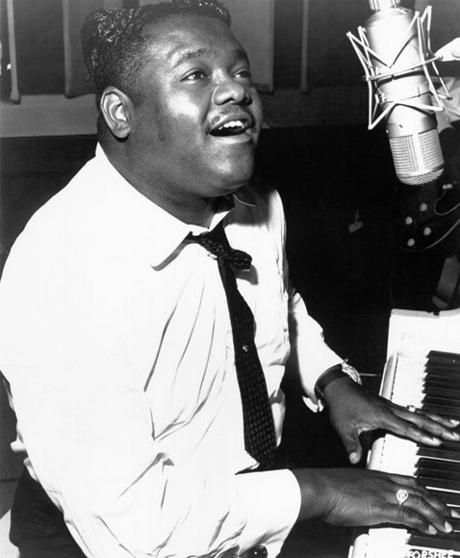
Fats Domino
Group Three:
Jennifer Day, Tyler Kallevig, Adam Vandenhouten, Duke McGhee, Shelby Stehn, and Alexander Jamow

Slide 2
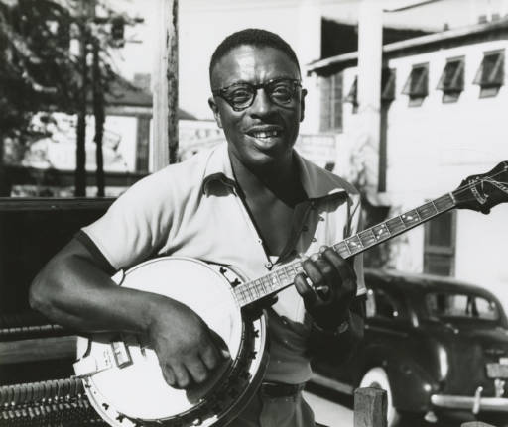
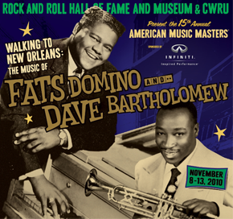
Domino’s Childhood
-Born Antoine Domino February 26, 1928 as the youngest of eight children.
-Raised in New Orleans, Louisiana in the Lower Ninth Ward - one of the poorer areas.
-His father was a well-known violinist and inspired Domino to play.
-His sister married a local musician, Harrison Verrett, who ended up teaching him piano and introducing him to the industry.
Harrison Verrett

Slide 3
Domino’s Childhood
-By age 10, he was already performing as a singer and pianist.
-He left school at the age of 14 to both work in a bedspring factory and perform in nightclubs.
-He was given his nickname, “Fats”, by the well known bass player, Billy Diamond, whom Domino played piano for.
-At the age of 21, he was discovered by Dave Bartholomew and Domino joined Bartholomew’s band.

Slide 4
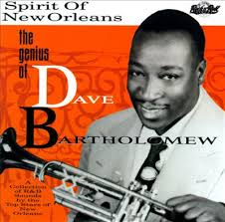
The Effects of His Upbringing
-Domino was raised in New Orleans, so he was immersed in one of the largest hubs in the country for R&B.
-As a result, the R&B style is very noticeable in his music.
-He was exposed to music and trained at a young age.
-As a result, not only did he pursue music at a young age, but he also enjoyed success at a young age. Additionally, he became an extremely skilled piano player and singer which were often showcased by his arranger - Dave Bartholomew.

Slide 5
Outside Factors (1930s)
-There was still segregation and division between races at this time which made for pretty mutually exclusive white culture and black culture.
-As a result, young, aspiring artists were usually subjected to one or the other. Additionally, once making it, black artists were often swindled by their white managers and agents.
-However, the black population was gaining enough wealth that they were redistributing across the US, so the market for R&B (a primarily black genre) was growing.

Slide 6
Outside Factors (1930s)
-His childhood was during the depression, so many families were poor and struggling.
-As a result, music was a great luxury that many people turned to for comfort. So, music was used as a getaway; therefore, it rarely touched on heavy topics.
-C&W, Pop, and R&B were still pretty separate, and crossovers and covers of different genres hadn’t become commonplace until he was just starting his career.
-As a result, many artist tested the waters of different genres.

Slide 7
Musical Style
-Fats Domino was one of the most popular artist in the 1950s & early 60s.
-Domino innovatively mixed Rhythm & Blues, Jazz, and Boogie-Woogie piano style.
-He had a unique style, using the creative approach of the eight bar blues (instead of the traditional twelve bar blues).
-Songs frequently featured multiple instruments: piano, electric guitar, bass, drums, and saxophones.
-He frequently included not only a saxophone accompaniment, but also a sax solo in his songs.

Slide 8
Musical Versatility
- Fats Domino came from the R&B genre, by 1955 he placed 12 hits on the Top 10 R&B chart.
- Although he was quite the R&B musician, Fats was able to show his ability to be versatile. He easily transitioned to Rock ‘n’ Roll during the Mid to late 1950s, and then to pop music.
- For example his single “Ain’t That a Shame” was a top record on the R&B charts, but it also managed to break the the Top 10 Pop chart.
- He managed to keep his R&B sound by utilizing a falsetto voice in his Rock ‘n’ Roll tracks.
-He also recorded covers of old Pop favorites from past decades.

Slide 9
Performance Style
-Fats Domino’s performance style was different from other popular artist of his time.
-Fats sat at the piano, instead of jumping around, and actually performed his songs in a refined way, unlike other popular figures, such as little Richard and Jerry Lee Lewis.
-His style was controlled and not flamboyant.
-His music and style felt uncomplicated and entertaining.
-Noted to have 100 percent New Orleans sound.

Slide 10

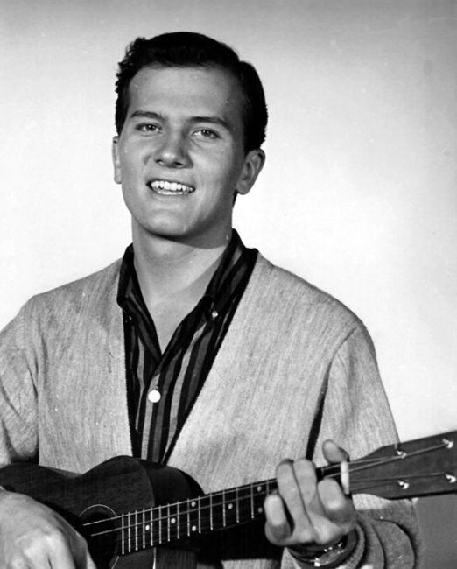


Impression
-His songs influenced new rock and roll songs for 50 years
- He influenced artists such as Cheap Trick, The Beatles, Paul McCartney, Pat Boone, and many others
-He was the most covered artist of his time
-Brought together different races through his concerts
-”One of the founding fathers of the genre” (spclarke)

Slide 11
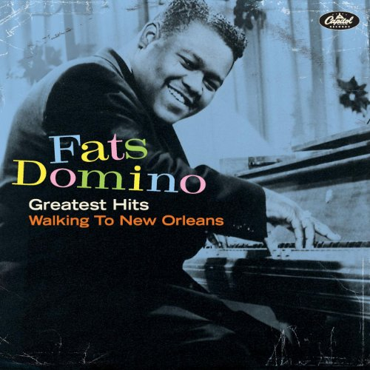
Biggest Hits
-Blueberry Hill -Valley of Tears
-Ain’t That A Shame -I Want To Walk You Home
-Walking To New Orleans -I’m In Love Again
-Whole Lotta Loving -It’s You I Love
-I’m Ready -I’m Walking

Slide 12
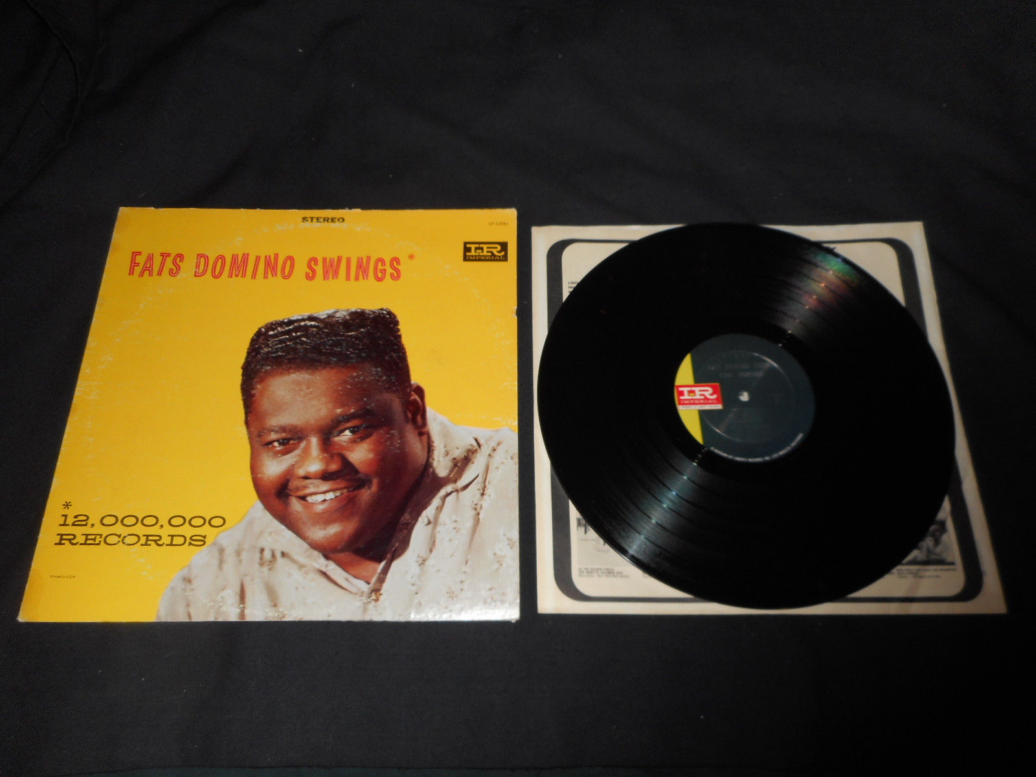
Achievements
“The Fat Man” was the first ever rock and roll record to sell over 1 million copies, and topped at number 2 on pop charts.
His song, “Ain’t it a Shame” hit number 10 on the pop charts in 1955, while a cover of it, sung by Pat Boone, hit number 1.
1956, Domino had 5 top 40 songs, including his cover of “Blueberry Hill,” which hit number 2 on the pop charts.

Slide 13
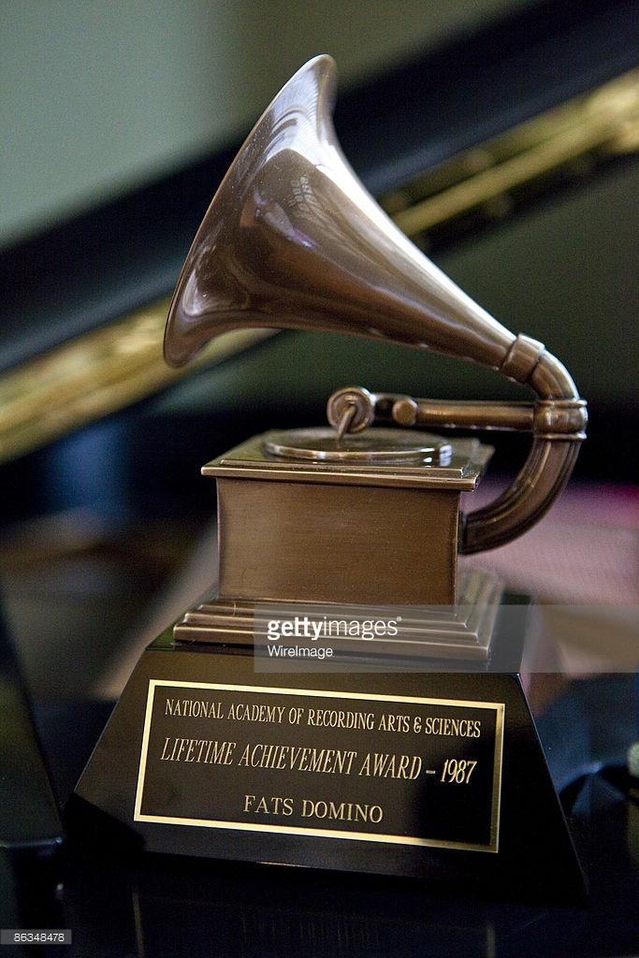
Achievements
Recorded a total of 37 different top 40 songs
Inducted into the Rock and Roll Hall of Fame in 1986
Awarded the Grammy Lifetime Achievement Award in 1987
Was awarded the National Medal of Arts in 1998 from President Clinton
Sold 65 million records

Slide 14

Modern Fats
Generally lives a shy and private life, aside from the company of his friends
Didn’t like the paparazzi whatsoever, once removed a man from his home who was taking pictures
His home and life was hit by Hurricane Katrina, which changed his life a little bit
  His neighborhood was devastated, so he was forced out of his home and into the suburban life where he is living with his daughter.
As his name suggests, he loves to eat classic New Orleans food and boogie-woogie on his keyboard.
Joe Lauro and Fats

Slide 15
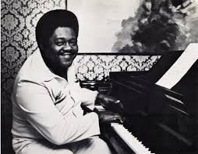
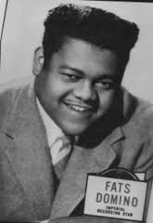
Fats in a Wrap
Fats had a less fortunate upbringing that was always filled with music, where he found great success
His natural New Orleans R&B style brought him to Dave Bartholomew, with whom he really took off on the stage of fame.
His music was so influential that it was one of the key components to the upbringing of Rock and Roll.

Slide 16


Fats in a Wrap
Had an iconic performance style that differed from many others in the R&B industry.
Earned numerous awards and lifetime achievements through his hit singles.
Currently jamming and eating his happy life away in the New Orleans area with no sign of stopping anytime soon.

Slide 17
Bibliography
-About Fats Domino and The Birth of Rock 'n' Roll. (2016, February 26). Retrieved May 27, 2016, from http://www.pbs.org/wnet/americanmasters/fats-domino-and-the-birth-of-rock-n-roll/6230/
-Doyle, P. (2016, February 26). Inside Rock Legend Fats Domino's World: Crawfish, Cards, Boogie-Woogie. Retrieved May 30, 2016, from http://www.rollingstone.com/music/news/inside-rock-legend-fats-dominos-world-crawfish-cards-boogie-woogie-20160226
-Fats Domino; A Giant of Rock & Roll. (n.d.). Retrieved May 30th, 2016. http://www.spclarke.com/?page_id=153
-Fats Domino. (2016). In Encyclopædia Britannica. Retrieved from http://www.britannica.com/biography/Fats-Domino
-Fats Domino. (n.d.). Retrieved May 29, 2016, from http://www.biography.com/people/fats-domino-9276748#rise-to-fame
-Fats Domino. (n.d.). Retrieved May 30, 2016, from http://www.history-of-rock.com/domino.htm

