Slide 1
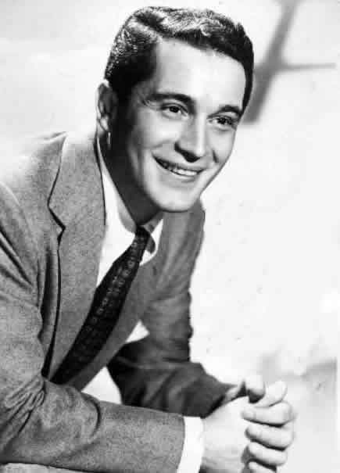
Perry Como
Hosam Alkhatib, Cody Komorouski, Hannah Gibson, Lizzy Ting

Slide 2
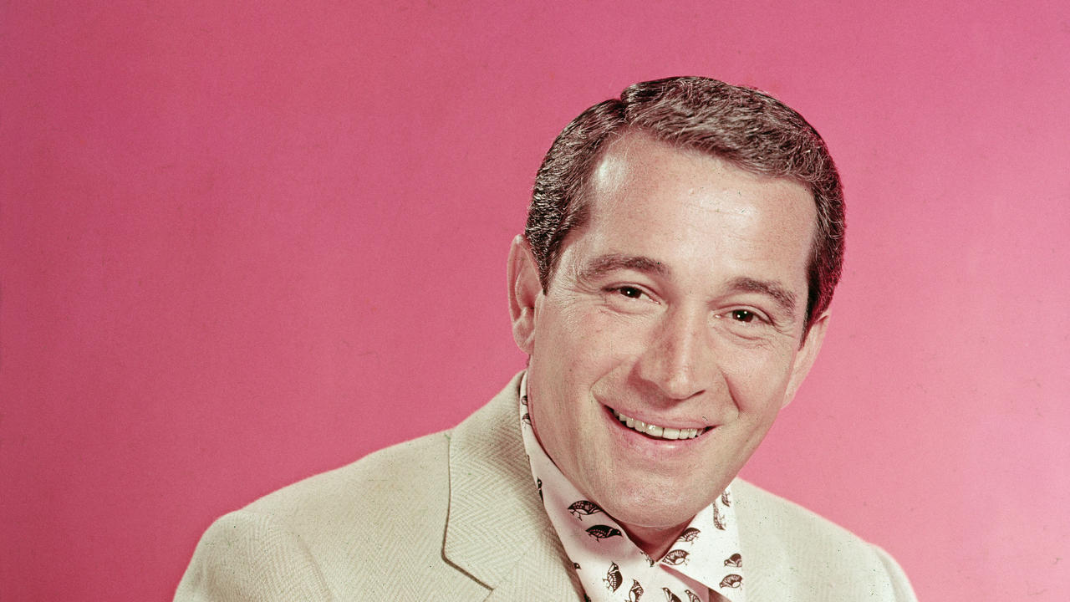
Overview
Full Name: Pierino Ronald “Perry” Como
Born:May 18, 1912
Died: May 12, 2001
Hometown: Canonsburg, Pennsylvania

Slide 3
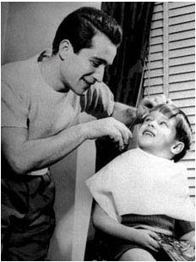
Early Life
7th child of 13 children
His parents were Italian immigrants
He did not speak English until beginning school
Took music lessons at a very young age
Played trombone, guitar, and organ.
Never had vocal training as a child.
Earliest ambition was to become the best barber in town
Married high school sweetheart Roselle Beline at the age of 21 and had three children
Roselle passed in 1998 and Como never remarried

Slide 4
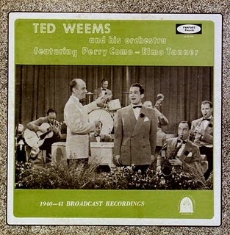
Musical Beginnings
First began touring at the age of 21 while working as a singing barber
Mid-1930’s: performed with Ted Weems’s Orchestra on Weems’s radio show “Beat The Band”
1942: Hosted CBS radio show “Supper Club”
1943: Gained contract with RCA Victor Records, started his work in Hollywood
Appeared in the film “Something for the Boys” this same year

Slide 5
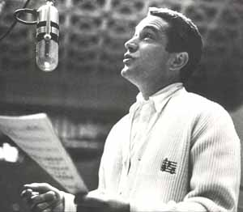
Musical Style
Como’s singing is known for being smooth and good-natured, such as in “Hot Diggity”. His relaxed personality was also reflected in his singing style. Como gave Bing Crosby credit as an influence for his voice and singing style. He sang over soft instrumentals and background vocal ensembles, such as in “Catch a Falling Star.” Como focused more on his sound rather than singing and performing with invigorating energy.

Slide 6
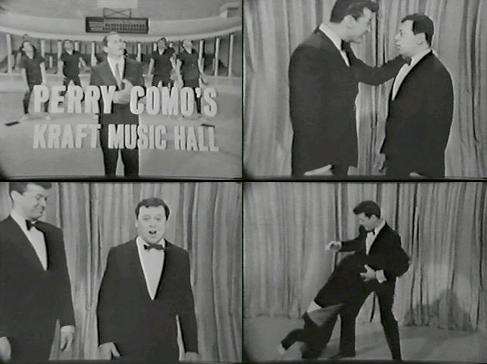
Acting Career
Como starred in three films
Something for the Boys (1944)
Doll Face (1945)
If I’m Lucky (1946)
On the topic of his movie career...
“I was wasting their time and they were wasting mine” -Perry Como
Como’s television presence was much more successful
Supper Club
Sing to Me 1955 - 1959
The Perry Como Show (Kraft Music Hall) 1959 - 1967
Throughout his television career, Como won five Emmy Awards

Slide 7
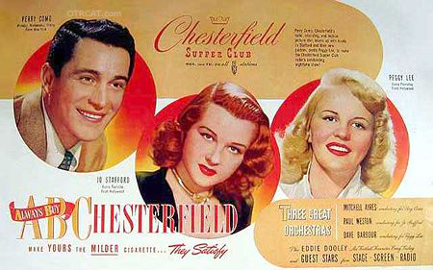
Como’s Life on Television
Como’s career on television took off when NBC approached him about putting his radio show, Chesterfield Supper Club on television on December 24th, 1948.
NBC was so pleased with the results that they extended experimentally televising the show through August 1949.
Chesterfield Supper Club became an official television program on September 8th, 1949 and aired for half an hour on Sunday nights
Chesterfield Supper Club was renamed The Perry Como Chesterfield Show when Perry moved to CBS in 1950
The program aired three times a week for 15 minutes each episode

Slide 8
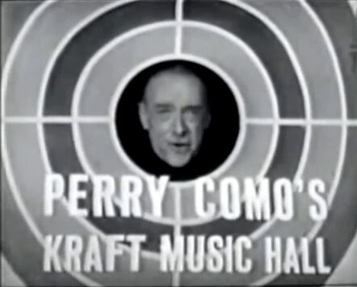
Como’s Life on Television (cont.)
Como signed a 12-year contract with NBC in April of 1955 for The Perry Como Show, which debuted on television on September 17, 1955.
After airing for only two months, the show rated as number seven in the Nielsen Top Ten
Como was approached by Kraft Foods company in early 1959 about becoming the new host for their television program named Kraft Music Hall.
Como signed a $25 million two-year contract with Kraft, which was a record-breaking deal at that time

Slide 9
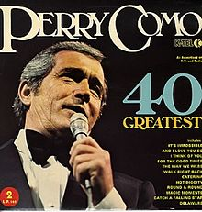
Top Hits
Till The End of Time
Catch a Falling Star
It’s Impossible
Magic Moments
And I Love You So
Papa Loves Mambo
For the Good Times
Hot Diggity
Home for the Holidays
Como had 148 total charted hits, with 14 #1 hits. He ranked as the #5 best selling music artist of the 1950s, behind only Elvis Presley, Frank Sinatra, Nat King Cole, and Miles Davis.

Slide 10
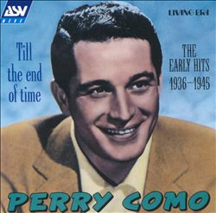
Till the End of Time
“Till the End of Time” was Como’s first and biggest hit. He recorded a rendition for the film A Song to Remember. Como’s rendition was released in 1945 and spent 11 weeks at #1.
https://www.youtube.com/watch?v=KFXA_-2cIYU

Slide 11
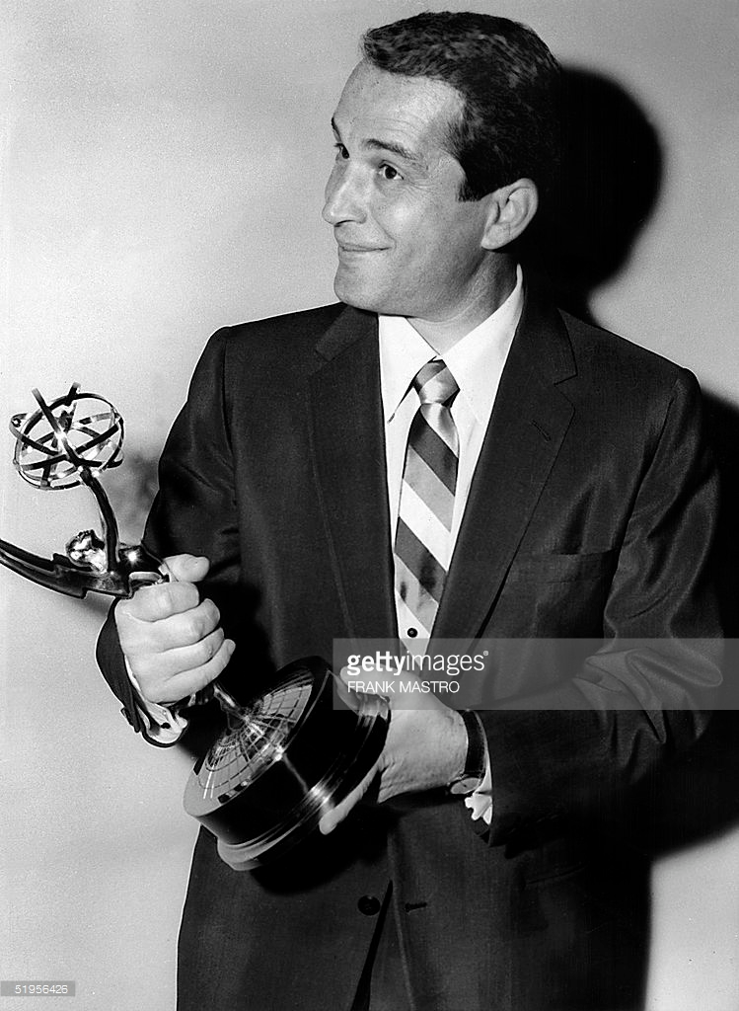
Notable Awards and Honors
1956- Peabody Award
1959- Grammy for Best Male Vocal Performance
1955-1959- 5 Emmys
1990- Inducted into the Academy of Television Arts & Sciences Hall of Fame
2002- Grammy Lifetime Achievement Award
Notes:
Peabody- https://news.google.com/newspapers?id=f2EaAAAAIBAJ&sjid=uCUEAAAAIBAJ&pg=7410,258987&dq=perry+como&hl=en
Emmys- http://www.emmys.com/awards/nominations/award-search?search_api_views_fulltext=perry%20como&field_is_winner=All&field_nomination_category=All&field_nominations_year=All&search_api_views_fulltext_1=&search_api_views_fulltext_2=&search_api_views_fulltext_3=&search_api_views_fulltext_4=&page=2&submit=Search
Hall of fame- https://news.google.com/newspapers?id=XKxdAAAAIBAJ&sjid=fV0NAAAAIBAJ&pg=3045,2723684&dq=roselle+como&hl=en

Slide 12
Artists Influenced by Como
Frank Sinatra was motivated to leave the Tommy Dorsey orchestra and begin a solo career in 1942 after Perry Como’s successes with the Ted Weems orchestra
“Mr. Como was with Ted Weems, a then-popular orchestra leader, and he is still such a wonderful singer. I thought if I don’t make a move out of this band and try to do it on my own soon, one of these guys will do it, and I’ll have to fight.”
-Frank Sinatra

Slide 13
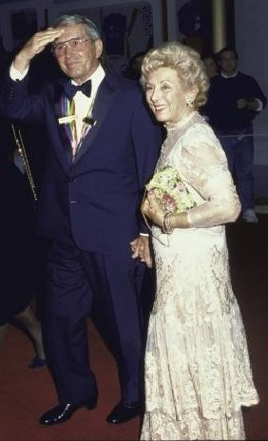
Life Outside of Entertainment
Perry Como lived a respectfully mellow and tame lifestyle outside of entertainment, especially in comparison to the controversial lifestyles of many other famous musicians of that time.
He was married to Roselle Como for 65 years until she died in 1998. They were the parents of several adopted children.
During the prime of his career, he made no appearances in clubs for 26 years, concentrating on his TV show, recordings, and family instead.

Slide 14
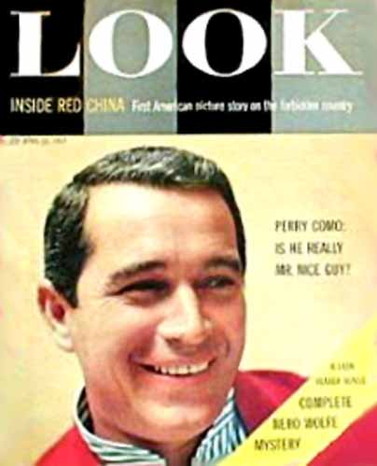
Life Outside of Entertainment
“Como is the only TV performer with a price tag of more than a million dollars a year who has no enemies and no embarrassing eccentricities and whose personal life has always been unblemished by gossip.”
- Joe McCarthy (Look Magazine Writer)
“Perry Como: Is He Really Mr. Nice Guy?” - Look Magazine, 1957

Slide 15
Life Outside of Entertainment (Personal Style)
Como prefered casual clothing and was known for his “casual cardigan” look
On the topic of Como’s casual style, Bing Crosby described him as “the man who invented casual”
Named one of the Best Dressed Men in 1946
Had his own line of sports/casual men’s clothing through Bucknell (1950’s)
Perry Como Putters were produced by MacGregor as a result of Como’s love for golfing

Slide 16
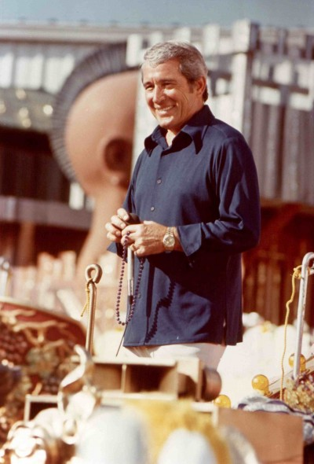
Perry Como’s Decline in Popularity
As music, television entertainment, and the American lifestyle began to adopt a more egocentric lifestyle, the unpretentious and humble personality of Perry Como was gradually replaced in entertainment. However, Como was accepting of his decline in popularity, unlike other entertainers who fight tooth-and-nail to stay in the headlines. Como welcomed his decline in the same way he welcomed his rise to the limelights.

Slide 17
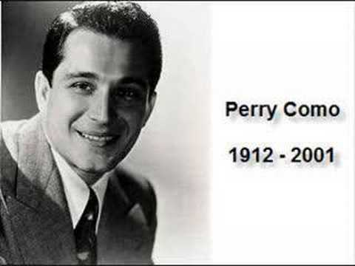
Como’s Death
Como died at the age of 88 on May 12, 2001
He passed away in his sleep in his home in Jupiter Inlet Colony, Florida
Como reportedly suffered from symptoms of Alzheimer’s disease prior to his death
“50 years of music and a life well lived. An example to all.”
- RCA Records’ memorial in Billboard magazine

Slide 18
Perry Como’s Legacy
Perry Como was a very popular entertainer with massive successes in music, radio, and television. He set innumerable precedents in these entertainment industries and made significant impacts within them as well. Como’s humble lifestyle ensures that he will be remembered for his impacts within entertainment rather than controversies.
“I was a barber. Since then I’ve been a singer. That’s it.”
-Perry Como

Slide 19
References
AM740 Staff (2013) Top Ten Songs of Perry Como. Retrieved from: http://www.zoomerradio.ca/blogs/station-blog/top-ten-songs-of-perry-como/
Bissonnette, Z. (2012) Why Perry Como Matters. Retrieved from: http://www.saturdayeveningpost.com/2012/05/18/culture/music/why-perry-como-matters.html
Denisova, M. (2005) Como, Perry. Retrieved from: http://pabook2.libraries.psu.edu/palitmap/bios/Como__Perry.html
King, P. (2015) Perry Como Biography. Retrieved from http://www.imdb.com/name/nm0173908/bio
Mohler, R. (2011) Perry Como’s Biography. Retrieved from http://perry-ronald-como.journal-of-life.com/#!biographies
Observer Reporter (1990) Como Inducted into TV Hall of Fame. Retrieved from https://news.google.com/newspapers?id=XKxdAAAAIBAJ&sjid=fV0NAAAAIBAJ&pg=3045,2723684&dq=roselle+como&hl=en
The Milwaukee Journal (1956) Honor Como and Gleason Peabody Awards . Retrieved from: https://news.google.com/newspapers?id=f2EaAAAAIBAJ&sjid=uCUEAAAAIBAJ&pg=7410,258987&dq=perry+como&hl=en
Records of Emmy Awards retrieved from: http://www.emmys.com/awards/nominations/award-search?search_api_views_fulltext=perry%20como&field_is_winner=All&field_nomination_category=All&field_nominations_year=All&search_api_views_fulltext_1=&search_api_views_fulltext_2=&search_api_views_fulltext_3=&search_api_views_fulltext_4=&page=2&submit=Search

Slide 20
Links for Pictures
http://kokomo.ca/harry_smith/photo_pages/private/look_april_16_57.htm
http://perry-ronald-como.journal-of-life.com/#!photos
http://www.gettyimages.com/detail/news-photo/file-photo-taken-16-march-1957-shows-us-singer-perry-como-news-photo/51956426
http://old.post-gazette.com/obituaries/20010513como4.asp
http://canonsburgfriends.blogspot.com/2011/05/perry-como-singing-sensation-and-barber.html
http://www.findagrave.com/cgi-bin/fg.cgi?page=gr&GRid=22303
http://classicshowbiz.blogspot.com/2011_03_13_archive.html
https://sites.google.com/site/pittsburghmusichistory/pittsburgh-music-story/pop/perry-como

