Slide 1
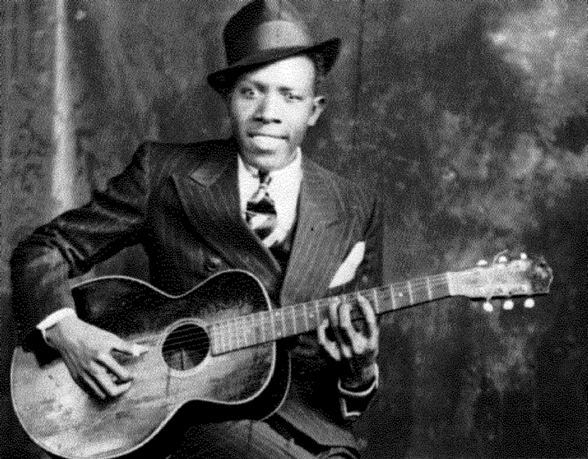
Robert Johnson
Group #2
Jovanny Velez, Aaliyah Hodge, Katherine Kral, Jens Frederickson

Slide 2
Why Robert Johnson?
Robert Johnson represents the classical blues artist, but he brought a unique type of playing and helped pioneer Delta Blues.
His soulful wailing helps set him apart from other blues artists in the early days of Rock and Roll and Rhythm and Blues.
His distinctive guitar skills made him an influential musician.

Slide 3
Biography of A life too short
Mr. Robert Johnson 1911-1938
Personal Life
Johnson’s personal life is extremely circumstantial, even his cause of death is still debated, though one circulating rumor is that he was killed by a jealous lover.
Robert Johnson was born on May 8th, 1911 in Hazelnut, Mississippi to his mother Julia Major Dodds and father Noah Johnson. Johnson died on August 16th, 1938 of a suspected poisoning.
In 1929, Johnson married Virginia Travis, whom died in 1930 during childbirth.
In 1931, Johnson remarried to Calletta Craft.

Slide 4



Biography of A life too short
Mr. Robert Johnson 1911-1938
Musical Journey
First instruments played were the Jew's harp and harmonica
Johnson played the now famous Gibson Acoustic L-1 guitar.
Johnson played what was known as the Delta Blues. He was a pioneer in the Blues genre, because he is seen as one of the first to carry his own base line on his guitar, which gives the listener the feeling as though two guitars are playing.
In 1936, Johnson recorded 17 songs in San Antonio, Texas.
In 1937, Johnson returned to the studio to record another 12 songs for a lifetime total of 29 recorded tracks.

Slide 5
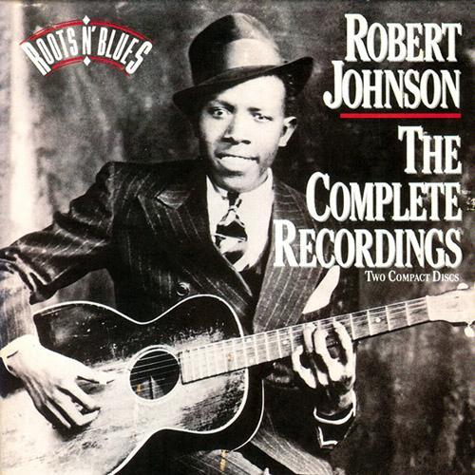
Biography of A life too short
Mr. Robert Johnson 1911-1938
Famous In Death
As a musician, Johnson was seemingly more popular in death than he was in life.
In 1990, Columbia records reissued Johnson’s recordings to what they suspected would be 20,000 copies in sales. The total sales instead reached over 1 million copies.
Johnson was featured on a United States Postal Service stamp in 1994 which cements his short but enduring legacy as a Blues legend.
Rolling Stone Magazine’s list of top 100 guitar players of all time has Robert Johnson listed as #5, which is a tribute to his pioneering guitar style.
Johnson’s 1990 album cover
Amazon.com. (2011). Robert Johnson: The Complete Recordings [Box Set]

Slide 6
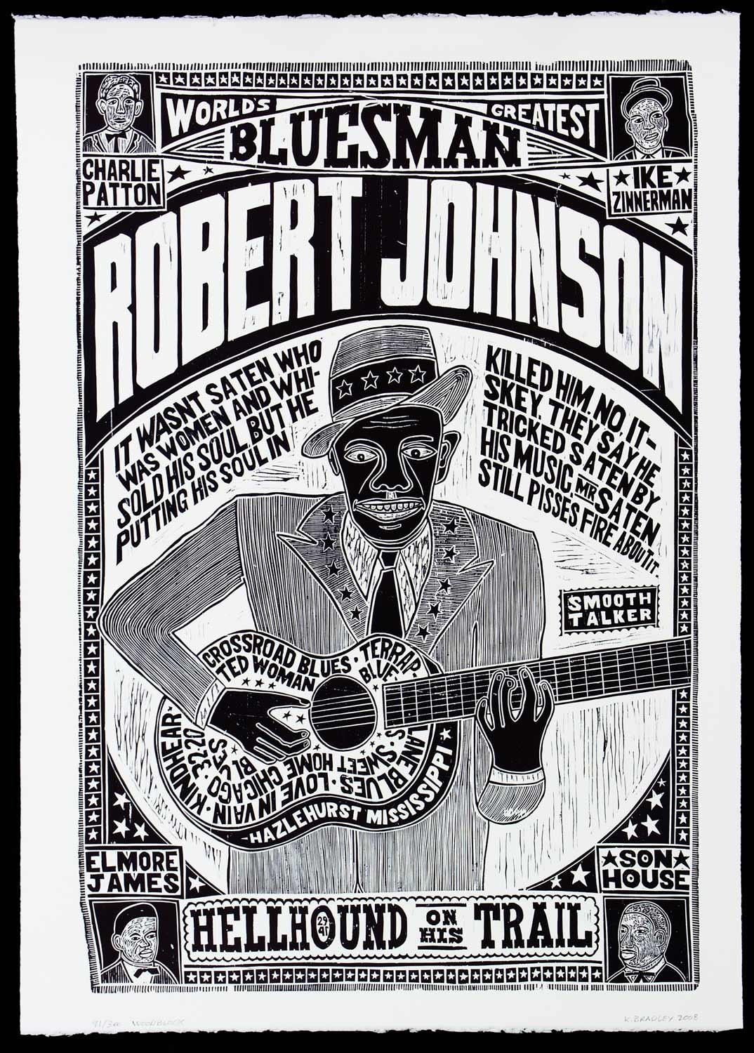
What Makes Robert Johnson stand out
Johnson sang with raw emotion. No other musician had ever expressed themselves like this in that time period, and it was almost painful to hear as he described the “intense loneliness, terrors and tortuous lifestyle that came with being an African American in the Deep South during the Great Depression” (Sony Music Entertainment).
Through his raw emotion he was able to effectively communicate with listeners decades later.
etsy.com

Slide 7
What MAKES ROBERT JOHNSON STAND OUT CONT’
One aspect of his music that impressed many established artists, such as Bob Dylan and Eric Clapton, was Johnson’s ability to skillfully combine many different musical elements such as lyrics, vocals and guitar to create a masterpiece.
Another aspect that impresses listeners is the rough authentic sound that Johnson’s records have, which is attributed to the fact that the recordings were made before multi-track recording techniques were invented.

Slide 8
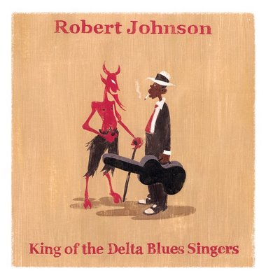
Folklore about Johnson
One rumor surrounding Johnson was that “he sold his soul to the devil in exchange for guitar playing prowess”. His claim is reinforced when Keith Richards (Rolling Stones bass guitarist) says that, “when I first heard him I was hearing two guitars, and it took me a long time to realize that he was actually doing it all by himself.” ("Robert Johnson Biography)
dinlos.blogspot.com

Slide 9
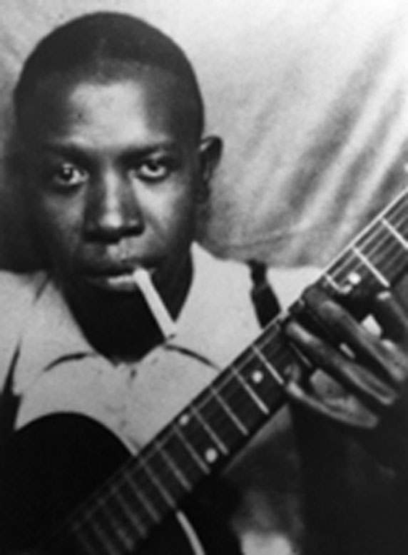
What makes Robert Johnson stand out cont’
Johnson pioneered the guitar playing style known as the “sliding pitch effect”, in which the guitarist wears a metal or glass cylinder on one finger and slides the cylinder up and down the neck (of the guitar) while pressing the strings to the fingerboard creating a glissando.
Music by Robert Johnson “is the foundation of modern rock… and he either wrote or adapted from traditional sources many of the most popular blues songs of all time, including "Cross Road Blues," "Sweet Home Chicago" and "I Believe I'll Dust My Broom,“” ("100 greatest guitarists," ) with rock legends stating that he inspired them.
Johnson playing guitar

Slide 10
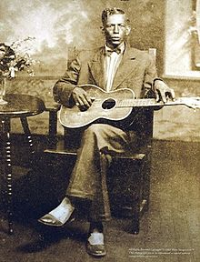
Influences on Robert Johnson
Charlie Patton: “Clowned” during his performances and “slapped” the strings on his guitar
There were similar tunes and techniques used in the songs “Tom Rushen Blues” by Charlie Patton and “From Four Till Late” by Robert Johnson.
Patton befriended Eddie “Son” House, whom also had an impact on Johnson’s musical development.
Johnson also imitated local guitarist Ike Zinnerman.
http://upload.wikimedia.org/wikipedia/en/thumb/f/f7/Charlie_Patton_studio_portrait.jpg/220px-Charlie_Patton_studio_portrait.jpg

Slide 11
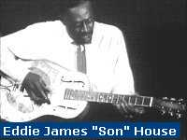
Influences on Robert Johnson
Robert Johnson grew up around Eddie “Son” House and Willie Brown, who also had a great influence on him.
Eddie knew Johnson since he was a child and was able to see Johnson’s skills on the guitar improve.
Johnson would listen in on Eddie, Brown, and Lonnie Pitchford when they played near him.
Later, when Eddie moved to Robbinsville, he spent more time with Johnson.
http://www.12bar.de/gif/son_house.jpg

Slide 12
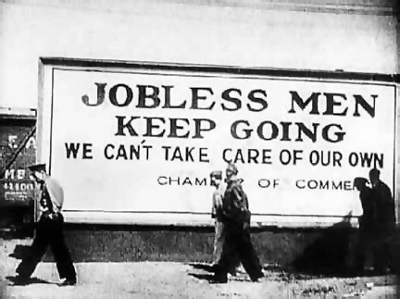
Social Influences on Robert Johnson
Johnson wrote romanticized songs about his view on street corners, jook joints, and his loneliness.
He was greatly affected by the Great Depression, as was any African American in the South and most people in the United States.
The Great Depression made Johnson feel extremely lonely, contributed to him having terrors, and encouraged an unhealthy lifestyle.
With these hardships, Johnson was able to create music that was relevant to everyone during the Great Depression.
http://jamieumbc.files.wordpress.com/2009/12/2_great_depression.jpg

Slide 13

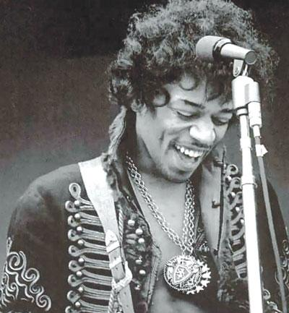
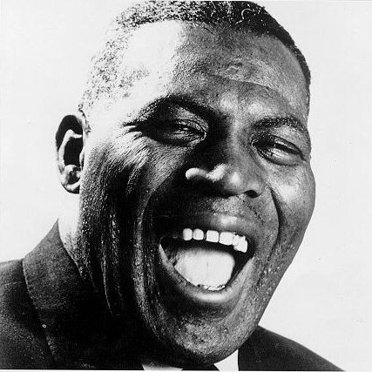
Artist Influenced by Robert Johnson
Inevitably, artists that incorporate blues into their Rock and Roll have been influenced by Johnson.
Popular artists include Led Zeppelin, The Rolling Stones, Eric Clapton, Muddy Waters, B.B. King, Bob Dylan, Bonnie Raitt, Red Hot Chili Peppers, Jimi Hendrix, Fleetwood Mac, Howlin’ Wolf, T-Bone Walker, Willie Dixon, Buddy Guy, Jimmy Reed, and Eddie Taylor
http://www.graphicshunt.com
altamontapparel.com
bobcorritore.com

Slide 14
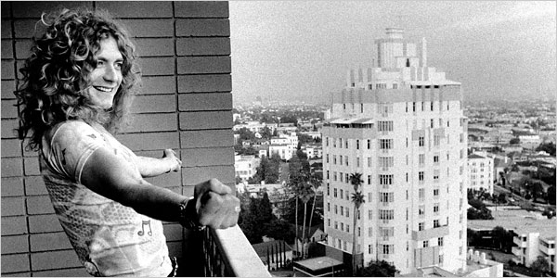
Influenced by Johnson Continued
Eric Clapton recorded many covers.
Robert Plant of Led Zeppelin uses the soulful wail that is distinctive of Johnson’s raw voice.
What can be considered the blues genre (specifically Delta Blues) is partially built by Johnson.
Robert Plant
patrickbrayer.com

Slide 15
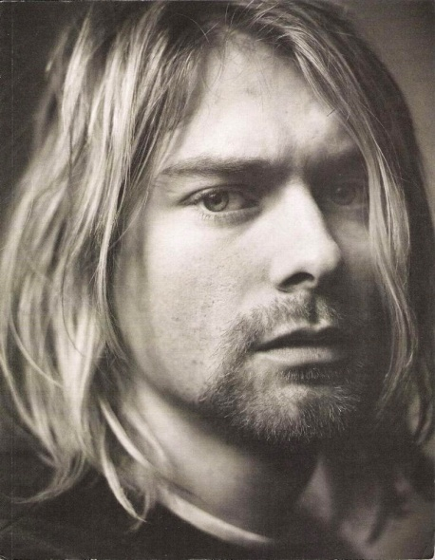
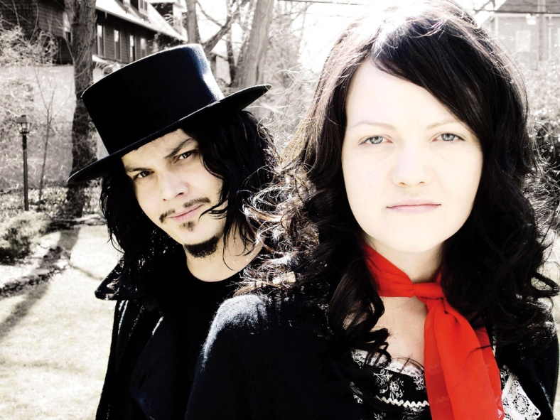
New age artists influenced by Johnson
Early grunge borrowed intensity of early blues. This can easily be heard in Kurt Cobain’s voice of Nirvana.
A subgenre called punk blues music was also influenced by Johnson.
  The White Stripes
caroundtheworld.com
whitestripes.gr

Slide 16
Influences by Johnson continued
Some of the largest artists in the history of Rock and Roll were influenced by Johnson.
In turn, they have influenced many artists.
  Johnson influenced Dylan, Dylan influenced The Beatles.
Essentially, Robert Johnson is a huge influence on Rock and Roll before 1970 and continues today in current music we hear today.

Slide 17
Bibliography
D.A.N. (2007, April 06). Deal with the devil: understanding Robert Johnson, his music and his impact. Retrieved from http://www.soulofrocknroll.com/content/articles/deal-devil-understanding-robert-johnson-his-music-and-his-impact
Robert Johnson Biography. (n.d.). Retrieved from http://rockhall.com/inductees/robert-johnson/bio/
Sony Music Entertainment, Initials. (n.d.). Robert Johnson blues foundation. Retrieved from http://www.robertjohnsonbluesfoundation.org/biography
100 greatest guitarists of all time. (n.d.). Retrieved from http://www.rollingstone.com/music/lists/100-greatest-guitarists-of-all-time-19691231/robert-johnson-19691231
A & E Television Networks. (2011). Robert Johnson Biography. Retrieved from http://www.biography.com/articles/Robert-Johnson-9356324
Danforth and Rissetto, C. A. (1997, July 7). Robert Johnson Biography. Retrieved from http://xroads.virginia.edu/~music/BLUES/rjbio.html
Amazon.com. (2011). Robert Johnson: The Complete Recordings [box set]. Retrieved from http://www.amazon.com/Robert-Johnson-Complete-Recordings/dp/B000002757/ref=sr_1_2?ie=UTF8&qid=1306643143&sr=1-2
Robert Johnson, king of the delta blues singers. (2011, February 25). Retrieved from http://www.ameriblues.com/2011/02/25/robert-johnson-king-of-the-delta-blues-singers/
Trail of the hellhound: delta blues in the Mississippi valley. (2001, April 30). Retrieved from http://www.nps.gov/history/delta/blues/index.htm
Buncombe, A. (2006, July 26). The grandfather of rock'n'roll: the devil's instrument . Retrieved from http://www.independent.co.uk/news/world/americas/the-grandfather-of-rocknroll-the-devils-instrument-409317.html
"Robert Johnson the Father of Blues Guitar." Who is Robert Johnson. Web. 29 May 2011. <http://www.squidoo.com/robertjohnson?utm_source=google&utm_medium=imgres&utm_campaign=framebuster>.
Rucker, James “Sparky”. Robert Johnson and the Roots of the Delta Blues .Retrieved May 29, 2011, from http://www.sparkyandrhonda.com/johnson.html

