Slide 1
The Everly Brothers
Kao-wei Chen, Rebecca Galarowicz, Brittany Kelly, David Oberg, Nikolas Sell

Slide 2
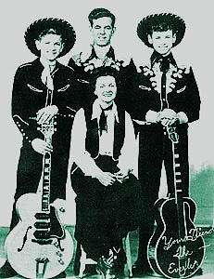
Beginning of the Everly Brothers
Don
Real Name: Donald Everly
Birth Date: February 1, 1937
Place of Birth: Brownie, Kentucky
The Everly Family
Phil
Real Name: Philip Everly
Birth Date: January 19, 1939
Place of Birth: Chicago, Illinois
Don and Phil are blood brothers.
Sons of country artist Ike and Margaret
Were in the limelight of becoming stage performers with their public appearances in the 40’s to mid-50’s on their parents tours
http://www.acousticguitar.com/issues/ag92/everlybros.shtml
Kao-wei Chen

Slide 3
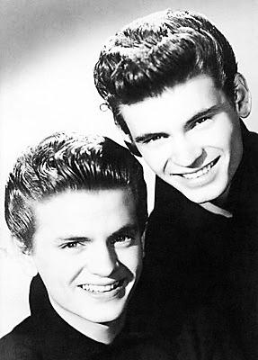
Music Career
Mid-1950’s, brothers moved to Nashville, Tennessee
1954, Don’s composition was being recorded by Kitty Wells
1957, 1st hit #1 for the Everly Brothers, cover of “Bye Bye Love” by Felice and Boudleaux Bryant
End of the 1950’s, The Everly Brothers were the #1 Vocal Group in the World
Signed with Warner Brothers Records
1961, two songs hit #1 at the end of the year drafted into the Marines
Following years, Don’s became addicted to drugs
1973, marked the end of The Everly Boys with Phil stating, “I will never get on a stage with that man (Don) again”
http://progbeat-vvche.blogspot.com/2010/08/everly-brothers-two-yanks-in-england.html
Kao-wei Chen

Slide 4
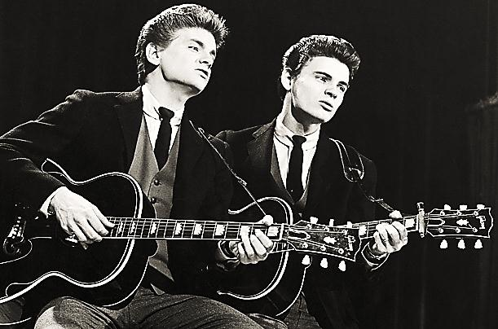
Importance
Set the standards for close harmony singing
2001, elected into the Country Music Hall of Fame
http://progbeat-vvche.blogspot.com/2010/08/everly-brothers-two-yanks-in-england.html
Kao-wei Chen

Slide 5
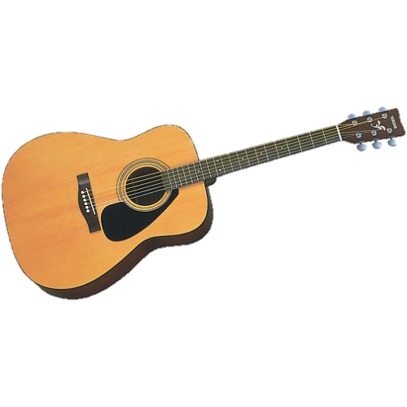
Unique/Innovative Elements
Vocal harmony in parallel thirds
Each line as its own melody line
Intuitive harmony
Steel-string guitar
Infused elements of country and pop music with early rock and roll
Rebecca Galarowicz
http://coppellconservatory.com/types_of_guitars.html

Slide 6
Everly Brothers & Evolution of Rock Music
No-nonsense rock and roll with contemporary sound
Their harmony singing had strong influence on rock groups of the 60s
Beatles, Simon & Garfunkel, Dave Edumnds, Nick Lowe
John Lennon and Paul McCarney, The Byrds, The Beach Boys
Rebecca Galarowicz

Slide 7
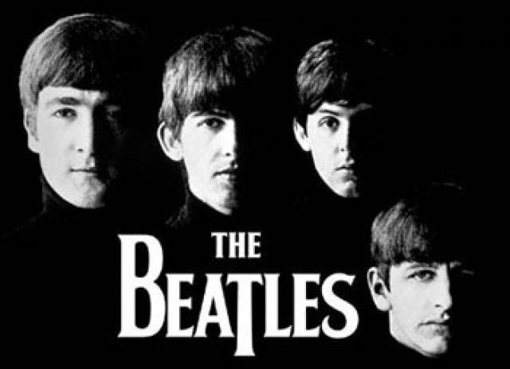
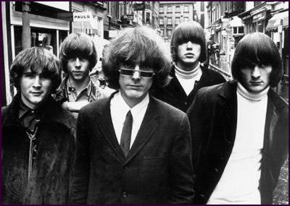
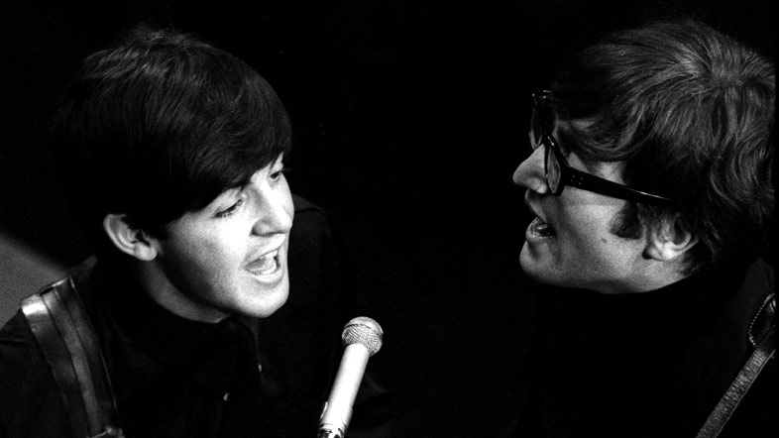
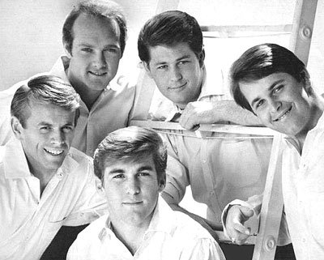
Influenced Artists & Groups
The Beatles
The Byrds
http://thebeatlesautographs.net/
http://www.thebyrdscollective.com/byrds-history/
John Lennon and Paul McCarney
The Beach Boys
http://www.bbc.co.uk/radioscotland/60s/famousfaces/
http://classic-film-tv.blogspot.com/2012/04/beach-boys-harmonize-in-girls-on-beach.html
Rebecca Galarowicz

Slide 8
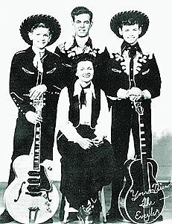
Influences
Parents were also singers, and played a large role in inspiring the Everly Brothers
Had wide-reaching influence themselves, including the Beatles; the Beach Boys; and the Byrds
http://www.acousticguitar.com/issues/ag92/everlybros.shtml
Nickola Sell

Slide 9
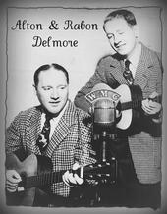
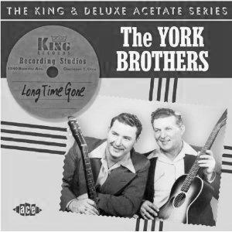
Those who came before
The brothers’ father, Phil, was a singer himself and started the boys off on the musical track
The Delmore Brothers and York Brothers
Traditional country acts
Also blood brothers
Nickola Sell
http://en.wikipedia.org/wiki/File:Delmorebrothers.jpg
http://www.raucousrecords.com/products/300px/york-brothers-long-time-gone-cd.jpg

Slide 10
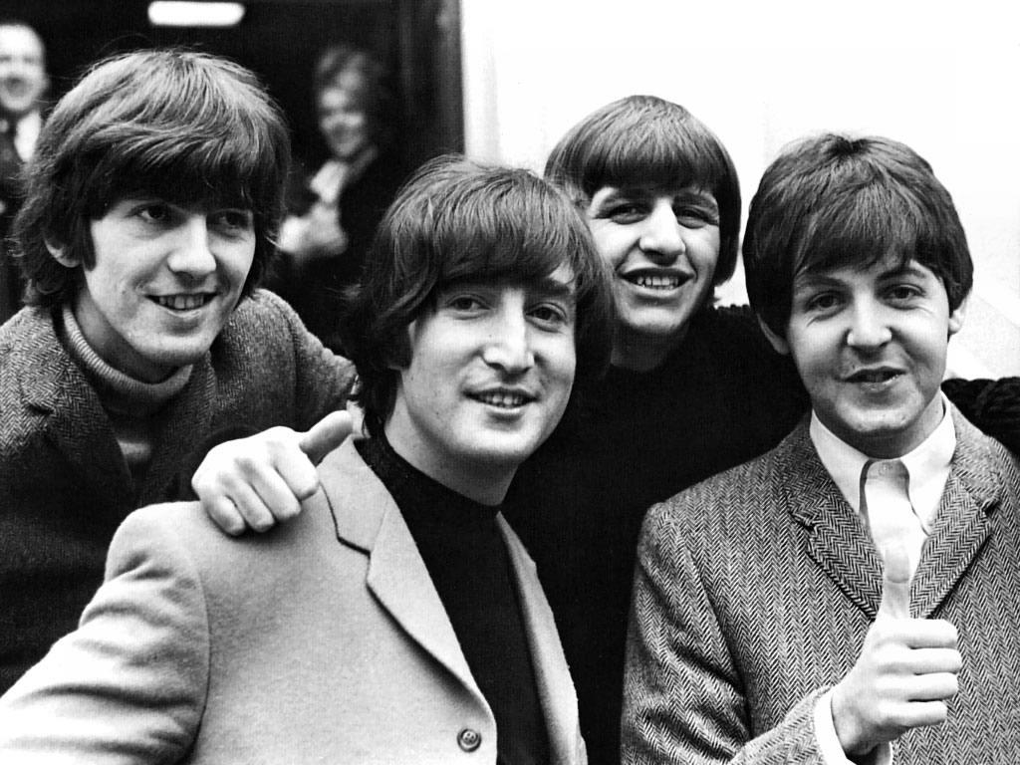
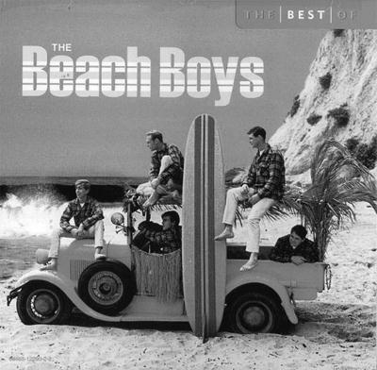
Those who followed
The close harmonies of the group had a wide-reaching appeal
‘’Power-chord intros, complex harmony intervals, and country inflections’’ have had tremendous effect on numerous later artists (Simons, 2000)
Nickola Sell
http://3.bp.blogspot.com/-Y7L_OpwQHiU/T0xaOlIRcOI/AAAAAAAACFs/-Hps-OJ2-ho/s1600/The+Beatles+2.jpg
http://staugustinelife.com/wp-content/uploads/2012/03/Beachboys.jpg

Slide 11
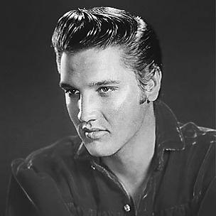
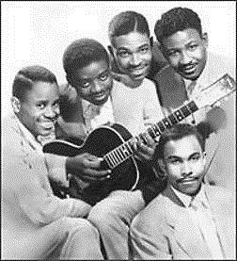
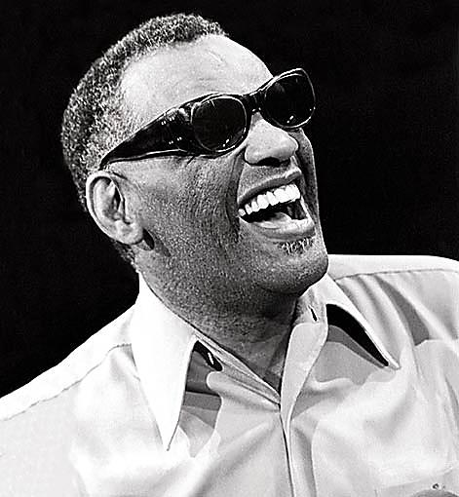
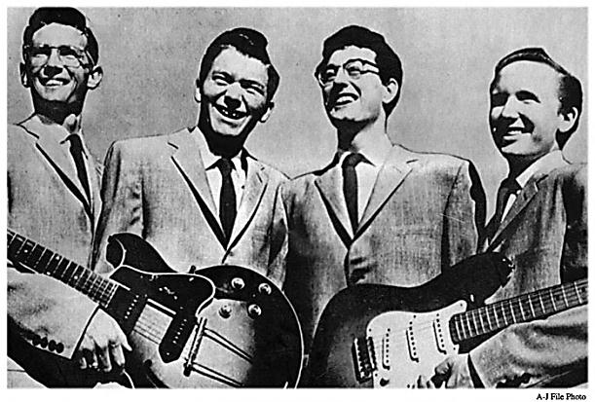
Those who were popular while the Everly Brothers were
-Elvis Presley
-Ray Charles
-Buddy Holly & The Crickets
-The Clovers
http://www.rollingstone.com/music/artists/elvis-presley
http://1957timecapsule.wordpress.com/2011/08/16/august-16-1957-buddy-holly-the-crickets-at-the-apollo-theater/
http://www.last.fm/music/Clovers
http://www.palzoo.net/Ray-Charles
Brittany Kelly

Slide 12
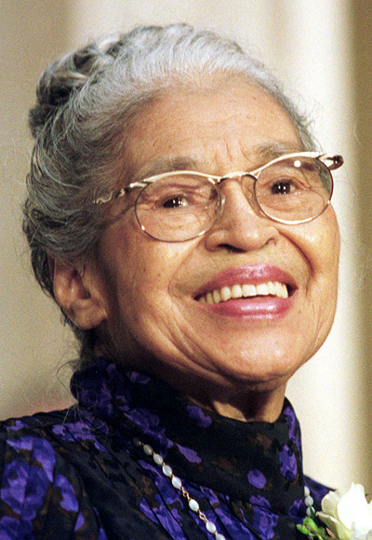
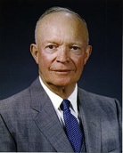
Social/Political Events of 1950’s
-Dwight Eisenhower was president 1953-1961
-1953-fighting ends in Korea
-1955-Rosa Parks refuses to give up her seat on a bus
Brittany Kelly
http://www.achievement.org/autodoc/photocredit/achievers/par0-018
http://en.wikipedia.org/wiki/Dwight_D._Eisenhower

Slide 13
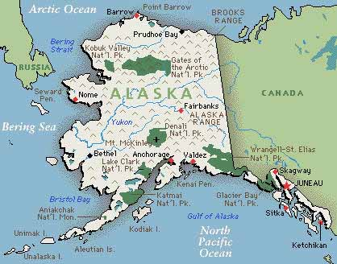
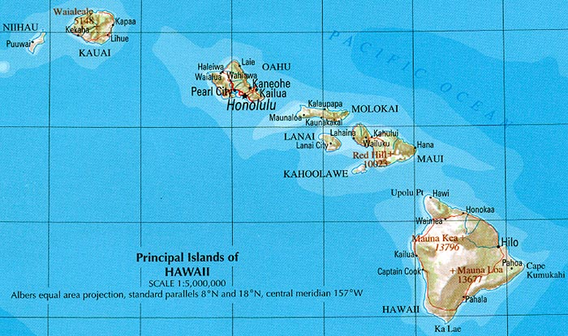
Social/Political Events of the 1950’s
-1956- The Federal Highway Act is signed
-1959-Alaska and Hawaii become the 49th & 50th states
http://www.lib.utexas.edu/maps/hawaii.html
Brittany Kelly
http://www.dermhairclinic.com/alaska-hair-restoration/

Slide 14
Other Music of the Period
The Everly’s were an iconic group at the very beginning of the Rock & Roll era and therefore they played amongst some of the most influential rock groups of all time. Although the Everly’s sound is much different than many of their counterparts, the rock influences in their music is undeniable.
David Oberg

Slide 15
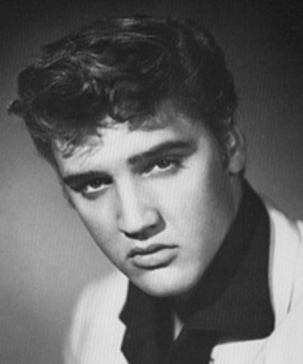
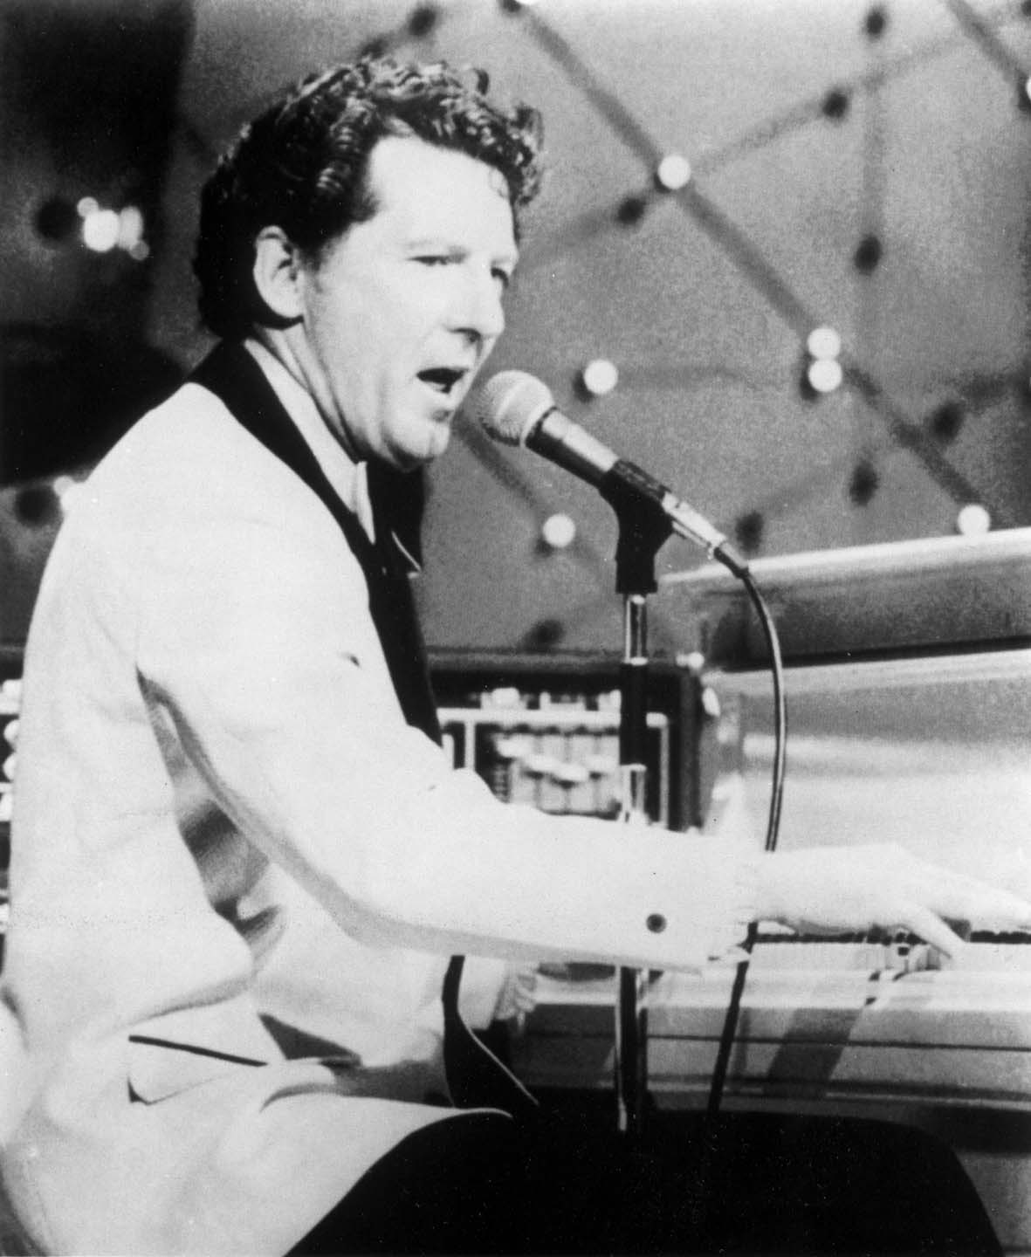
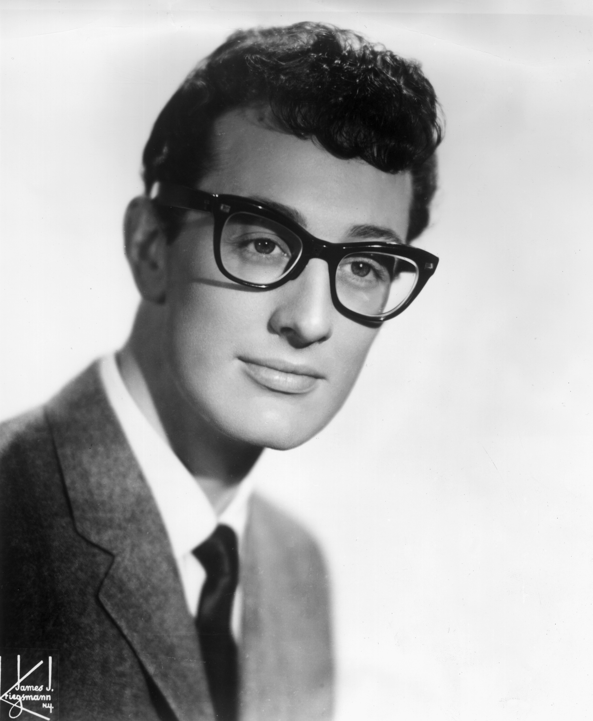
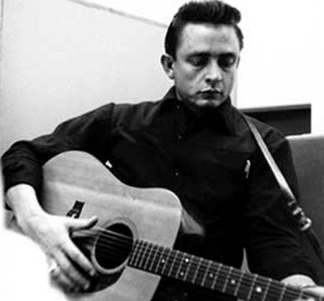
Other Artists
Among the other important artists of the time period, the most influential include
Elvis Presley
Jerry Lee Lewis
Buddy Holly
Johnny Cash
http://www.famouspeople.com/famous/_images2/58.jpg
http://static.cinemagia.ro/img/db/actor/08/63/89/jerry-lee-lewis-414191l.jpg
David Oberg
http://content.answcdn.com/main/content/img/getty/0/2/3226402.jpg
http://essentiallyeclectic.files.wordpress.com/2008/09/johnny-cash-1351.jpg

Slide 16
Other music
Among the popular hits similar to the Everly brother’s was Elvis’s C&W hits including “I Forgot to Remember to Forget”, “Heartbreak Hotel”, and “I Want You, I Need You, I Love You.” There was also Jerry Lee Lewis’s “Great Balls of Fire”, Buddy Holly’s “That’ll be the Day ”, and Johnny Cash’s “I Walk the Line” and “Ring of Fire.”
David Oberg

Slide 17
Information Citation
Bradley, Becky (1950-1959). American Cultural History. Lone Star College-
Kingwood Library, 1998. Web. 7 Feb. 2011.
Cox, Erica (n.d.). The Everly Brothers – a family that sings together. Rewind the Fifties. Retrieved May 27, 2012 from http://www.loti.com/
music/everly_brothers_ec.htm.
The Everly Brothers: Biography (August 18, 2009). CMT. Retrieved May 27, 2012 from http://www.cmt.com/artists/az/everly_brothers/bio.jhtml.
The Official Everly Family Fansite ~ HISTORY (n.d.). The Official Everly Family Fansite ~ HISTORY. Retrieved May 27, 2012 from http://www.everlybrothers.net/history.html.
Schreiber, Carl and Barnett, Betsy (n.d.). Story Behind the Song. Everly Brothers. Retrieved May 27, 2012 from http://www.rockabill
yhall.com/EverlyBros.html.
Simons, Dave (2000). How the Everly Brothers helped pave the way for the ‘60s
musical revolution. Acoustic Guitar, 92.
Unterberger, Richie (n.d.). The Everly Brothers. AllMusic. Retrieved May 27, 2012 from http://www.allmusic.com/artist/the-everly-brothersp4208/
biography.

Slide 18
Image Citation
3226402 [JPEG file] (n.d.). Answcdn. Retrieved May 27, 2012 from http://content.answcdn.com/main/content/img/getty/0/2/3226 402.jpg
58 [JPEG file] (n.d.). Famous People. Retrieved May 27, 2012 from http://www.famouspeople.com/famous/_images2/58.jpg
August 16, 1957 – Buddy Holly & the Crickets at the Apollo Theatre (August 16, 2011). 1957 Time Capsule. Retrieved May 28, 2012 from http://1957timecapsule.wordpress.com/2011/08/16/august-16- 1957-buddy-holly-the-crickets-at-the-apollo-theater/.
Beachboys [JPEG file] (n.d.). St. Augustine Life. Retrieved May 28, 2012 from http://staugustinelife.com/wpcontent/uploads/2012/03/Beachb oys.jpg
Clovers (May 22, 2012). last.fm. Retrieved May 26, 2012 from http://www.last.fm/music/Clovers.
Elvis Presley (n.d.). Rolling Stones Artists. Retrieved May 27, 2012 from http://www.rollingstone.com/music/artists/elvis-presley.
jerry-lee-lewis-414191I [JPEG file] (n.d.). Cine Magia. Retrieved May 27, 2012 from http://static.cinemagia.ro/img/db/actor/08/63/89/jerry-lee- lewis-414191l.jpg
johnny-cash-1351 [JPEG file] (n.d.). Essentailly Eclectic. Retrieved May 27, 2012 from http://essentiallyeclectic.files.wordpress.com/2008/
09/johnny-cash-1351.jpg
Morgankevinj (April 11, 2011). File:Delmorebrothers.jpg. Wikipedia. Retrieved May 25, 2012 from http://en.wikipedia.org/wiki/File:Delmore
brothers.jpg
Ray Charles (n.d.). PalZoo. Retrieved May 27, 2012 from http://www.palzoo.net/Ray-Charles
Rick29 (April 18, 2012). The Beach Boys Harmonize While Kookie Stays in Orbit!. Classic Film and TV Café. Retrieved May 27, 2012 from http://classic-film-tv.blogspot.com/2012/04/beach-boys- harmonize-in-girls-on-beach.html.
Simons, David (n.d.). Rock Foundations: The Everly Brothers. Acoustic Guitars. Retrieved May 27, 2012 from http://www.acoustic
guitar.com/issues/ag92/everlybros.shtml.
Summer In the 60’s (n.d.). BBC Radio Scotland. Retrieved May 26, 2012 from http://www.bbc.co.uk/radioscotland/60s/famousfaces/.
The+Beatles+2 [JPEG file] (n.d.). 3.bp. Retrieved May 27, 2012 from http://3.bp.blogspot.com/-Y7L_OpwQHiU/T0xaOlI
RcOI/AAAAAAAACFs/-Hps-OJ2ho/s1600/The+Beatles+2.jpg
The Beatles (n.d.). The Beatles Autographs. Retrieved May 27, 2012 from http://thebeatlesautographs.net/.
The Byrds’ Story (n.d.). The Byrd Collective. Retrieved May 27, 2012 from http://www.thebyrdscollective.com/byrds-history/.
Vvche (August 29, 2010). The Everly Brothers. 60’s-70’s. Retrieved May 27, 2012 from http://progbeat-vvche.blogspot.com/2010/08/everly- brothers-two-yanks-in-england.html.
York-Brothers-Long-Time-Gone-CD [JPEG file] (n.d.). Raucous Records. Retrieved May 27, 2012 from http://www.raucousrecords.com/
products/300px/york-brothers-long-time-gone-cd.jpg

