Slide 1
U2
Ernest Heifort, Rachel Wood & Will Siegel

Slide 2
Why U2?
U2 has been one of the few bands to make successful albums for multiple decades, joining the likes of the Rolling Stones and Chicago
They also are one of the few bands that throughout all of those years have managed to keep the same band members
They also have been active socially and politically for a large portion of the last 30 years

Slide 3
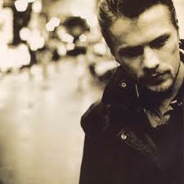
Larry Mullen
Mullen was born Artane, Dublin on October 31 1961
In the mid 1970s, learned military drumming from Joe Bonnie
Joined Artane Boys' Band, then was forced to leave because he wouldn't cut his hair
Before he started U2, he was interested in jazz music
His sign looking for band members started U2, for which he is currently the drummer
metadiary.wordpress.com

Slide 4
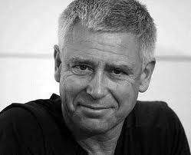
Adam Clayton
Clayton was born in Oxfordshire, England on March 13, 1960
Clayton sent to boarding school where he joined the Gramophone Society, which would listen to classical music
He was expelled, and was sent to St. Columba's College, where he gained an interest in bass guitar
He was then expelled from St. Columba's, and then attended Temple Mount School
claytonsgarden.zip.net

Slide 5
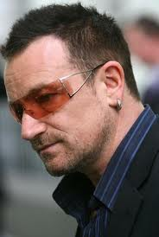
Paul Hewson
Bono was born in Dublin on May 10, 1960
Attended St. Patricks Cathedral Choir School
Asked to leave for throwing dog feces at his spanish teacher
Nickname was originally Steinhegvanhuysenolegbangbangbang, later shortened to Bono
Has gone on to become the face of U2, and is known for his philanthropic endeavors
salu2podcast.wordpress.com

Slide 6
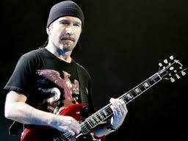
David Evans
The Edge was born in Barking, Essex on August 8, 1961
Had planned on going to college to become either a doctor or engineer
-Was the first to respond to Mullen's ad, and impressed with his guitar skills
His nickname was given to him by Bono for his sharp mind, and the fact that he observes often from "the edge"
laist.com

Slide 7
Formation
In Dublin, Ireland in 1978, Larry Mullen posted an ad to form a band at Dublin's Temple Mount School. Adam Clayton, Paul Hewson (Bono), and David Evans (The Edge) responded, and they formed what would become U2. (Burns).
http://www.u2.com/timeline

Slide 8
Early Years
The four teenagers started out calling themselves "Feedback" rehearsing in Larry Mullen's kitchen. The Edge would play guitar, Adam Clayton and Larry Mullens would be the bass and drums, and Bono would perform the vocals. (Burns).
h ttp://u2.interference.com/f195/picture-request-u2s-early-years-photos-by-colm-henry-205812.html

Slide 9
The Beginning
After being Feedback, they then became The Hype and then U2
After being managed by Adam for a brief time, they met Paul McGuinness, and he became their new manager
After being rejected from many record companies, they signed their first contract with Island Records

Slide 10
Early Records: 1980-1984
Boy (1980)
October (1981)
Under a Blood Red Sky (1983)
The Unforgettable Fire (1984)
http://www.freecodesource.com/album-covers/B0013LPS6Q--u2-boy-album-cover.html

Slide 11
Records: 1985-1991
Wide Awake in America (EP) (1985)
The Joshua Tree (1987)
Rattle and Hum (1988)
Achtung Baby (1991)
http://en.wikipedia.org/wiki/File:The_Joshua_Tree.png

Slide 12
Records: 1993-2000
Zooropa (1993)
Original Soundtracks Number 1 (Passengers) (1995)
Pop (1997)
All That You Can't Leave Behind (2000)
http://www.lyricspond.com/artist-u2/album-all-that-you-cant-leave-behind

Slide 13
Records: 2004-2009
How To Dismantle an Atomic Bomb (2004)
No Line on the Horizon (2009)
Artificial Horizon (2010) (Vinyl)
Wide Awake in Europe (2010) (Vinyl) (EP)
http://media.photobucket.com/image/atomic%20bomb/BlomPhoto/u2_-_how_to_dismantle_an_atomic_bom.png?o=3

Slide 14
Other Music of the Period
1980-84 - Jessie's Girl (1981), Ghostbusters (1984), Thriller (1982), Seek and Destroy (1983).
1985-91 - To Live Is to Die (1988), Every Rose Has It's Thorn (1988), Ice Ice Baby (1990)
1993-2000 - Gangsta's Paradise (1995), Secret Garden (1995), Believe (1998)
2004-2009 - Let Me Go (2005), Don't Make Me (2005)

Slide 15
Musical Influences
Some of the bands/artists that had significant influences on U2 would include the Rolling Stones, Bob Dylan, B.B. King, and the Beatles.
The Sex Pistols - Early punk rock influences
The Clash - Also had early punk rock influences on U2
Rolling Stones - Their Rock and Roll style influence is heard in U2's music.
Bob Dylan - He has worked with U2 in a documentary about the band called Rattle and Hum.
B.B. King - He also worked with U2 on Rattle and Hum.
The Beatles - Rock and Roll influence, U2 has covered Helter Skelter.

Slide 16
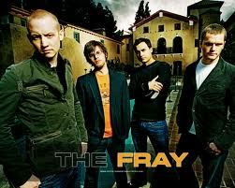
Musical Influences (Influenced by)
Some of the bands that have been significantly influenced by U2's style of music playing all throughout their various stages through the decades are Coldplay, Lifehouse, The Fray, and Creed.
entertainmentwallpaper.com

Slide 17
Musical Style
U2 is known for their non-traditional, experimental music. They weren't afraid to push the limits lyrically and instrumentally.
Their roots are in Punk Rock and Roll and Traditional Irish Country Music ("Understanding the essence," 4ap).
The 90's contained more synthesizers and distorted music, while the 80's started with more traditional rock ("Understanding the essence," 4ap).

Slide 18
Musical Style (Continued)
In 1984 the band released an album that marked Edge's transition from guitar to keyboard. This new album and the next one they released reflected a lot of new diverse flavor in comparison to previous U2 releases. ("Understanding the essence," 4ap).
The band's latest music is said to be the best creation by them yet. It combines the essence of rhythmic beats of Moroccan country music, and western Rock and Roll. Showing that they still haven't lost their touch. ("Understanding the essence," 4ap).

Slide 19
Musical Analysis
'One' from their 1992 album Achtung Baby
Tempo: Slow throughout the song, only 91 beats per minute
Beat: Quadruple subdivision, with an emphasized backbeat.
Timbre: Drums are light; the guitar sets the beat with strong notes
Form: Simple form, AABA
Range: The range of Bono and the instruments are wide; they change octaves often

Slide 20
Musical Analysis cont...
Tone: The singing was moderately high pitched, with a good quality sound. There was a lot of soul in the song, but not a lot of strength
Rhythm: The rhythm is set by the drum for the entire song
Meter: Starts as triple but concludes at duple
Texture: Polyphonic, non-imitative
Dynamics: The dynamics change throughout the song, oscillating between piano and forte

Slide 21
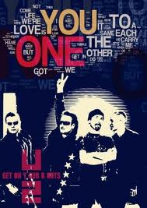
Musical Analysis (Lyrics)
The lyrics were written by the lead singer, Bono.
The lyrics address the population of the world asking them to come together to help bring peace to everyone that needs it.
It was additionally used to bring awareness to an AIDS fundraiser.
Its emphasis is saying that we are all one, yet we are all different. If we bring our differences together, we can achieve great things.
pophistorydig.com

Slide 22
Political and Social Influences
One event that had an influence over U2's song writing of the time and caused them to write a song about it was the death of Martin Luther King Jr. And his non-violent struggle for equal rights. (Greer, 2008)
The song that came from this was the song Pride (1984). This song talks a lot about love, and how "they" (the person who killed and opposed King) could take his life away but they couldn't take his pride. (Greer, 2008)
One chorus in this song asks "what more in the name of love?" meaning what more can one man do to show his love for everyone, regardless of race. And MLK made the ultimate sacrifice, he gave his life. (Greer, 2008)

Slide 23
Political and Social Influences (Continued)
Another political influence that U2 wrote a song about is the Cold War, Nuclear war was an "ever present danger". What U2 is referring to in their song named Seconds (1983), is that the nuclear armageddon is only "seconds away". (Greer, 2008)
This song is also about how people were becoming complacent about the politics and it was to serve as a wake up call, to get the people to realize what was happening around them. (Greer, 2008)

Slide 24
Fundraising
One major fundraising effort the band has been a part of is the "I'm gonna be your friend" social media campaign. This campaign is raising money in an effort to help people affected by the drought in North Africa.
This fundraiser is asking people to buy a single by Bob Marley & The Wailer for $1.29 on the site www.imgonnabeyourfriend.org. At the site you can also donate money for the cause if you do not want to buy the song. You can also share information about the site via social media networks.

Slide 25
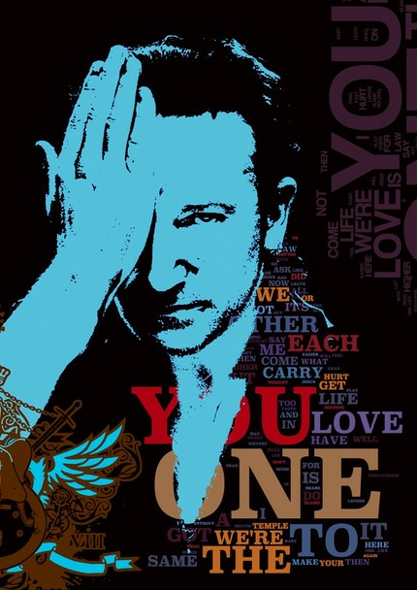
The ONE Campaign
ONE was co-founded by U2 lead singer Bono, and began by using online ad campaigns and concerts to fight for a new initiative at the G8 Summit in 2005. ONE then had over 2 million members. In 2007, DATA and One merged, and in January 2008 officially became ONE. It combines DATA's policy depth and ONE's member base to continue to help the fight against poverty, unfair trade conditions, and AIDS. (ONE).
thewitcontinuum.wordpress.com

Slide 26
Conclusion
Throughout this presentation we learned about U2 and how they influenced and affected society with their moving lyrics and selfless fundraising to help causes around the world.
U2 represents the music of the period because they were experimental with their sounds and wrote lyrics that touched many people.
It is exciting to say that they are still together as a band and we can't wait to see what comes from U2 next!

Slide 27
References
Burns, R. (n.d.). U2-biography. Retrieved from http://www.imdb.com/name/nm1277752/bio
Fry, M. (1995, 3 5). Atu2. Retrieved from http://www.atu2.com/band/bono/
Fry, M. (2002, December 04). The Edge biography. Retrieved from http://www.atu2.com/band/edge/
Greer, M. (2008). @ u2. Retrieved from http://www.atu2.com/news/u2-lists-top-10-political-u2-songs.html
One. (n.d.). Retrieved from http://www.one.org/c/us/about/754/
RIA, N. (2011, November 08). World. Retrieved from http://en.rian.ru/world/20110810/165684481.html
Tomooka, J (1995). atu2.com. Retrieved from http://www.atu2.com/band/adam/
U2.com. (2012). Retrieved from http://www.u2.com/timeline - (n.d.). Retrieved from http://www.threechordsandthetruth.net/u2bios/u2larrybio.php
U2wanderer.org. (2011). Retrieved from http://www.u2wanderer.org/disco/album.html
Understanding the essence of u2′s musical style. (4 Ap). Retrieved from http://www.u2fanclub.net/understanding-the-essence-of-u2s-musical-style/9/

