Slide 1
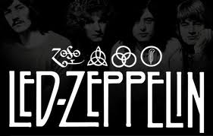
LED ZEPPELIN
By Stephanie Kocer, Moriah Wald and Christian Lindman

Slide 2
introduction
The British invasion in the United States had huge successes with the Beatles and The Rolling Stones.
This signaled other British blues-based bands to travel to America where they would hopefully hit it big time.
When Jimmy Page of the Yardbirds suddenly became a one man show, he quickly recruited young and enthusiastic replacements. The Band called themselves Led Zeppelin and would have a lasting impact and influence on the future of rock music

Slide 3
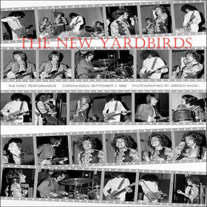
The NEW yardbirds
In 1968 Jimmy Page was abandoned by his fellow group members of The Yardbirds.
He formed a new group with a younger, more enthusiastic feel. They were called the New Yardbirds.
The primary reason for assuming a similar name was because the band was formed to fulfill the concerts that were already booked for the Yardbirds across Scandinavia before they disbanded (“Led Zeppelin…” 2012).
http://static.rateyourmusic.com/album_images/9c9463899d478de54e88fc6a60b46c2f/488388.jpg

Slide 4
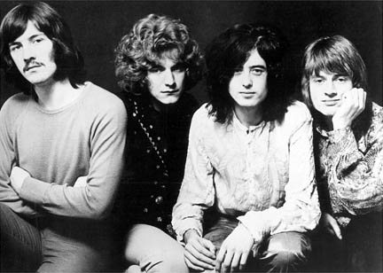
Group members
Jimmy Page had already worked with bassist John Paul Jones prior to 1968 (“Led Zeppelin…” 2012).
He recruited Robert Plant for vocals, who brought in his friend John Bonham for drums (“Led Zeppelin…” 2007).
http://s3.amazonaws.com/classic-rock-concerts/photos/1/LedZeppelin1968Promo.fullpage.jpg

Slide 5
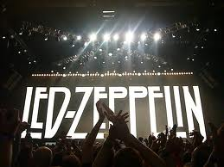
Led zeppelin
The group changed their name to Led Zeppelin after the final Yardbirds concert.
The name came after Keith Moon, the drummer from The Who, mocked the group saying that “They would go down like a ‘lead zeppelin (“Led Zeppelin…” 2007).’”

Slide 6
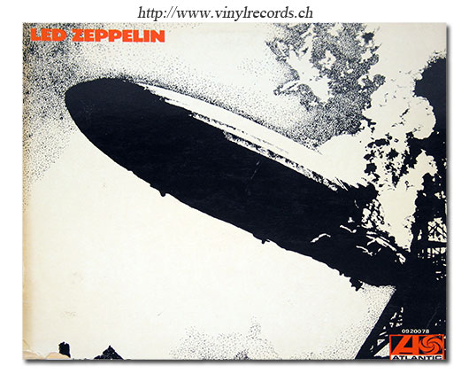
Early history
The group recorded their first album, self-titled as ‘Led Zeppelin’ October 1968.
The album was complete within 36 hours and began the controversial image that surrounded the band.
http://www.vinylrecords.ch/L/LE/Led_Zeppelin/Led-Zeppelin-FR/led-zeppelin-FR-90.jpg
The album cover was a picture of a blown up Hindenburg airship to purposefully create a phallic image (“Led Zeppelin…” 2012).

Slide 7
Early history
Before the album was released, the band played their first gig at the University of Surrey.
Soon after they went on a series of tours through both the United Kingdom and the United States.
During their US tours, they recorded their second album. Because the band was always on tour, they recorded the new album at various recording studios along the way (“Led Zeppelin…” 2012).

Slide 8
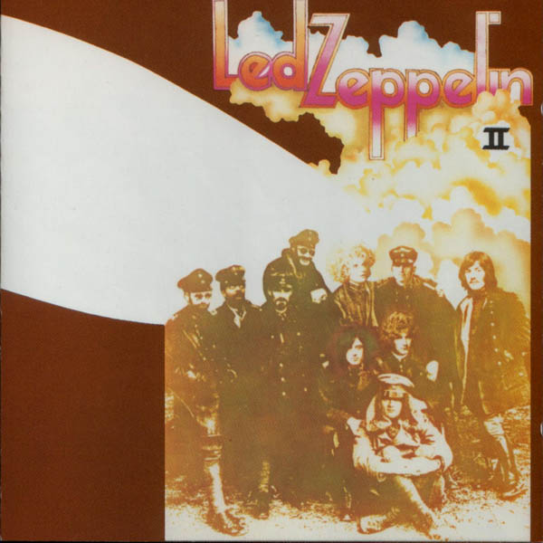
Initial success
The first album reached #10 on the album charts in 1969 (“Led Zeppelin”). It remained on the charts for 73 weeks (“How Led Zeppelin…” 2012).
In the same year, the second album ‘Led Zeppelin II’ topped the U.S. album charts for seven weeks.
http://1.bp.blogspot.com/-4vKY7jw47vY/TyrLRWZMp3I/AAAAAAAAADM/ikCb_Uh1Ytk/s1600/II.jpg

Slide 9
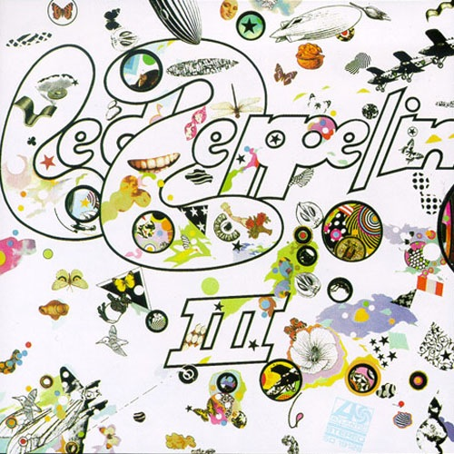
Initial success
The band released their third album titled ‘Led Zeppelin III’ in 1970 which quickly became a hit and was the band’s second #1 album.
It was considered to have more folk influences showing the band’s versatility (“Led Zeppelin”).
http://4.bp.blogspot.com/-0o1iawU_nuw/Tv9ho8a5t8I/AAAAAAAAAOw/_pvgNnbUi0w/s1600/led-zeppelin-iii+guitar+lessons+in+south+shields+www.rock-licks.com+01914552172.jpg

Slide 10
The lifestyle
The band was beginning to have a reputation for their offstage lifestyle. They were known to live lavishly. They would rent whole sections of hotels and go crazy, throwing televisions out windows and riding motorcycles through hotel lobbies.(“How Led Zeppelin…” 2012).
Jimmy Page was known to use up to 10 different guitars during a show enhancing live stage performances (“How Led Zeppelin…” 2012).

Slide 11
The fourth album
On their trip to Japan, as part of their world tour in 1971, the band allowed a rare press conference.
Most of their career they avoided press which helped to drive people to their live performances so this was a rare occasion (“How Led Zeppelin…” 2012).
Shortly after their trip to Japan the band released their fourth album. It was released with “no official album title, group name, company logo, song list, or picture of the band on the cover (“How Led Zeppelin…” 2012).”

Slide 12
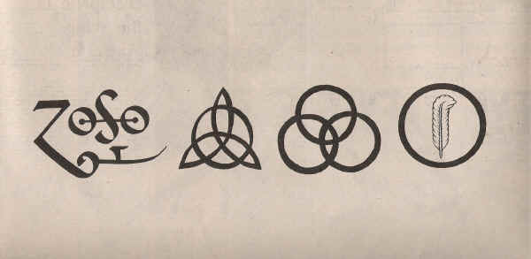
Led zeppelin iv, the runes, zoso
It has four symbols, which many claimed to be runes and believe to be the title of the album.
Each symbol was meant to represent a member of the band, and all but Jimmy Page’s symbol were easy to look up the meaning (“Zoso…” 2011).
The album is referred to as Led Zeppelin IV, The Runes, and Zoso is reference to Jimmy Page’s symbol (“How Led Zeppelin…” 2012).
http://1.bp.blogspot.com/-ioZ4pmx3zls/TrmGbvh877I/AAAAAAAAAJM/p0FMUn2oUNc/s1600/2566777926_29063c8d7c_o.jpeg

Slide 13
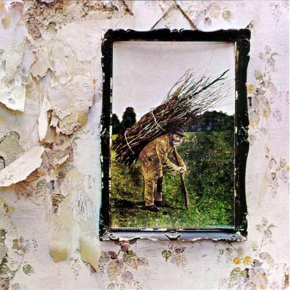
Rising success
The fourth album enters Billboard’s album chart and remains there for five years, but only reaches as high as #2 (“Led Zeppelin”).
The album contains ‘Stairway to Heaven’ which was never released as a single, but was the radio’s #1 most requested song (“Led Zeppelin”).
http://www.wmgk.com/Pics/ledzepiv.jpg

Slide 14
Musical analysis: Black Dog
Instrumentation: basic instrumentation-guitar, bass, vocals, drums.
Texture: varies throughout the piece. There is a conversation between vocals and instrumentation which translates to monophony to homophony melody and accompaniment. In the chorus it alternated from the 'hey baby' section as polyphonic nonimative because there are more then two textures but they are all independent. To a more homophonic chordal section where back up vocals come in. The guitar solo plays out in a polyphonic texture with vocals giving backup sounds like 'ooh' and the melody continues to play through
Meter: quadruple; beat subdivision: duple
Form: trade-off technique which is the statement and answer between the guitar and the vocals that is very present. It also coordinates into the 12-bar blues form especially in the chorus area starting with "Hey baby." The line is complete in 12 bars and mirrors the characteristics.

Slide 15
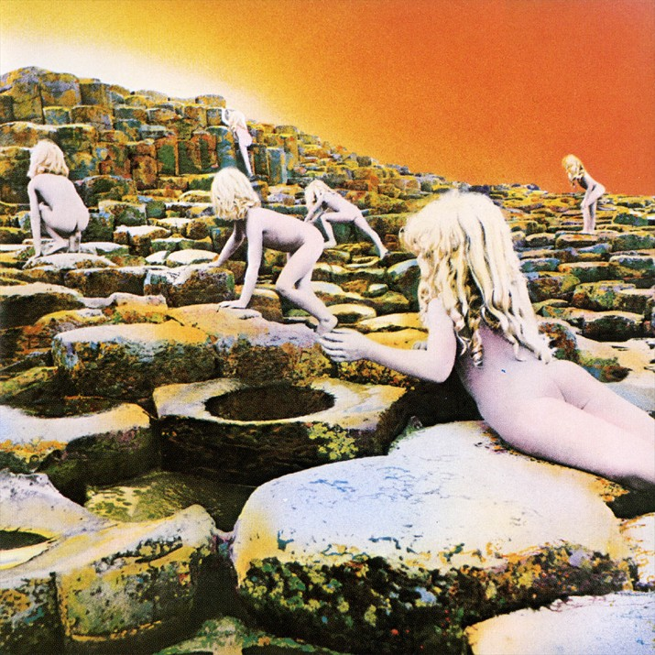
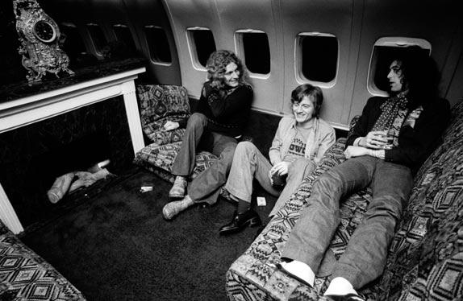
Rising success
The band began to tour extensively. They had tour after tour and eventually bought their own jet which they called ‘The Starship (“Led Zeppelin…” 2012).’
In 1973 the band releases its fifth album ‘Houses of the Holy’ and it becomes their third album to reach #1 (“Led Zeppelin”).
http://www.fastcompany.com/pics/how-led-zeppelin-changed-music-business#13
http://www.retro-cafe.com/70s/music/zeppelin/houses/led-houses.jpg

Slide 16
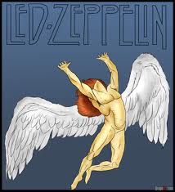
The swan song label
In 1974 the band released their own Swan Song label after completing a five-year contract with Atlantic records.
http://t0.gstatic.com/images?q=tbn:ANd9GcSjpKmV-JlzOAJUXNgTNRmLnzRzJLJ0Cv7BLAKC2xaPQE54q_McnS9fTDEEow

Slide 17
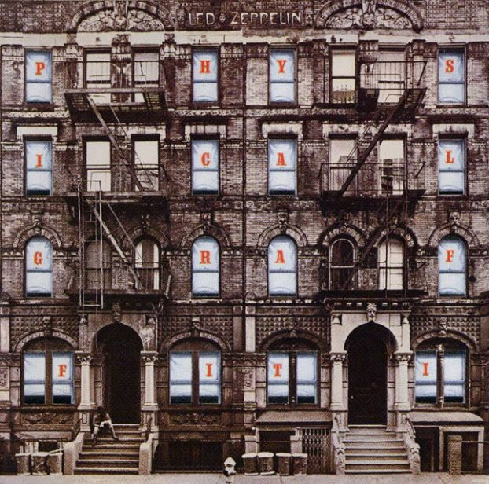
Physical graffiti
In 1975 Led Zeppelin released a double -album ‘Physical Graffiti’ which quickly rose to be #1 in its second week. The album remained #1 for six weeks straight, which made them the first band to have six albums on the chart at once (“Led Zeppelin”).
http://www.progarchives.com/progressive_rock_discography_covers/2705/cover_334726112010.jpg

Slide 18
The beginning of tragedy
Later that year Robert Plant and his family got into a car crash on an island in Greece. He almost lost his leg and therefore could not perform. This caused the band to be sidelined for two years while he recovered (“Led Zeppelin”).
While waiting for Plant’s recovery, the band released a documentary in 1976 called ‘The song remains the same (“Led Zeppelin”).’

Slide 19
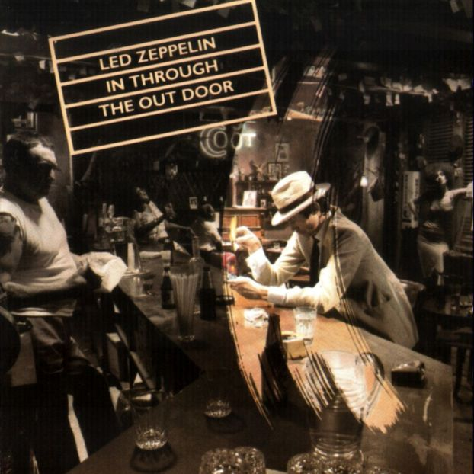
In through the out door
In 1977 Plant’s son died of a viral infection and caused the band to slow down. They finally release a new album in 1979 called ‘In through the Out Door.’
The album was considered to be their ‘swan song’ as it brought everyone back together and the disc was covered with the Swan Song Label logo. It topped charts for seven weeks (“Led Zeppelin”).
http://www.sodahead.com/entertainment/pink-floyd-or-led-zeppelin/question-1607023/?page=2&link=ibaf&q=&imgurl=http://4.bp.blogspot.com/_WWIy23PK7tM/S9SdDtcTMnI/AAAAAAAAHwY/LiAF2jR2pDs/s1600/cover.jpg

Slide 20
Tragedy strikes
The success of the last album was short lived. September 25th 1980 the band found John Bonham dead due to asphyxiation from too much alcohol.
The band was in the middle of rehearsals for an upcoming American tour and felt that Bonham was irreplaceable. They therefore decided to disband and cancel the tour (“Led Zeppelin”).

Slide 21
After led zeppelin
Robert Page launched a solo career.
Jimmy Page formed a new band called ‘The Firm.’
John Paul Jones returned to producing, and arranging music (“Led Zeppelin”).
In 1985, the band briefly re-forms for the Live Aid benefit concert in Philadelphia
In 1988 they reunite with John Bonham’s son, Jason Bonham, on drums for Atlantic Records 40th anniversary concert.
In 1994, Jimmy Page and Robert Plant produce another album ‘No Quarter’ using various orchestrial arrangements. The album reaches #4 on the charts (“Led Zeppelin”).
In 1995 the band is finally inducted into the Rock and Roll hall of fame (“Led Zeppelin”).

Slide 22
Musical Style
Led Zeppelin is considered one of the first bands of the heavy metal genre even though their music is heavily influenced by the Delta Blues.
Some of their influences were Howlin Wolf, Willie Dixon, and Robert Johnson (McGuiness, 2009). But they were always much more than merely a heavy rock band (Jones, 1998).
They incorporated the blues style and actual riffs of other artists into their songs.

Slide 23
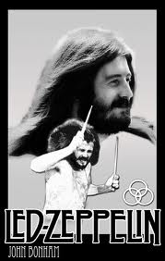
Influences
John Bonham (drummer) was the big soul lover of the group, a fan of the Stylistics and the smooth “Philly Sound,” and the heavily rhythmic funk of James Brown and his killer rhythm sections.
His jazz influences were Gene Krupa and Buddy Rich. Elements of Bonham’s drum solos and other spontaneous live moments distinctly displayed the influence and feel of improvisational jazz (Jones, 1998).

Slide 24
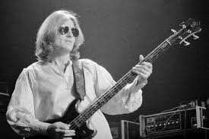
Influences
John Paul Jones (bassist/keyboardist) was raised in a musical family and his dad played in the well-known Ambrose Orchestra in the big band era (Jones, 1998).

Slide 25
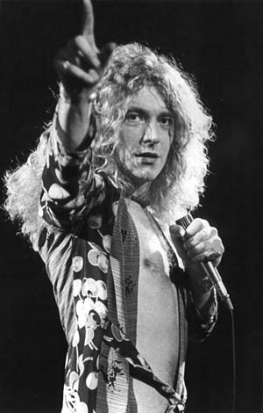
Influences
Robert Plant (singer) once made a comment about legendary jazz drummer Buddy Rich “Buddy Rich was always a big deal for all of us. His attitude and his playing were basically like ours, but he was twenty-eight years down the line. He played with such venom at times, and with such ease!” (Jones, 1998).

Slide 26
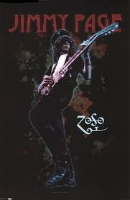
Influences
Jimmy Page (Guitar) had the broadest tastes of the three instrumentalists.
His love of English folk is well documented; he also brought knowledge of Moroccan, Indian, and other non-western music to the band, and was well acquainted with guitarists of the jazz idiom (Jones, 1998).

Slide 27
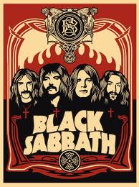
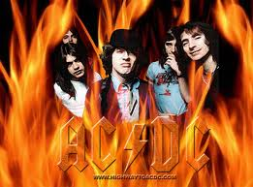
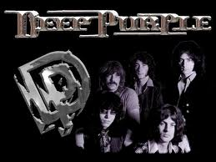
Music of the time
Contemporary bands of the 70s were Hard Rock bands Black Sabbath, Deep Purple, The Who, and AC/DC.

Slide 28
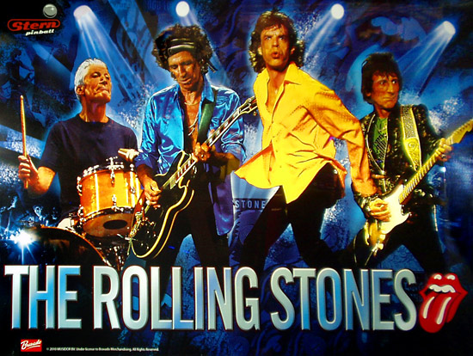
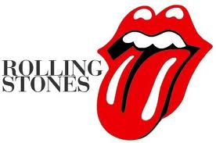
Music of the time
Another rock contemporary is the R&B influenced band The Rolling Stones.

Slide 29
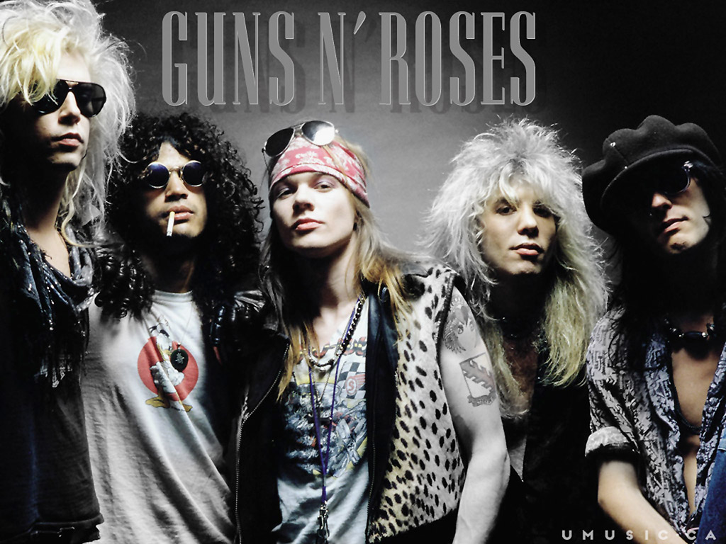
Influences on others
Led Zeppelin helped create a whole new genre of music called heavy Metal, or hard Rock.
Their influence spans across countless bands which include Guns and Roses, Van Halen, the White Stripes, Soundgarden, and the majority of 80’s rock bands.

Slide 30
Other Important influences
The 1960s signaled an explosion of sound technology that enabled groups to play their music at an all new level of loudness.
Rock music was never quiet, but most artist performed live using “tinny-sounding public address systems”. Concerts now featured bands that played their music at “riveting, even overwhelming” levels (Stuessy & Lipscomb 2012).

Slide 31
Influence of the Rock festival phenomenon
In England there were very few halls that could accommodate more than a few thousand people, which means it is only worthwhile playing at the major cities once every six months (Luerssen 2009).
The rock festival phenomenon in America, stemming from concerts such as Woodstock and Altamont, was very appealing to aspiring British bands.

Slide 32
Influences from the states
In America, the venues and the number of people you can communicate to through the mass media is what was so appealing to British Groups. So, the group focused their energy on becoming popular in America because in 1969 Britain’s mass media was not reflective of what the majority of the young people wanted to listen to, but in the states it was (Luerssen 2009).

Slide 33
Influences from san francisco
San Francisco was where everyone wanted to be. Robert Plant said in an interview “There was some kind of fable being created there, and a social change that was taking place, and the music was a catalyst in all of that” (Wall, 2008, p. 26).
The music scene in San Francisco was full of live performances where artists were free to make improvisations as they pleased.
When the Zeppelin’s arrived they offered a solution between two struggling musical styles; post-psychedelic, more lateral sounds of the west coast and the emerging country rock. Led Zeppelin was a “brew of ferocious hard rack and steamy blues awash in lengthy improvisations” (Wall, 2008, p. 100) and Americans loved it.

Slide 34
conclusion
Led Zeppelin was a powerful band that had the right equation to rise to fame. The right people, the right sound, and the right image. Their rise to fame allowed them a lavish lifestyle which eventually led to their disbandment.
There was a need for a new style of hard rock that was edgy and rebellious, but that would also take to the liking of a wide audience. Their folk, R&B, Jazz and Pop influences established the Zeppelins in a new genre of rock that influenced the music of many prominent rock groups of the future decades.

Slide 35
References
“How Led Zeppelin changed the music business.” (2012). Fast Company. Retrieved from http://www.fastcompany.com/pics/how-led-zeppelin-changed-music-business#6
Jones, H. (1998, July). ZEPPELIN IN JAZZLAND: Their Jazz Influences. Proximity. Retrieved June 26, 2012, from http://www.oldbuckeye.com/prox/jazz.html
“Led Zeppelin.” Rock and Roll Hall of Fame. Retrieved from http://rockhall.com/story-of-rock/timelines/led-zeppelin/basic/
“Led Zeppelin: A brief history.” (2007 Dec. 10). NME. Retrieved from http://www.nme.com/news/led-zeppelin/30855
“Led Zeppelin: Mini Biography.” (2012). Internet Movie Database. Retrieved from http://www.imdb.com/name/nm0496389/bio
Luerssen, J. D. (2009). Dancing Days: The Led Zeppelin Reader. United States: lulu.com.

Slide 36
references
McGuiness, M. (2009, November 3). The Led Zeppelin Guide to Creative World Domination . Lateral Action. Retrieved June 26, 2012, from http://lateralaction.com/articles/led-zeppelin/
Stuessy, J., & Lipscomb, S. D. (2012). Rock and roll: Its history and stylistic development. (7 ed.). Pearson Education.
“Supergroup.” (2012). The Free Dictionary. Retrieved from http://www.thefreedictionary.com/supergroup
Wall, M., (2008). When Giants Walked The Earth: A Biography of Led Zeppelin. 1st ed. New York: St. Martin's Griffin.
“Zoso – Jimmy Page’s symbol from the Led Zeppelin IV album.” (2011 Nov. 20). In the Light. Retrieved from http://www.inthelight.co.nz/ledzep/zososymbol.htm

