Slide 1
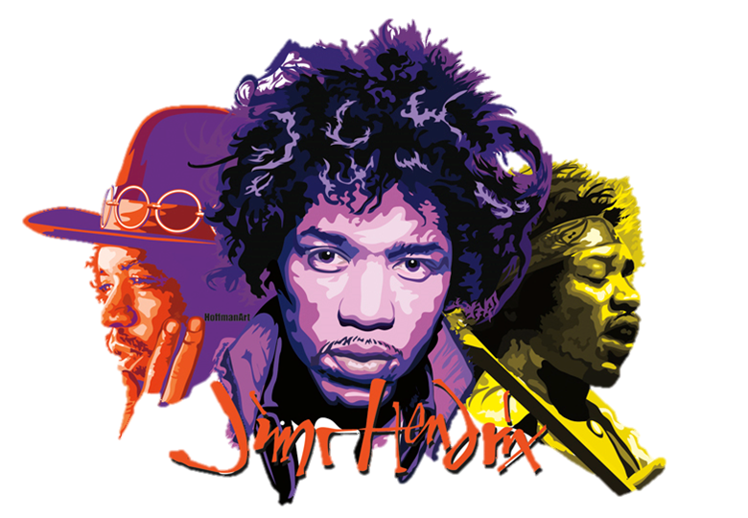
Erica Hebl, Myrrh-Anna Kienitz, Conor Leigh,
Eva Mueller, Tien Nguyen
Group 3

Slide 2
Why did we choose Jimi Hendrix?
Jimi Hendrix has influenced a legacy of blues-based psychedelic rockers and has contributed to the popularization of the flamboyant electric guitar style that we still hear today. His experimentation with improvisation has lead him to becoming one of the most influential guitarists in rock history.

Slide 3
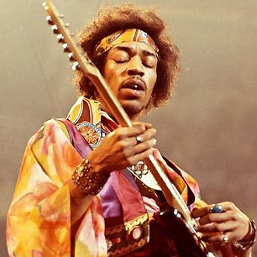
Biography: The basics
Born on November 27, 1942 (the day after thanksgiving)
Original name was Johnny Allen Hendrix. It was later changed to James Marshall Hendrix
Originally from Seattle, Washington
At the time, only about 1% of Seattle’s population was black
Had ancestors who were slaves, slave owners, and Cherokee
(Cross, 2005)

Slide 4
Early life
Developed an interest in music at a young age.
Completely self-taught
Unable to read music, which forced him to learn by ear
In 1958, his father bought him his first guitar - a five dollar acoustic from one of his friends.
Afterwards, he joined his first band, “The Velvetones,” which only lasted for a few months.
In 1961, Jimi joined the Army
Was later discharged, and began to pursue music once again
(Experience Hendrix, 2013)

Slide 5
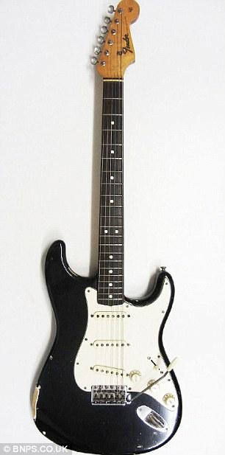
The start of Jimi Hendrix’s musical career
After being discharged from the Army, Hendrix worked as a pickup guitarist.
Chas Chandler (former bassist of The Animals) was impressed and became Hendrix’s manager in 1966.
Chandler flew Hendrix to London to join a new band, which was to be named “The Jimi Hendrix Experience.”
The band quickly gained popularity in London
First single: “Hey Joe”
First album: Are You Experienced
(Experience Hendrix, 2013)

Slide 6
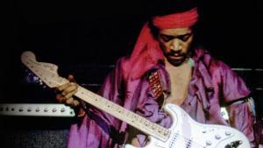
Mid-career fame
First appearance in U.S. was his performance at the Monterey Pop Festival in 1967
Hendrix burned his guitar as the climax of the show
He quickly rose to fame between 1967 and 1968
Released the albums Axis: Bold as Love and Electric Ladyland
Toured in America twice during this time
Tensions among band members and managers rose and eventually The Jimi Hendrix Experience was disbanded.
(Kemp, 2014)

Slide 7
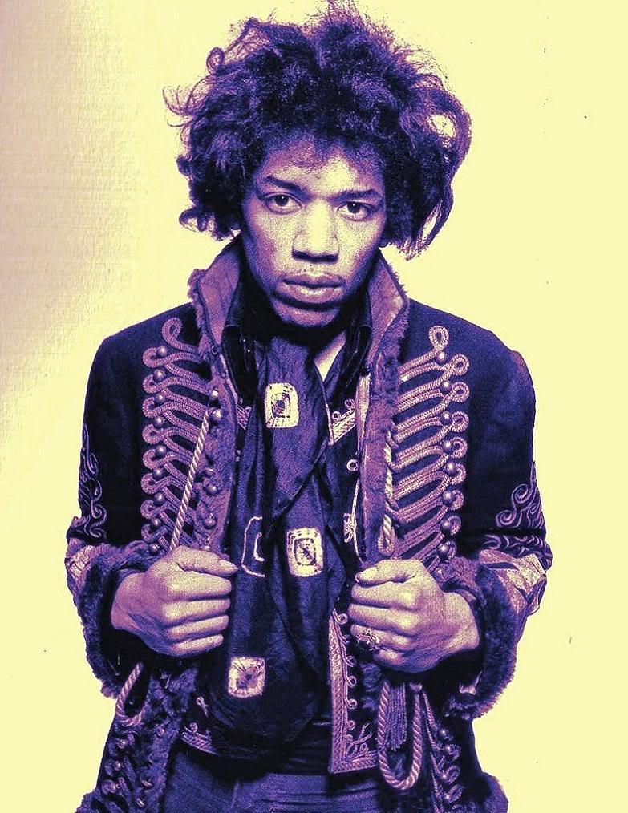
Late-career
In 1969, Hendrix performed at the Woodstock Festival
Hendrix was under pressure by black power groups to form an all black group.
Later in 1969 he formed an all-black band called “Band of Gypsys”
Produced only one album, titled Band of Gypsys
He later performed with previous band members to produce his last album, The Cry of Love, and held his last performance at the Isle of Wight Festival.
(Kemp, 2014)

Slide 8
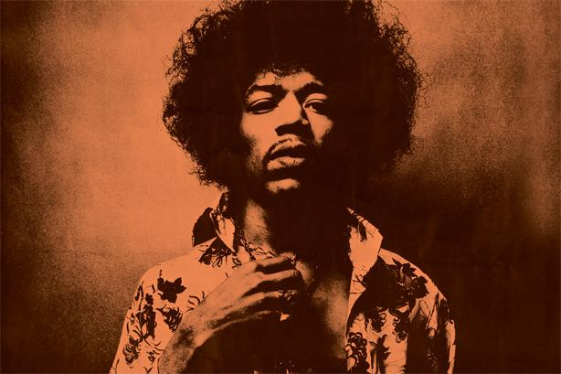
Death
Died of a drug overdose in 1970 (at the age of 27) in London
Asphyxiated after overdosing on barbiturates
Metaphorically died of an “overdose of rock ‘n’ roll”
(Murray, 1989)

Slide 9
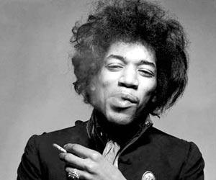
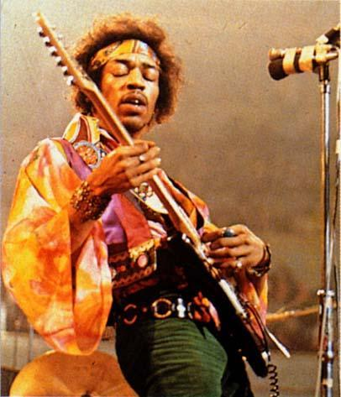
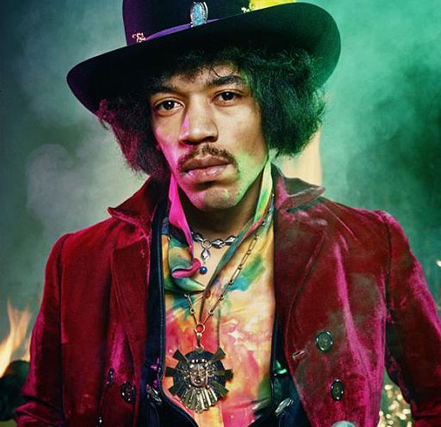

Slide 10
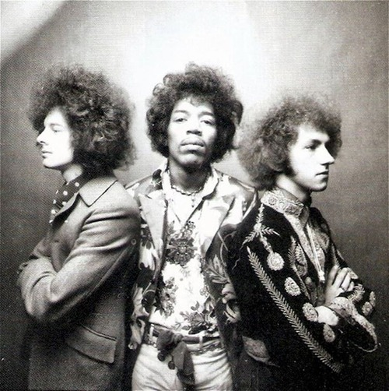
Musical Style
Jimi Hendrix’s musical style was deeply rooted in Rhythm & Blues and Jazz.
He was innovative with sound and was always looking for new ways to improvise and improve his music.
He performed from 1966 to his final concert which was held on September 6, 1970.
(The Rock and Roll Hall of Fame, 2014)

Slide 11
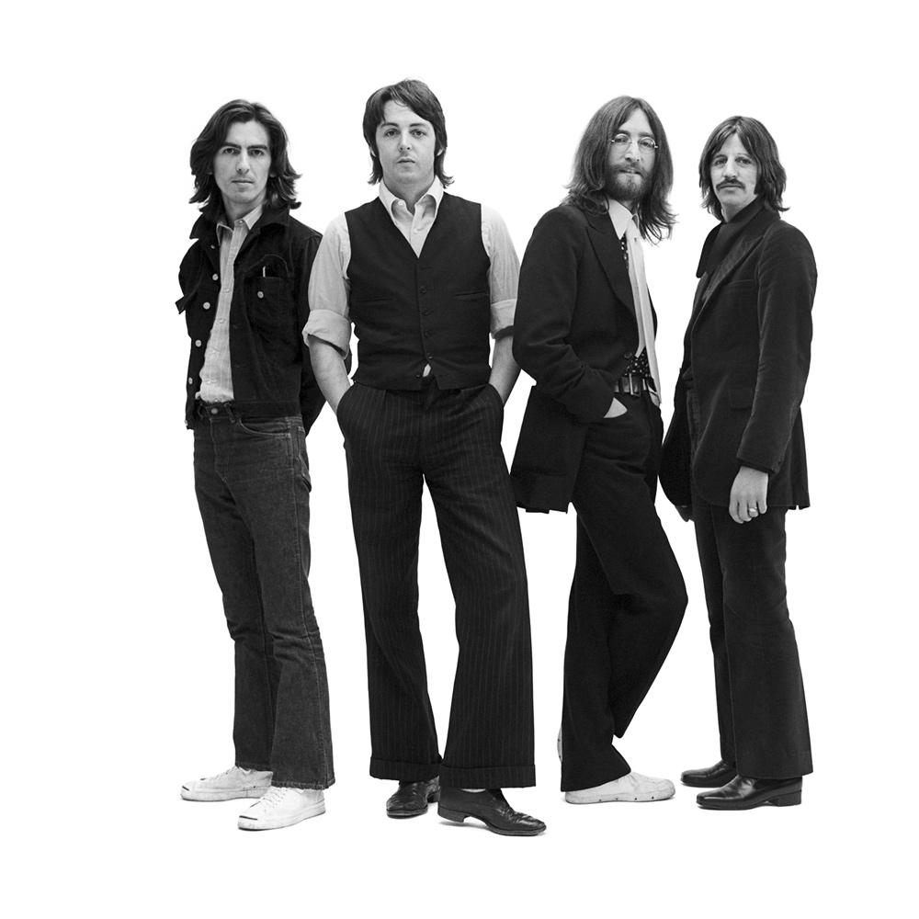
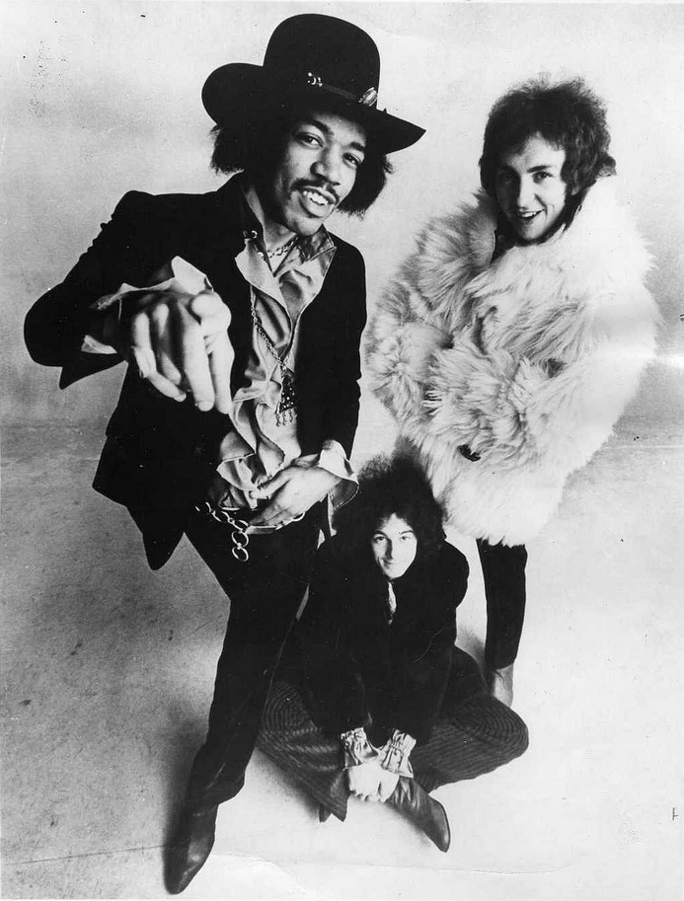
Compared to the Music of the Period
The Beatles
They were a huge worldwide phenomenon during this time period.
They represented the less rebellious side of rock ‘n’ roll.
Songs were both upbeat and psychedelic, along with a few slow rock ballads about love.
Jimi Hendrix
He received his inspiration of adding psychedelic sounds to his music from the Beatles.
His songs always seemed to push the rock ‘n’ roll envelope with his extensive stage shows and his impressive electric guitar skills.
(Herb, 2001)
(Light, 2007)

Slide 12
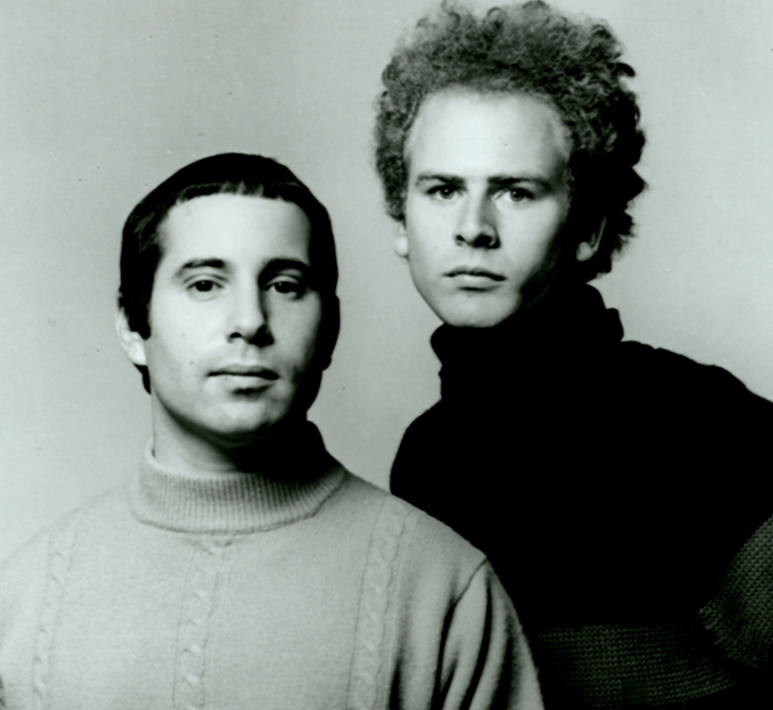
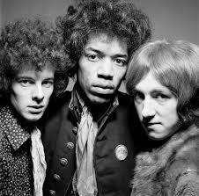
Compared to the Music of the Period
Simon and Garfunkel
They created music which fit into the soft rock/ folk rock genre.
Their music focused of slower rhythms and simple melody lines.
Jimi Hendrix
Jimi Hendrix’s songs focused on bringing together both “white hippies and black revolutionaries.”
His music was anything but simple; it contained complex rhythm schemes and unique texture.
(Murray, 2013)

Slide 13
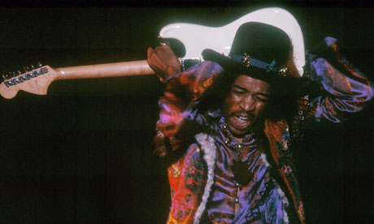
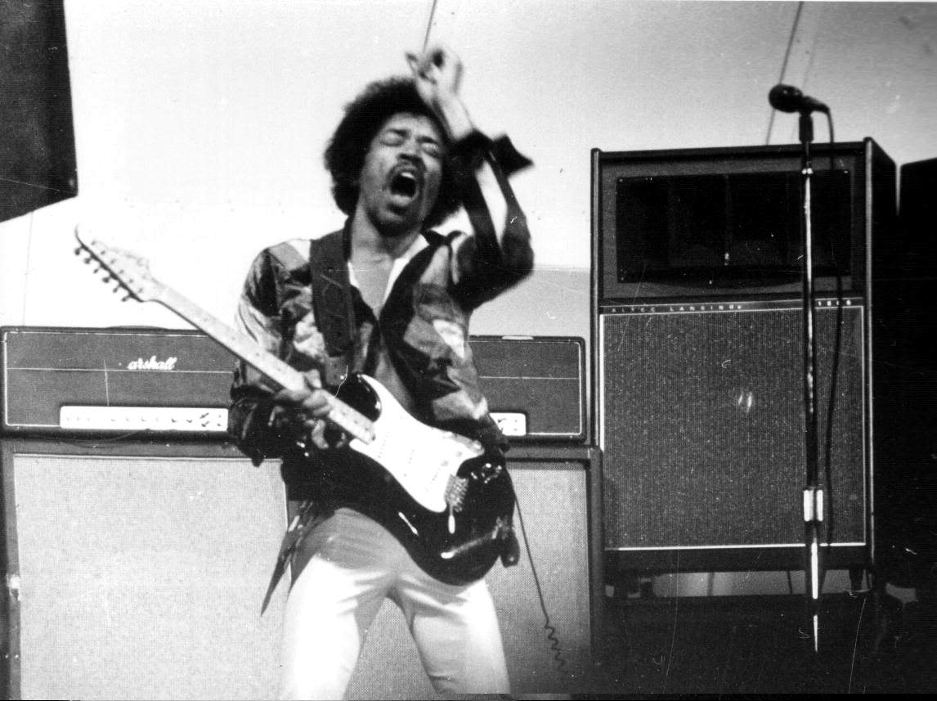
His Impact on Rock and Roll
Jimi Hendrix revolutionized the way musicians played music in the late 1960 and beyond.
He created many innovative ways to play his electric guitar.
He learned to play behind his back and with his teeth.
He learned many complicated melody lines, including impromptu instrumentals.
He also defined the theatrical way concerts would be performed.
His elaborate stage shows were the hottest ticket in town, even upstaging and outselling The Who.
His talented and lengthy solos kept the audiences coming back for more.
(Murray, 2013)

Slide 14
Video: Jimi Hendrix playing with his teeth
*Must be in presentation mode to view

Slide 15
His Innovations
Jimi Hendrix’s innovative style pushed the rock movement forward.
He inspired other artists to learn to play complicated electric guitar lines.
He created a new type of experimental music which sparked the beginning of rock ‘n’ roll music.
The use of amps and sound boards to create a new electric reverb and musical effects
(Reyes, 2004)

Slide 16
Song analysis: “Hey Joe” by Jimi Hendrix
If you are familiar with Jimi Hendrix, you have heard “Purple Haze” or “Hey Joe.” We chose “Hey Joe” because it is a great example of Jimi Hendrix’s sound and musical style of Blues Rock on a cover of a hard rock song. With the addition of phrases and vocals derived from R&B influences, Hendrix’s cover has become the most popular version of “Hey Joe.”
(Hicks, 2000)

Slide 17
“Hey Joe” Musical Analysis: Instrumentation
Jimi Hendrix plays the electric guitar, and sings lead vocals.
He is accompanied by:
An electric bass guitar, playing a similar rhythm to Hendrix’s guitar
Drums, including kick drum and high hat,
And backup vocalists, singing “ohh”s and “ahh”s
The conjunct melody of the song moves smoothly to the next beat and has a small range in its pitch.

Slide 18
“Hey Joe” Musical Analysis: Meter and Beat Subdivision
The Meter changes between Duple and Quadruple
Beat Subdivision is Duple.
Chord progression of VI III VII IV I
In the key of D : C G D A E

Slide 19
“Hey Joe” Musical Analysis: Texture
Intro, 0:00-0:06 monophonic electric guitar intro
Verse 1 and 2, 0:07- 1:40 Homophonic, Melody and Accompaniment. Jimi Hendrix sings the vocal melody, accompanied by his guitar, bass, drums, and backup vocals.
Instrumental break, 1:41-2:14 Homophonic, Melody and Accompaniment. Guitar solo melody, with accompanying drums, bass, and backup vocals.
Verse 3, 2:15-3:25 Homophonic, Melody and Accompaniment. Jimi Hendrix sings the vocal melody, accompanied by his guitar, bass, drums, and backup vocals.

Slide 20
“Hey Joe” Musical Analysis: Form
Strophic form
repeating verse structure
Dominant macrostructure of AABAB
A=Verse, B=Instrumental.
Dominant Microstructure is aabb
Verse 1 and 2 are aabb, and verse 3 is aabc

Slide 21
Musical Influences
During his teen years, he listened to a lot of blues artists
These included Muddy Waters, B.B. King, Howlin’ Wolf, and Lightnin’ Hopkins
Big fan of Elvis Presley, Little Richard, and Chuck Berry
Taught himself how to play by imitating such artists on records or the radio
The first song he taught himself all the way through was “Tall Cool One” by The Wailers
(Unterberger, 2009) (Experience Hendrix)

Slide 22
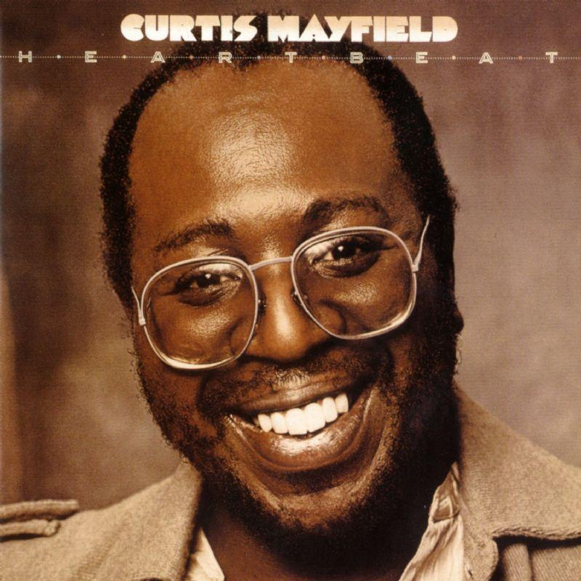
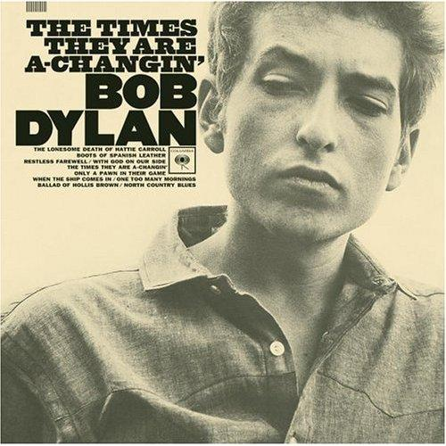
Influences Continued
Curtis Mayfield’s influence is audible in his guitar playing
His songwriting resembles Bob Dylan’s
He used to repeatedly play his records
(Unterberger, 2009)

Slide 23
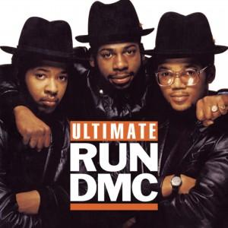
Jimi Hendrix’s Influence
Influenced Ernie Isley of the Isley Brothers
Many hip hop artists have cited his influence
These include Beastie Boys, Run-D.M.C., Digital Underground, and A Tribe Called Quest
(Unterberger, 2009) (Owen and Reynolds, 1991)

Slide 24
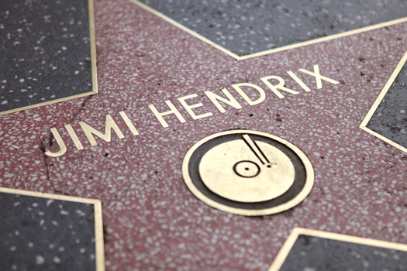
Fame and contribution
Although Jimi’s career span was only 4 years, he achieved great things and created a legacy
1967
Pop musician of the Year by Melody Maker
1968
Artist of the Year by Billboard
Performer of the Year by Rolling Stone
1969
World Top Musician by Disc and Music Echo
1992
Rock and Roll Hall of Fame
2005
UK Music Hall of Fame
3 albums, Are You Experienced, Axis: Bold as Love, and Electric Ladyland ranked in the 100 greatest albums of all time. ( by Rolling Stone)
Named the greatest guitarist and one of sixth greatest artist of all time. (by Rolling Stone)
(Experience Hendrix, 2013)

Slide 25
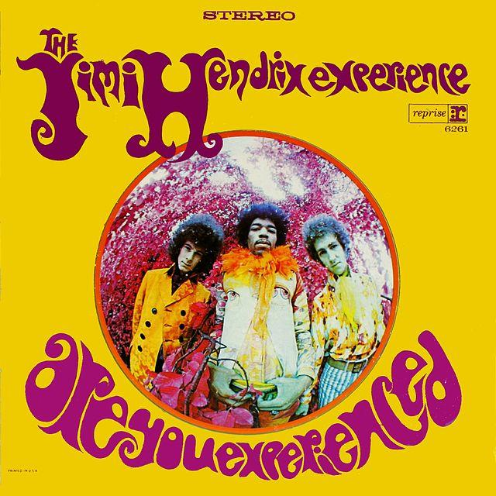
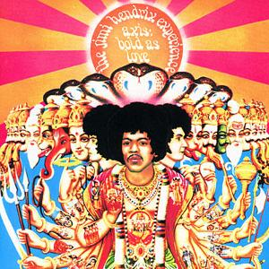
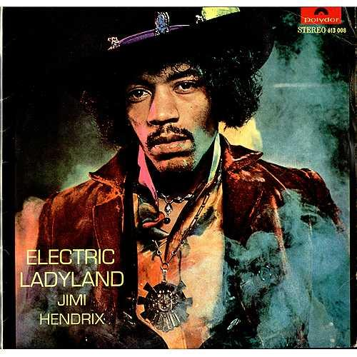
ALBUMS
May 12 1967
Jan 15 1968
Sep 16 1968
*click on the picture of each album to listen to them*

Slide 26
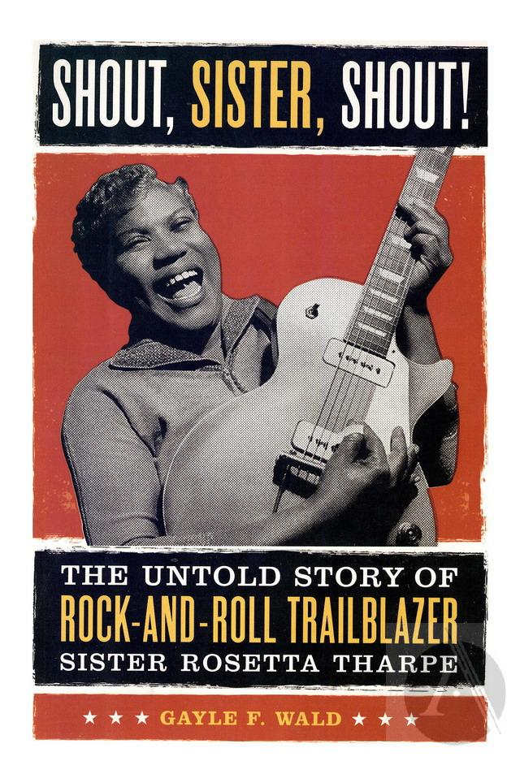
Other music of the period - Sister Rosetta Tharpe
African American singer, songwriter, and guitar virtuoso.
Main genre: Gospel with mixture of jazz and rhythms and blues
She is the first ever gospel crossover artist and was referred as “The Original Soul Sister”
Also called the Godmother of Rock n’ Roll
Even until today, there is no other American women can compare the Tharpe smooth flow of sound.
Invented the guitar playing technique that later evolve to rock and roll style adopted by Chuck Berry, Elvis Presley, and Eric Clapton
Toured until her death in 1973
(Sister Rosetta Tharpe, 2014)

Slide 27
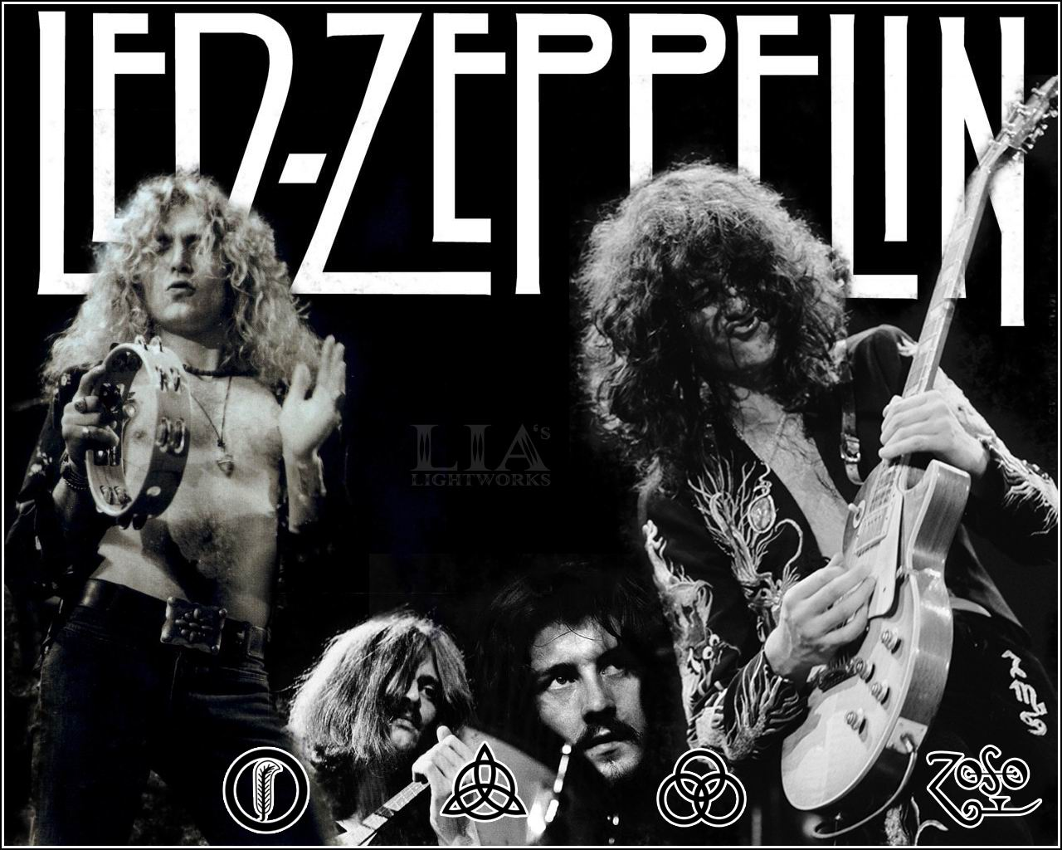
Other music of the period - Led Zeppelin
Formed in 1968 by former member of Yardbirds, Jimmy Page, went on to form a group called New Yardbirds. Later changed to Led Zeppelin, named after their first and wildly successful album.
The band consists of Robert Plant, John P Jones, and John Bonham. Like Yardbird band in the past, Led Zeppelin used a guitar style that drew heavily on the blues. Their music style is very much alike with Jimi Hendrix with a bit of distortion, feedback, reverberation, and out-and-out noise in their songs and performances.
While active from 1968 to 1982 , the band released 9 albums and were considered the most one of the most successful, innovative and influential rock groups in history.
Inducted as Rock n’ Roll Hall of Fame in 1995
(Led Zeppelin Biography, 2001)

Slide 28
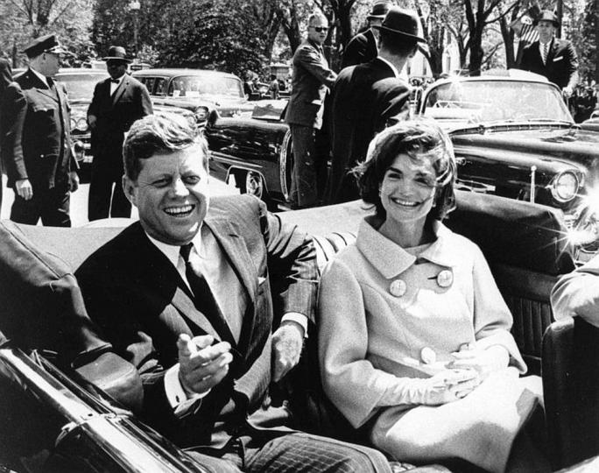
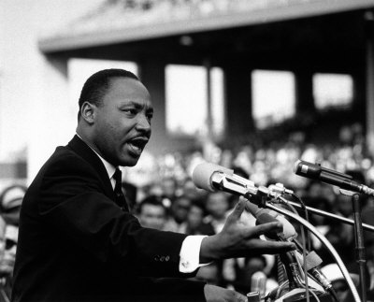
Political & Social Event
(Goodwin, 2011)
In 1966, Equality of Educational Opportunity was published, forced integration and busing in 1970s.
The Civil Rights movement in 1960s
Assassination Martin Luther King and Malcolm X shook the nation and inspirer many artists.
1963 - President John F Kennedy is assassinated in Dallas, Texas
US troops sent to Vietnam
many protest and rebellion throughout.
Artists especially folk

Slide 29
In Conclusion
Jimi Hendrix applied his appreciation of Jazz, and R&B into his style of Blues Rock and Rock ‘n’ Roll. His early lyrical style was influenced by Bob Dylan a noted Folk artist, but unlike Folk Music, Hendrix’s melodies were complicated using diverse cord combinations.
(Rolling Stone, 2014) (PBS, 2013)

Slide 30
He opened the door for electric guitarists to explore unique sounds and melodies using controlled distortion. Jimi did not view the electric guitar as another musical instrument, but as a source for electronic sound. He was not only a gifted musician but a skilled songwriter, and no other musician at the time could match his outrageous gift.
(Rolling Stone, 2014) (PBS, 2013)

Slide 31
Jimi Hendrix had a short lived music career but is one of the most well known guitarists in rock history. His use of experimental guitar forms and improvisation transformed him into a legend. His ability to learn solely by ear and his unique style of playing have become iconic for his time period.
(Rolling Stone, 2014) (PBS, 2013)

Slide 32
Photograph/Video URLs
Slide 1: http://choffman36.deviantart.com/art/Jimi-Hendrix-vector-collage-338617867
Slide 2 treble clef symbol: http://laisla.webstarts.com/meet_la_isla.html
Slide 3: http://www.rollingstone.com/music/lists/100-greatest-guitarists-20111123/jimi-hendrix-20120705
Slide 5: http://www.dailymail.co.uk/news/article-2239775/Jimi-Hendrixs-favourite-guitar-switched-setting-cheaper-version-sells-250-000.html
Slide 6: http://www.guitarworld.com/album-stream-jimi-hendrix-experience-live-berkeley
Slide 7: http://skoodmusic.com/2013/01/13/jimi-hendrix-around/
Slide 8: http://www.genesis-publications.com/hendrix/
Slide 9:
Left: http://www.thefamouspeople.com/profiles/jimi-hendrix-183.php
Middle: http://www.telegraph.co.uk/travel/destinations/europe/uk/london/7992020/Jimi-Hendrixs-London.html
Right: http://the100.ru/en/lovers/jimmy-hendrix.html
Slide 10: http://rebloggy.c om/post/jimi-hendrix-the-jimi-hendrix-experience-noel-redding-mitch-mitchell/65406892724
Slide 11:
Left: http://www.thebeatles.com/news/beatles-are-itunes-radio-
Right: http://The_Jimi_Hendrix_Experience#mediaviewer/File:Jimi_hendryx_experience_1968.JPG
Slide 12:
Top: http://proseworks.blogspot.com/2012/12/paul-simon-is-not-really-rock.html
Bottom: http://www.jacarandafm.com/post/jimi-hendrix-tribute/
Slide 13:
Left: http://www.theguardian.com/music/2010/aug/08/jimi-hendrix-40th-anniversary-death
Right: http://www.groovydad.co.uk/?paged=2
Slide 14: http://www.youtube.com/watch?v=ExSNjdGtTBc
Slide 16: https://www.youtube.com/watch?v=DpkDdLZGg30

Slide 33
Photograph/Video URLs Cont.
Slide 22:
Middle: http://www.jonolivermusic.com/category/music-appreciation/vinyl-recordings/page/2/
Right: http://emilydarlinginla.blogspot.com/2011/11/bob-dylan-album-covers.html
Slide 23:
Left: http://chicksinthehuddle.com/2013/02/06/espn-turns-athletes-into-music-superstars/
Right: http://www.ladazehollywoodnights.com/legends-pioneers-and-trail-blazers/album-beastie-boys-check-your-head/
Slide 24: http://cdn2-b.examiner.com/sites/default/files/styles/image_content_width/hash/56/b6/56b635cbb8aff8d3f8fa2eb81d6b0f27.jpg?itok=ereEzsn8
Slide 25:
album picture
1 and 2 http://callmeredtelephone.blogspot.com/2011/01/psychedelic-album-cover-art.html,
3 http://quoteko.com/jimi-hendrix-electric-ladyland-peru-vinyl-album-record.html
video link:
Are you experienced? http://www.youtube.com/watch?v=RK8N6DjJccc
Bold As Love http://www.youtube.com/watch?v=vQY26kcbDDc
Electric LadyLand http://www.youtube.com/watch?v=CbS6M5rcemo
Slide 26: http://rockhall.com/media/assets/images/originals/2c9/595/6a626c.jpg
Slide 27: http://www.chachaandspoons.com/wp-content/uploads/2013/06/zep.jpg
Slide 28 (from left to right) http://jewishcurrents.org/wp-content/uploads/2010/10/anti-war_vietnam_war_protest_rally.jpg
http://firstconvention.org/wp-content/uploads/2013/11/9043907-standard.jpg
http://images.nationalgeographic.com/wpf/media-live/photos/000/140/cache/05-martin-king-010909_14089_600x450.jpg
http://cdn.ph.upi.com/sv/b/upi/UPI-41021384680600/2013/1/835a5d06b0ec684a3c26cca76a51143e/The-Issue-The-Kennedy-assassination-did-the-mob-do-it.jpg

Slide 34
References
Cross, Charles R. (2005). A Room Full of Mirrors: A Biography of Jimi Hendrix. New York, NY: Hyperion.
Experience Hendrix. (2013). Jimi Hendrix Biography. The Official Jimi Hendrix Website. Retrieved June 26, 2014, from http://www.jimihendrix.com/us/jimi
Goodwin, S. (2011, January 1). American Cultural History. - 1960. Retrieved July 2, 2014, from http://kclibrary.lonestar.edu/decade60.html
Herb, B. (2001, January 1). Jimi Hendrix. Home. Retrieved July 1, 2014, from http://www.reasontorock.com/artists/jimi_hendrix.html
Hicks, M. (2000). Sixties Rock: Garage, Psychedelic, and Other Satisfactions (p. 51). University of Illinois Press.
Jimi Hendrix Biography. (2013). PBS. Retrieved June 30th, 2014, from http://www.pbs.org/wnet/americanmasters/episodes/jimi-hendrix/jimi-hendrix-biography/2743/
Kemp, Mark. (2014). Jimi Hendrix Biography. Rolling Stone. Retrieved June 26, 2014 from http://www.rollingstone.com/music/artists/jimi-hendrix/biography
Led Zeppelin Biography | Rolling Stone. (2001, January 1). Rolling Stone. Retrieved June 29, 2014, from http://www.rollingstone.com/music/artists/led-zeppelin/biography
Light, A. (2007). LONDON. Rolling Stone, (1030/1031), 64-137.Periodical.

Slide 35
References Cont.
Murray, Charles Shaar. (1989). Crosstown Traffic: Jimi Hendrix & the Post-War Rock ‘N’ Roll Revolution. New York, NY: St. Martin’s Press.
Murray, C. (2013, December 17). Jimi Hendrix (American musician). Encyclopedia Britannica Online. Retrieved July 1, 2014, from http://www.britannica.com/EBchecked/topic/261208/Jimi-Hendrix
Reyes, D. (2004, February 19). 'Jimi Hendrix: The Lyrics'. New York Amsterdam News. (p. 33).
Sister Rosetta Tharpe. (2014). The Biography.com website. Retrieved 09:31, Jun 28, 2014, from http://www.biography.com/people/sister-rosetta-tharpe-17172332.
The Rock and Roll Hall of Fame + Museum. (2014, January 1). Jimi Hendrix. Retrieved July 1, 2014, from https://rockhall.com/exhibits/featured-collections/jimi-hendrix/
Wald, G. F. Shout, Sister, Shout!: The Untold Story of Rock-and-Roll Trailblazer Sister Rosetta Tharpe. Journal Article.
Owen, Frank, and Simon Reynolds. "Why Hendrix Still Matters." SPIN Apr. 1991: 28+. Web.
Unterberger, Richie. (2009). The Rough Guide to Jimi Hendrix. London: Rough Guides.

