Slide 1
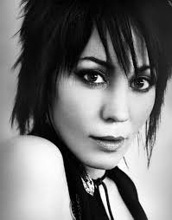
Joan Jett
Group 1
Sara Larson, Olivia Rezac, Hannah Weber, Brittney Whited
Picture: http://www.ticketmaster.com/Joan-Jett-tickets/artist/735389

Slide 2
Introduction
Joan Jett was a popular musical icon of the 1980’s. She is widely recognized for her hit “I love Rock n’ Roll” , her punk rock appearance, and attitude. Our group picked Joan Jett as our topic because there has been little female representation in this class, and we wanted to diversify the sample of musicians.
https://www.reddit.com/r/OldSchoolCool/comments/3zic4d/joan_jett_circa_1980/

Slide 3
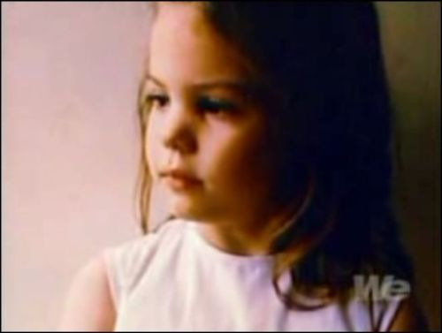
Joan Jett -Early Years
Joan was born September 22, 1958, in Philadelphia Pennsylvania.
She was born into an everyday run-of-the mill family. Her mother was a secretary, and her father worked for insurance.
During grade school their family moved to Baltimore and then southern California in her early teens.
https://www.pinterest.com/artofprogress/joan-jett/

Slide 4
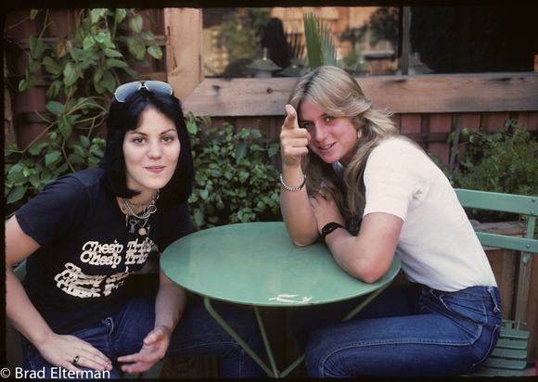
Joan Jett- Early Years
When Joan was 14 years old she received her first guitar for Christmas, and her love for music creation began.
She took lessons, but was unsatisfied because the lessons revolved around folk music, which was not her interest at all.
http://www.vintag.es/2013/06/joan-jett-of-runaways-in-los-angeles.html

Slide 5
Joan Jett Musical Timeline
Joan Jett and the Blackhearts
The Runaways
Joan Jett: Solo Artist

Slide 6
Joan Jett-The Runaways
Joan formed her first band at the young age of 15 called The Runaways. Their band was highly criticized because it was an all female punk rock group that sang about sex and partying. On top of that, they also wore lingerie and jumpsuits during their performances. Needless to say they were not well accepted into the mainstream music scene.
Joan Jett-Guitar & vocals
Sandy West-Drums
Cherie Currie-Lead vocals
Jackie Fox-Bass guitar
Lita Ford-Guitar
http://www.usmagazine.com/celebrity-news/news/joan-jett-cherie-currie-weigh-in-on-jackie-foxs-rape-allegations-2015137

Slide 7
Joan Jett-The Runaways
The Runaways first self-titled album was released in 1976. Though the album was highly rejected in the mainstream music scene, the song “Cherry Bomb” was a big hit in the punk scene.
The following year they released yet another album titled “Queens of Noise” which was also not well accepted in the US. However, this album was a big hit in Japan.
After the second album two band members left, and Joan and the others squeezed out two more albums before their demise.

Slide 8
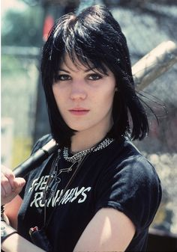
Joan Jett- Going Solo
After The Runaways ended Joan decided to travel to England to work with former Sex Pistols musicians Paul Cook and Steve Jones to initiate her solo career.
During this time, Joan dabbled in other things too like acting and producing. In her time spent producing, she crossed paths with another producer named Kenny Laguna and a songwriter named Ritchie Cordell, both whom helped Joan complete her first solo album.
https://clothescloture.wordpress.com/2015/07/11/joan-jett-godmother-of-punk/

Slide 9
Joan Jett-Going Solo
After completing her solo album she tried and failed with 23 different record labels to sign her.
The remaining solution was clear to her and Kenny Laguna. They founded their own record label they named Blackheart Records in 1980. Joan Jett and Kenny did all the grunt work, and printed/distributed all the records on their own. They would just sell the records at her performances for people to purchase.
One of the records being sold at a show was purchased by someone from Boardwalk records which was released as “Bad Reputation”. At the time it seemed like a stroke of good luck, but unfortunately the record didn’t do very hot.

Slide 10
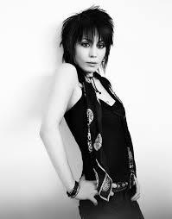
Appearance
Short Black Hair
Heavy Mascara
Dark Clothes
Tight Leather Pants
Photo Credit: https://www.samvilla.com/pro/blog/jett-channeling-side-sweeping-fringes-crowns-that-pop/

Slide 11
Joan Jett-Finally Fame
Despite her first solo record being a flop, she pushed forward with another album titled “I Love Rock ‘n’ Roll”, and finally her edgy pop-rock sound caught on. She soared up the pop charts making it into the top 40’s in 1982.
Two more of her songs “Crimson and Clover” and “Do You Wanna Touch Me” were also big hits during 1982.
Beyond this album came a couple more album releases, but alas, did not do well. Making her one album a big hit.
http://thegiant.org/wiki/index.php/Joan_Jett_Pop

Slide 12
I Love Rock and Roll

Slide 13
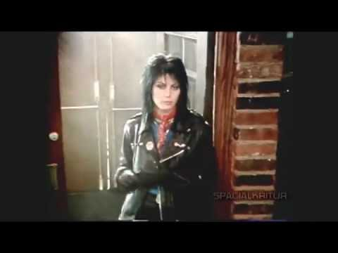
“I Love Rock and Roll” Lyrics
I saw him dancin' there by the record machine
I knew he must a been about seventeen
The beat was goin' strong
Playin' my favorite song
An' I could tell it wouldn't be long
Till he was with me, yeah me,
An' I could tell it wouldn't be long
Till he was with me, yeah me, singin'
I love rock n' roll
So put another dime in the jukebox, baby
I love rock n' roll
So come an' take your time an' dance with me
He smiled so I got up and' asked for his name
That don't matter, he said,
'Cause it's all the same
Said can I take you home where we can be alone
An' next we were movin' on
He was with me, yeah me
Next we were movin' on
He was with me, yeah me singin'
I love rock n' roll
So put another dime in the jukebox, baby
I love rock n' roll
So come an' take your time an' dance with me
Said can I take you home where we can be alone
Next we're movin' on
He was with me, yeah me
And we'll be movin' on
An' singin' that same old song
Yeah with me, singin'
I love rock n' roll
So put another dime in the jukebox, baby
I love rock n' roll
So come an' take your time an' dance with me
I love rock n' roll
So put another dime in the jukebox, baby
I love rock n' roll
So come an' take your time an' dance with
I love rock n' roll
So put another dime in the jukebox, baby
I love rock n' roll
So come an' take your time an' dance with
I love rock n' roll
So put another dime in the jukebox, baby
I love rock n' roll
So come an' take your time an' dance with
I love rock n' roll
So put another dime in the jukebox, baby
I love rock n' roll
So come an' take your time an' dance with me
Picture from “I Love Rock and Roll” Music Video

Slide 14
Analysis of “I Love Rock and Roll”
Meter
The song has beats that are grouped into sets of three
This means that the song is triple meter
Beat Subdivisions
The beats are divided into three equal notes
This makes the song’s beat subdivision triple subdivision
Musical Texture
One melody grabs the listener’s attention more than the others
The texture is homophonic, melody and accompaniment
Picture: http://www.clipartpanda.com/categories/music-note-border-clipart

Slide 15
Joan Jett- After The Fact
Moving forward into her adult years, Jett has always kept music in her life. She signs on new musicians to her record label, does some producing, acting, and even comes out with more of her own music, though doesn’t really attract mainstream audiences.
Jett’s music career evolved interestingly at a young age, and even though she wasn’t a lasting success, her hits are/will be known by past, present, and future generations.

Slide 16
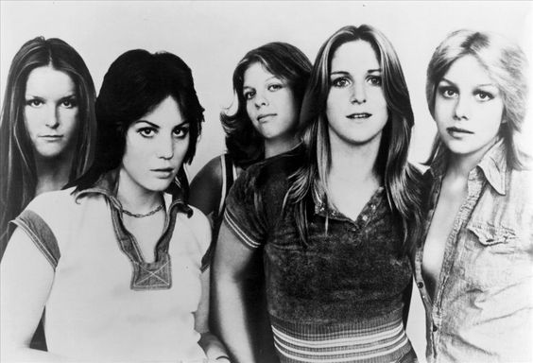
Musical Style
The Runaways:
The all-female group were not taken seriously for a large portion of their existence, but today are credited for inspiring an entire generation of young female rockers
The band had more success in underground punk circles and in Japan than in the mainstream American market, mostly for their mixed style of heavy metal and punk rock paired with their in-your-face lyrics about sex, alcohol, and life on the streets.
Photo credit: http://musicbloodline.info/artist/MN0000492275/spotify

Slide 17
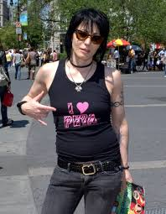
Musical Style
Jett is considered one of the
founders for the feminist-punk rock
movement
“People look at women differently”
she says
She wanted to make women equal
to men in the world of rock and roll
The goal of her music was to express
her emotions and show people that she
was not afraid to be herself as a woman
https://en.wikipedia.org/wiki/Joan_Jett

Slide 18
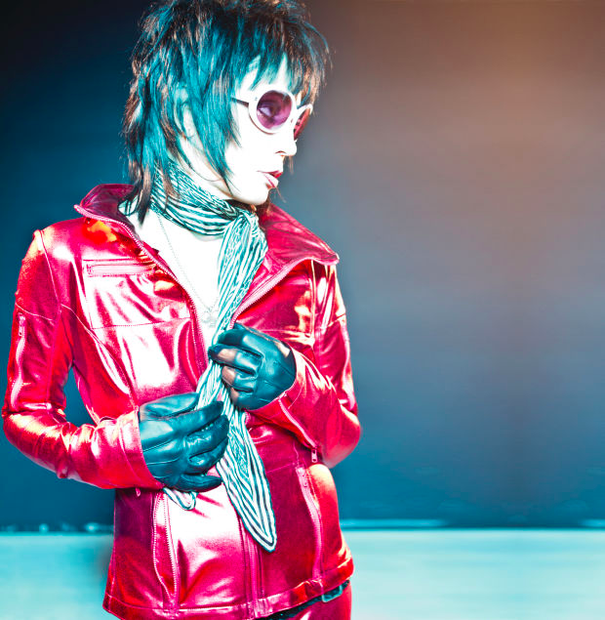
Musical Style
“The Queen of Rock and Roll”
Jett’s career has been described as, “a perfect collision of brass-knuckled trouble, punk rock sass, leather-clad sneers, indelible riffs, and perfect melodies” (Jensen 2015).
Her stripped-down take on hard rock has remained a constant as the market has shifted from punk to glam rock to hair metal to grunge.
“I just say I’m a rock and roller. And how do I want to be remembered? As one of the first women to really play hard rock and roll” (Uhelszki).
Photo credit: http://www.biography.com/news/joan-jett-rock-and-roll-hall-of-fame-interview

Slide 19
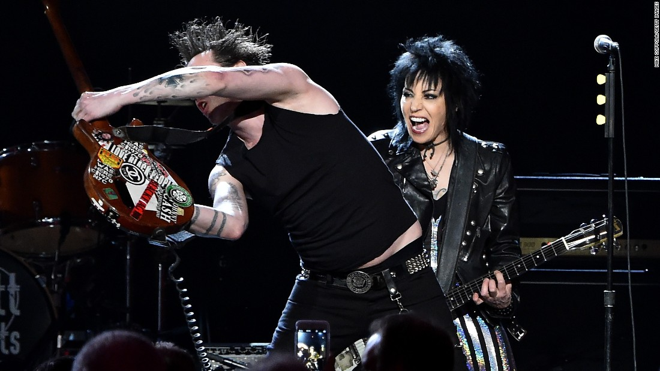
Inducted Into Rock and Roll Hall of Fame
Inducted in spring of 2015
Inducted along with Ringo Starr and Green Day
Miley Cyrus inducted Jett
Cyrus talked about how impressed she was with Joan Jett’s strength, wisdom, and soul
http://www.cnn.com/2015/04/19/entertainment/feat-rock-roll-hall-fame-billboard/

Slide 20
Influential Predecessors
Joan Jett was influenced by a variety of performers throughout her lifetime
While Jett claims to like most genres of music, she was heavily influenced by punk rock musicians
Although these musicians influenced her, Joan Jett had her own distinct sound and dreamed of starting her own band
Led Zeppelin, Black Sabbath, The Sex Pistols

Slide 21
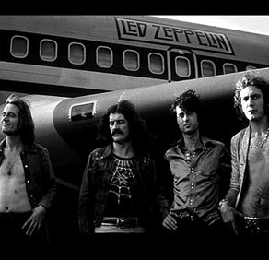
Musical Influences: Led Zeppelin
According to the Rock and Roll Hall of Fame, Led Zeppelin redefined Rock in the 70s and for all time
They impacted not only alternative rock musicians with their music, but classic rock as well
The group experimented with blues-rock form, but added in exotic flavors, with layered guitar work and thunderous drumming
https://rockhall.com/inductees/led-zeppelin/bio/

Slide 22
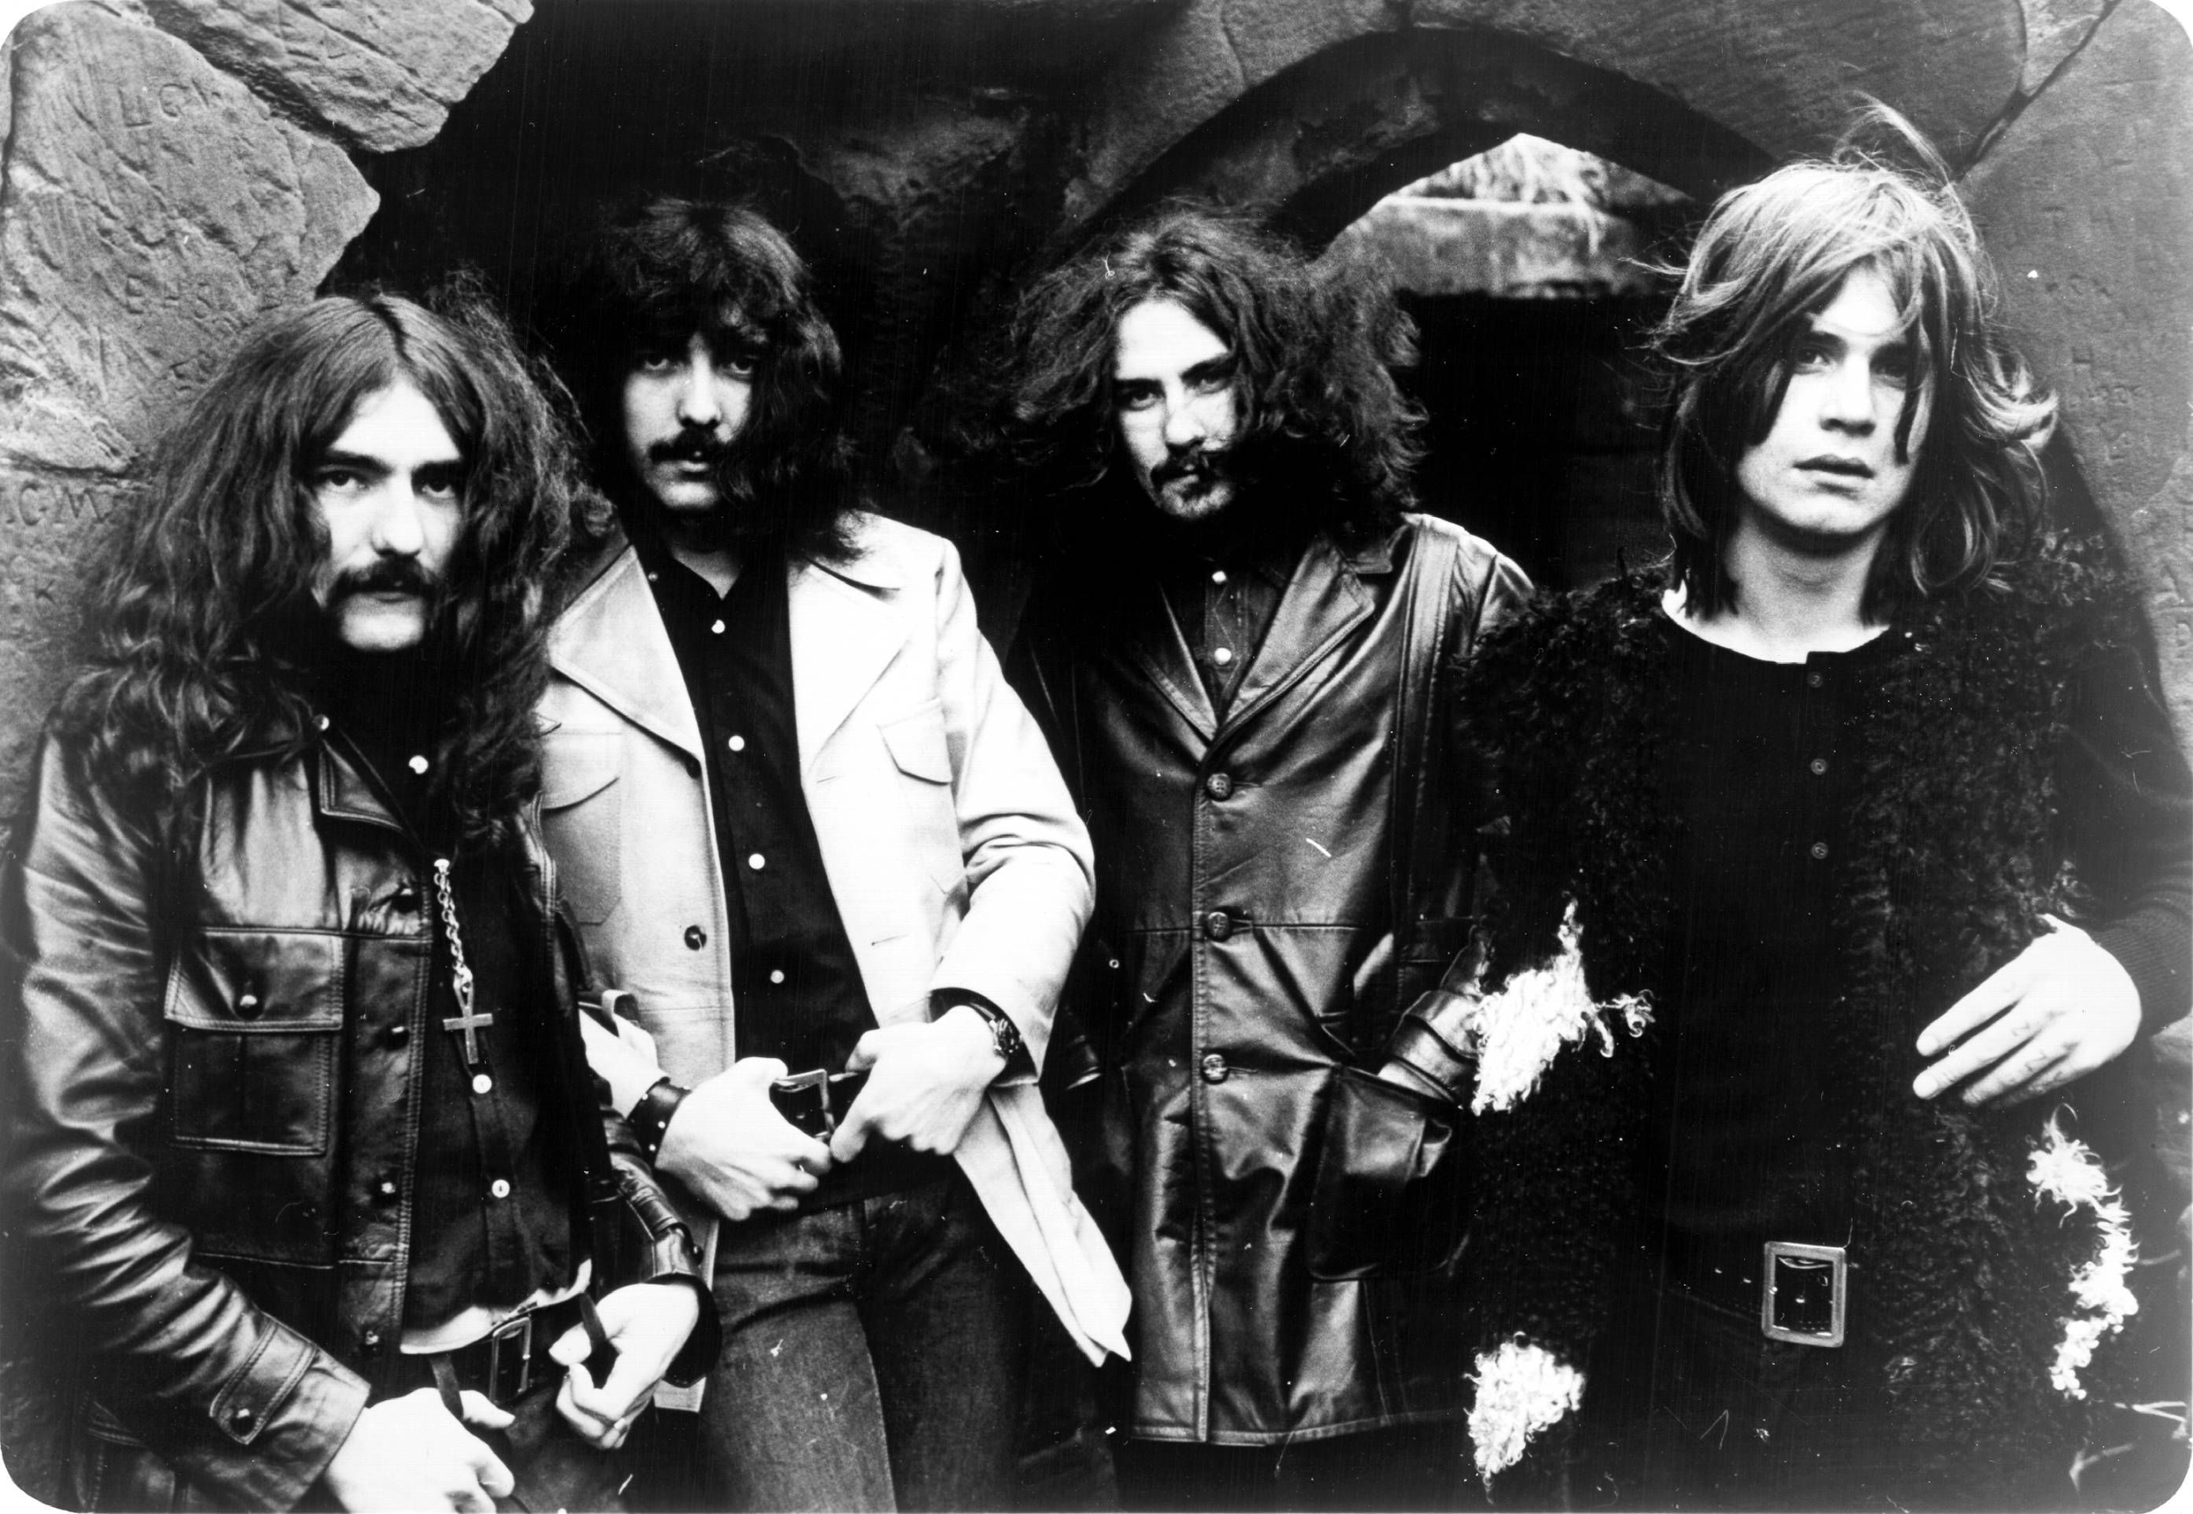
Musical Influences: The Black Sabbath
The Black Sabbath, according to The Rock and Roll Hall of Fame, is credited for the creation of heavy metal
Their extreme volume and dark subject matter embodied a heavy-metal aesthetic
They possessed an inventiveness and fluency that also made them a progressive-rock band as well
Their songs were lengthy, with frequent meter changes
https://upload.wikimedia.org/wikipedia/commons/4/42/Sabs.jpg

Slide 23
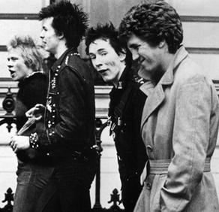
Musical Influences: The Sex Pistols
The Sex Pistols “ignited the Punk Revolution” according to the Rock and Roll Hall of Fame
The band was loud and dangerous, instilling a danger to rock music
There were often fistfights and flying bodies at their concerts
The group was scandalous and controversial, with taunting chants often added to their songs
“Actually, we’re not into music, we’re into chaos,” said guitarist Jones
https://rockhall.com/inductees/sex-pistols/bio/

Slide 24
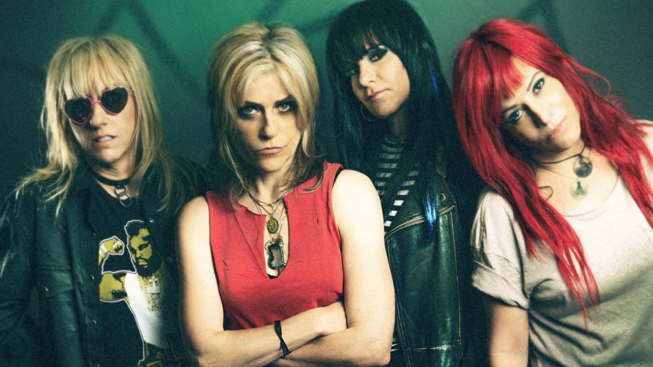
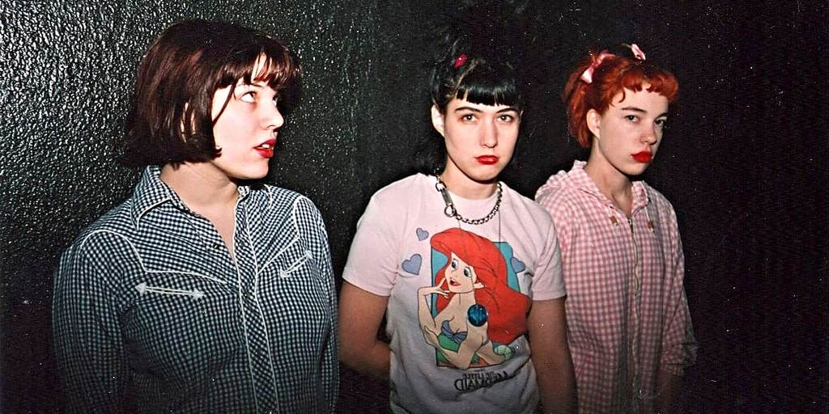
Artists Joan Jett Influenced
Considering Joan Jett was one of the first female rockers, she influenced a multitude of female rockers to follow
She was a fearless, young, controversial artist who paved the way for female musicians
Her perseverance proved that females can succeed in a male dominated industry
Bikini Kill, L7, The Gits, and many, many more
e
Left: L7
Below: Bikini Kill
http://cultureaddicts.com/wp-content/uploads/2016/03/1280x720.jpg
http://cdn0.dailydot.com/cache/ad/6b/ad6bfc5312bb0a5876086b9463f7cbee.jpg

Slide 25
“Girls see these defined roles they're supposed to follow in life, but when I was a young child, my parents told me I could be anything.”
-Joan Jett

Slide 26
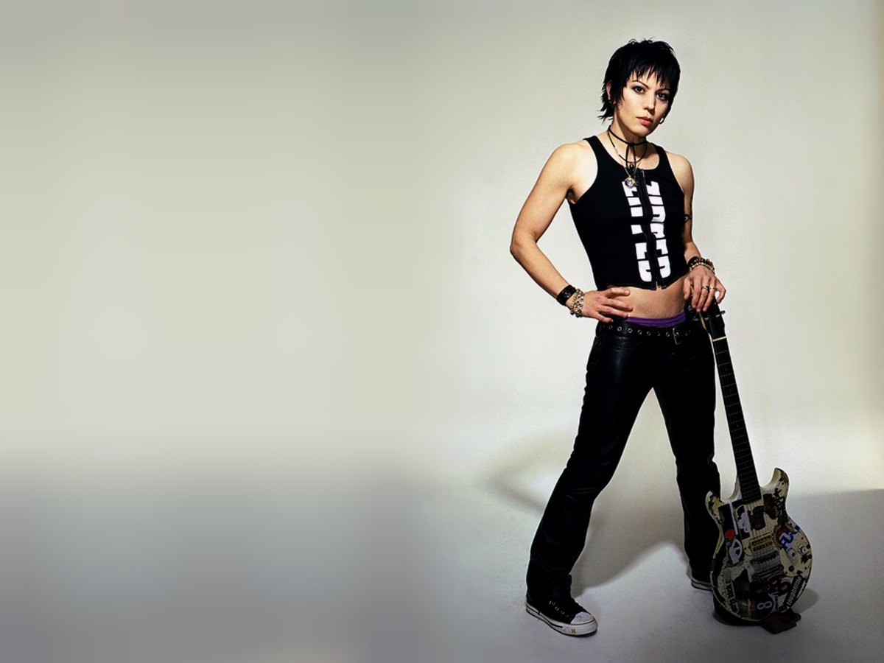
Conclusion:
Joan Jett served as an inspiration to a multitude of female musicians. Her rebellious attitude and strong passion for her music made her a role model for several artists that followed her. This artist paved the way for female singers in all genres, but especially those in rock and roll. She will remain an iconic symbol of the growth of rock and roll for decades to come.
http://innocentwords.com/celebrating-the-one-and-only-joan-jett/

Slide 27
References
"Famous Biographies & TV Shows." Bio.com. A&E Networks Television, n.d. Web. 26 June 2016.
Fricke, David. "Joan Jett: Built to Rock." Rolling Stone. Rolling Stone, 7 May 2015. Web. 25 June 2016.
Huey, Steve. “The Runaways - Biography.” All Music. N.p., n.d. Web. 27 June 2016.
Jensen, Todd Aaron. "Joan Jett on Being 'The Queen of Rock 'n' Roll' (INTERVIEW)." Bio.com. A&E Networks Television, 25 May 2015. Web. 27 June 2016.
Jett, Joan. I Love Rock and Roll. Joan Jett. Mickie Most, 1981. CD.
"Joan Jett and the Blackhearts." Stanislaus County Fair. Stanislaus County Fair, 23 Jan. 2014. Web. 25 June 2016.
"Joan Jett Quotes." Brainy Quote. Brainy Quote, 2001-2016. Web. 28 June 2016.
Kemp, Mark. "Rolling Stone – Music, Movies, TV, Politics, Country, and Culture." Rolling Stone. The Rolling Stones Encyclopedia, 2001. 26 June 2016.

Slide 28
References
Lipscomb, Dr. Scott D. "History & Styles of Rock." Dr. Scott D Lipscomb, n.d. Web. 13 June 2016.
Parker, Chris. "Rock and Roll Hall of Fame Inducts Ringo Starr, Green Day, Joan Jett." CNN Entertainment. CNN, 21 Apr. 2015. Web. 27 June 2016.
Shmoop Editorial Team. (2008). Joan Jett and the Blackhearts Influences. Retrieved June 25, 2016, from http://www.shmoop.com/i-love-rock-n-roll/influences.html
The Rock and Roll Hall of Fame Museum. (n.d.). Retrieved June 28, 2016, from https://rockhall.com/inductees/
Thompson, D. (2011). Bad reputation: The unauthorized biography of Joan Jett. Milwaukee, WI: Backbeat Books.
Uhelszki, Jaan. "The Rock and Roll Hall of Fame + Museum." Joan Jett & the Blackhearts Biography. Rock and Roll Hall of Fame, n.d. Web. 27 June 2016.
Villa, Sam. "Jett Channeling- Side Sweeping Fringes & Crowns That Pop." Sam Villa Professional. FJ Solutions, n.d. Web. 26 June 2016.

