Slide 1
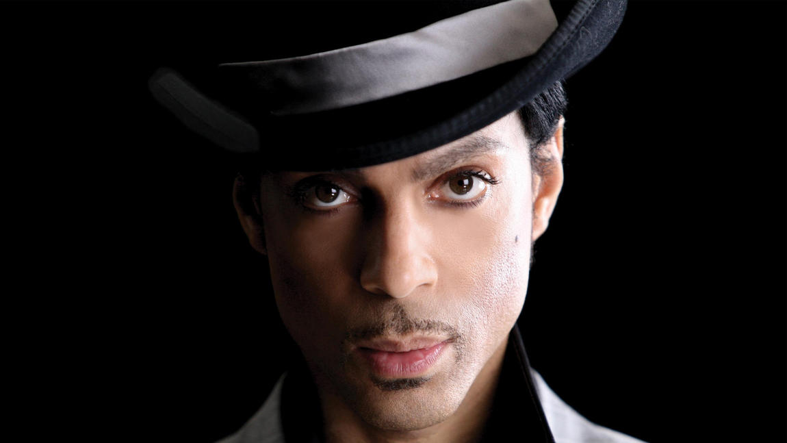
Prince Rogers Nelson
By Elizabeth Ting, Hosam Alkhatib, Cody Komorouski, and Hannah Gibson

Slide 2
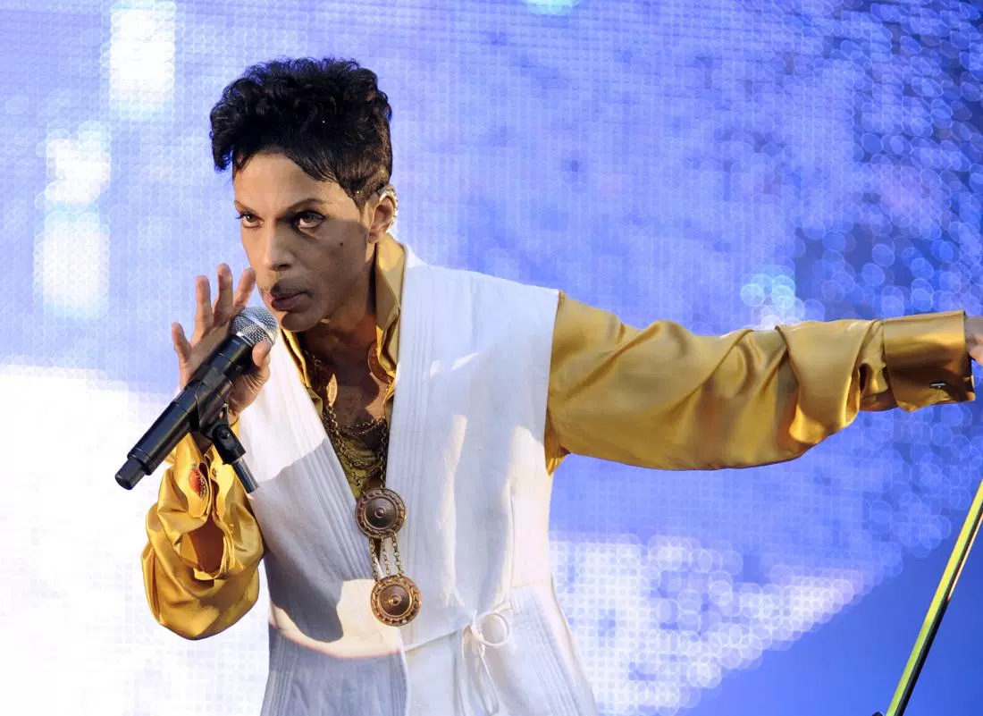
Our Interests In Prince
We decided to create a presentation on Prince because has left an absolutely incredible legacy behind in music. With the tragedy of his recent death, Prince has again been in the headlines and the impacts he made in music are being appreciated. Prince was a highly innovative pop, contemporary R&B, and rock artist, so we wanted to uncover the aspects of his music and style that made him such an influential artist.

Slide 3
Prince, A Short Biography...
The musical icon known as Prince was born on June 7, 1958 as Prince Rogers Nelson, in Minneapolis, Minnesota. Prince became interested in music at a young age, perhaps due to the fact that both of his parents were musicians. He taught himself to play the piano, guitar and the drums. After his parents split up when he was ten, he and his sister divided their time among their parents. Eventually Prince ran away, moving in with “The Anderson Family,” his next door neighbors. In high school Prince formed his band, known as Grand Central. Not until late in his musical career did Prince reveal that as a child he suffered from epilepsy, which he went on to claim was cured by an angel.

Slide 4
Biography, cont….
In 1978 Prince signed with Warner Bros and released his first album, in which he played almost every instrument on. He would go on to make numerous albums, and in 1984 Prince would win an Academy Award for best original song score for his hit Purple Rain. Prince had a number of high and low profile relationships. When he was 37 he married his backup dancer, Mayte Garcia, on Valentine's Day 1996. The two had a son together, he was born with Pfeiffer syndrome, and he died a week after birth. Prince and Garcia divorced in 1999, and in 2001 he married Manuela Testolini. They divorced in 2006. Prince was a vegan, and he was a longtime animal rights activist.

Slide 5
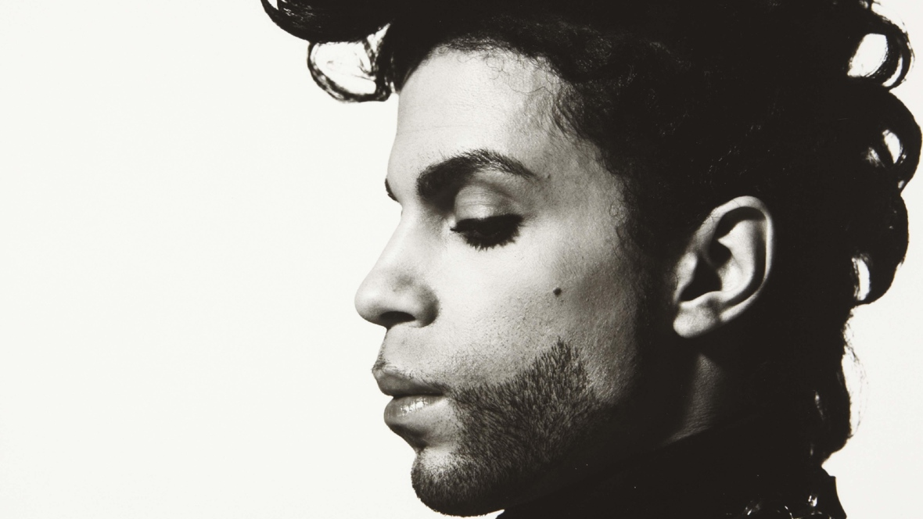
Biography,
Cont….
In 2001 Prince joined the Jehovah’s Witnesses. He attended religious meetings at a local hall, and it is said that he would sometimes knock on doors to discuss the faith.

Slide 6
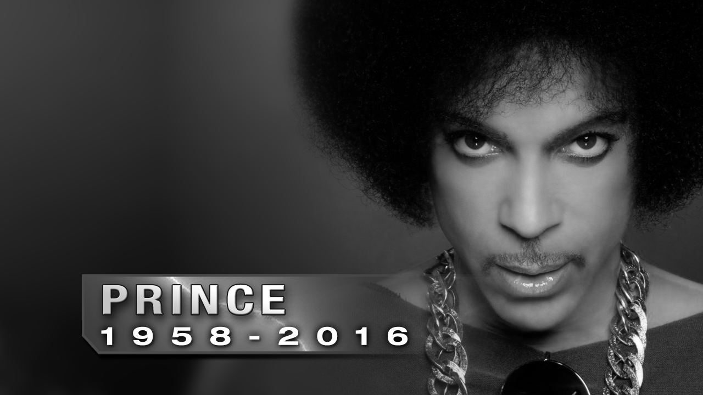
Prince’s Death
On April 21 at 9:43 a.m., a call was made to 911 from Prince’s Paisley Park residence. A man was found unconscious in an elevator, that man was later revealed to be Prince. Prince died of an accidental Fentanyl overdose at the age of 57. Since Prince’s death Paisley Park has hosted thousands upon thousands of mourners, coming to pay their respect to one of the greatest artists who ever lived.

Slide 7
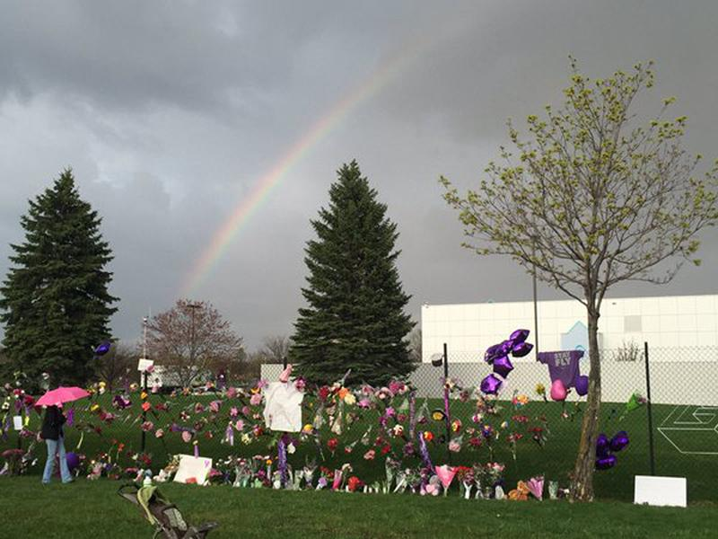
Mourners gather to remember Prince shortly after his announced death.

Slide 8
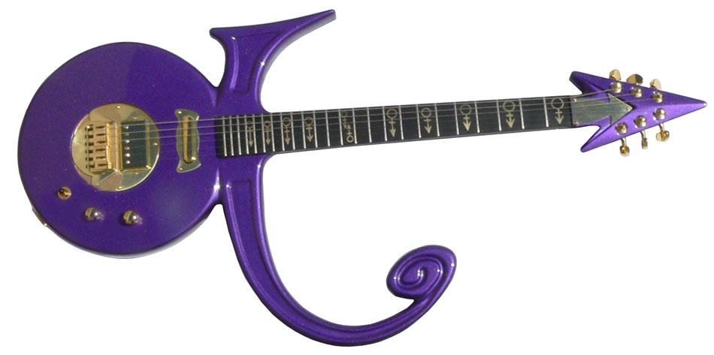
Prince’s Musical Style
Prince took pride in mastering multiple instruments
Guitar
Piano
Drums
Bass
Saxophone
Many more...
Prince is known to have crossed many types of musical genres, sometimes within a single song
Funk
Acid Rock
Mainstream Rock
R&B
Pop
Disco
Prince was also known for his vocal range, transitioning from falsetto to baritone with ease
Notes:
http://www.latimes.com/entertainment/music/posts/la-et-ms-prince-versatility-united-pop-genres-20160421-story.html

Slide 9
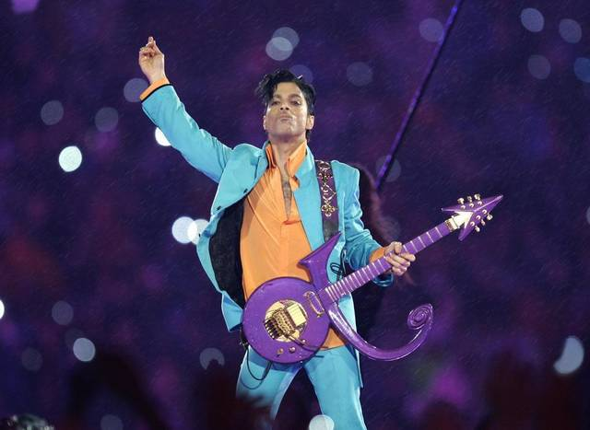
Prince’s Unique Style
Refused to comply with society’s idea of masculinity
Wore tight pants, high-heels, crop tops, and other cross gender items
Charismatic performer who used flirtation to create his character
Embraced sexuality in all forms, becoming the sex icon of his generation
Notes:
http://www.cbc.ca/news/arts/prince-musical-legacy-1.3548053

Slide 10
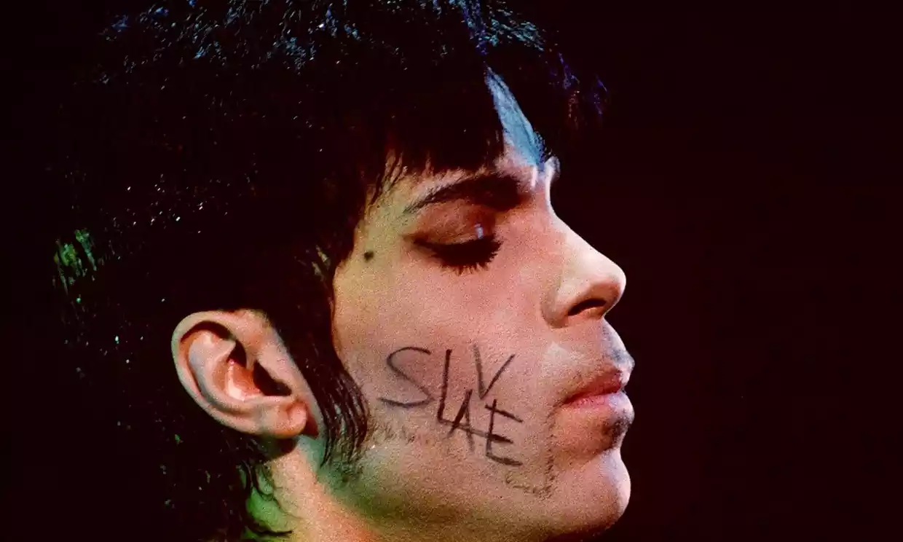
Prince and the Evolution of Rock & Roll
Prince was the embodiment of versatility and experimentation. He is also a perfect illustration for the struggle between record labels and musicians. He has shown future musicians that learning, experimentation, and fighting for your work is what makes an artist great.
Notes:
http://pitchfork.com/thepitch/1117-heres-every-battle-prince-waged-against-the-internet-and-the-music-industry/

Slide 11
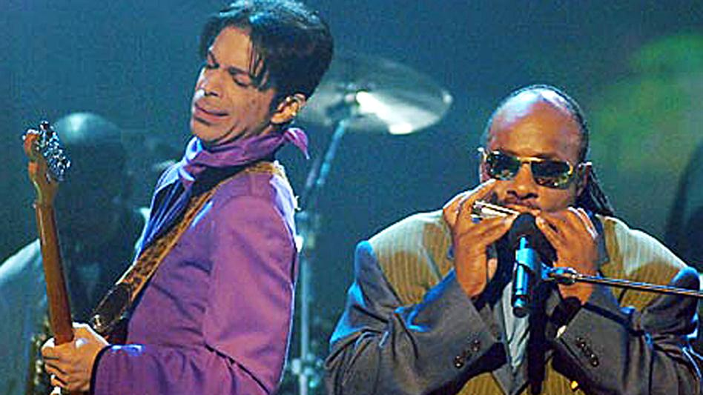
Musical Influences
Carlos Santana
Joni Mitchell
Jimi Hendrix
Larry Graham
Sly and The Family Stone
Stevie Wonder
Notes:
http://theboombox.com/deconstructing-prince-part-1-his-musical-influences/

Slide 12
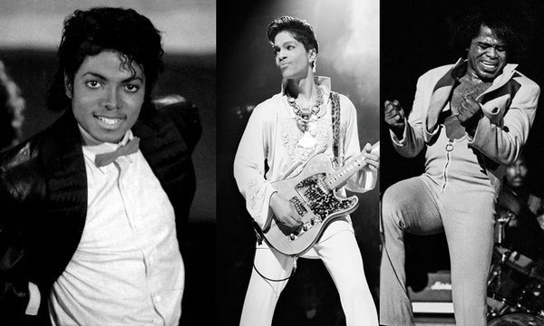
Musical Influences
James Brown
Known as the “Godfather of Soul”
Funk/ Soul/ R&B artist
Strong social activist
Racial equality
Education for the underprivileged
“James Brown played a big influence in my style. When I was about 10 years old, my stepdad put me on stage with him, and I danced a little bit until the bodyguard took me off” --Prince
Notes:
http://www.biography.com/people/james-brown-9228350#early-life-in-georgia

Slide 13
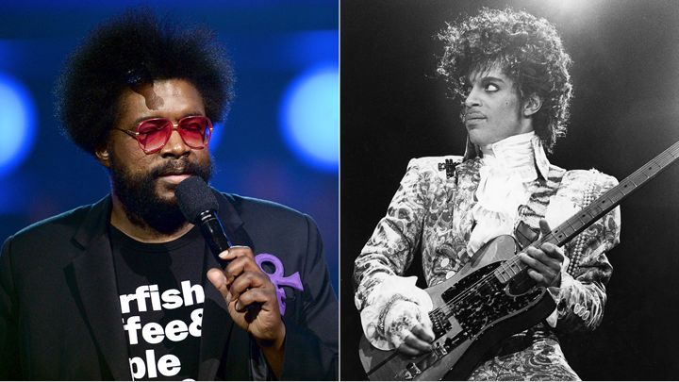
Artists Influenced by Prince
Questlove
Co-founder and drummer of the Roots
Hip-hop, soul music
Plays in the house band for Late Night with Jimmy Fallon
“Much of my motivation for waking up at 5 a.m. to work-and sometimes going to bed at 5 a.m. after work- came from him...Whenever it seemed like too steep a climb, I reminded myself that Prince did it, so I had to also.”
--Questlove
Notes:
http://pitchfork.com/news/65056-questlove-writes-essay-about-princes-music-and-influence/
http://www.biography.com/people/questlove-20734127

Slide 14
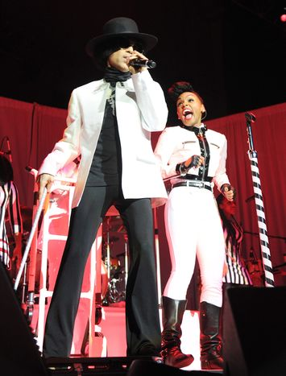
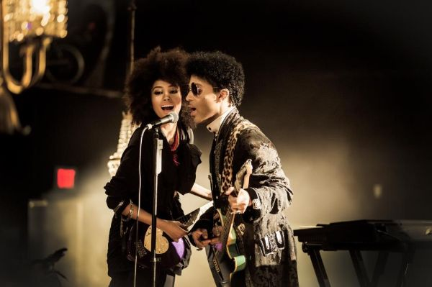
Artists Influenced by Prince
Janelle Monae
-R&B artist
-Appeared in musical
productions of The Wiz and
Cinderella
-Prince appeared
on her album The
Electric Lady (2013)
“He’s been in the industry for a really long time, he’s smart, and he’s constantly reinventing himself. I just hope when I reach that many years in the game I can still be as passionate as he and giving to new artists as he is”
--Janelle Monae

Slide 15
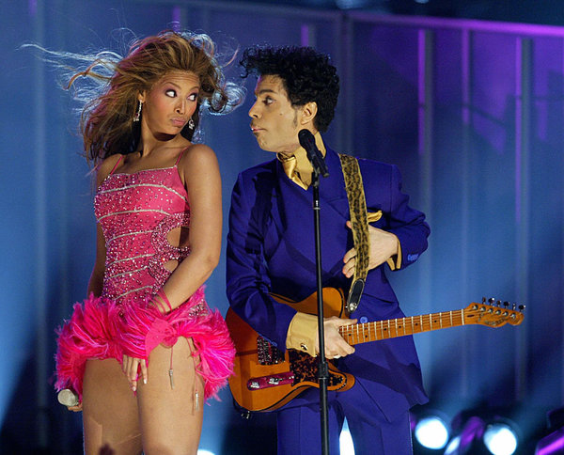
Artists Influenced by Prince
Beyoncé
Began career in R&B group Destiny’s Child
By 2013, she had won 16 Grammy Awards
Performed at two Super Bowls
Tied for the most No.1 hits on the Pop chart (2010)
On performing with Prince at the 46th Annual Grammy Awards…
“That night with Prince, I was just in a trance. I don’t remember anything after I walked through the smoke onstage. I was definitely Sasha Fierce that night, completely free.”
--Beyoncé

Slide 16
Artists Influenced by Prince
Justin Timberlake
“Prince, to me, is the ultimate artist. The thing that I love about Prince is he really makes his own rules, and I think that in creating something like music, you really shouldn’t have any rules”
--Justin Timberlake
The Weeknd
“Prince was always just pushing the envelope. Michael was doing that too, but he wasn’t as experimental. Prince turned experimental music into pop music.”
--The Weeknd
Notes:
http://www.huffingtonpost.com/entry/11-artists-capture-prince-influence_us_571934dce4b0d0042da8a574

Slide 17
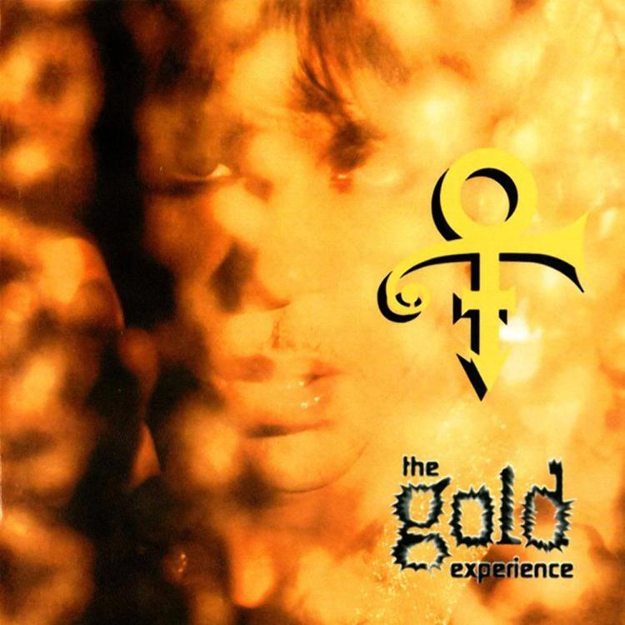
Prince’s Thoughts on Critics
Prince did not think highly of music critics throughout his career and had little regard for them
In 1982 Prince recorded the cynical “All the Critics Love U in New York”
He described writers as ‘mamma-jamma(s) wearing glasses and an alligator shirt behind a typewriter’
On The Gold Experience Prince wrote “Billy Jack Bitch” which was a direct stab to one local journalist who gave him negative feedback.

Slide 18
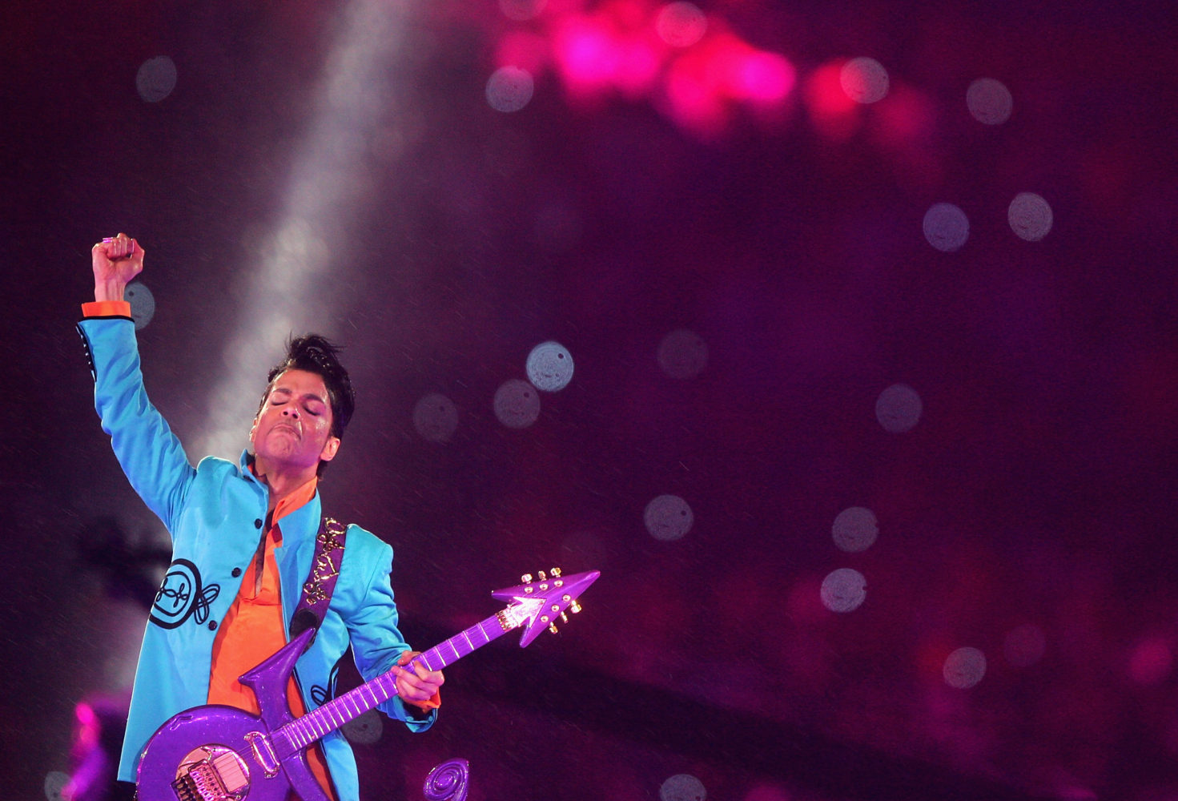
Other Music of the Period - 1980s
A major part of Prince’s appeal and success was due to his drastic self-reinvention during the last half of 1983 and first half of 1984. He had a sound that was familiar to those of experimental R&B musicians of the time, yet was remarkably unique at the same time. His music sounded like it was from an alternate reality or from the near future, and people were eager to embrace it.

Slide 19
1980s Music - Pop and Contemporary R&B
Pop
As the disco-style genre of pop began to decline in popularity during the 1980s, the pop genre began to favor lighter synthpop production, leading to dance-pop music.
R&B
Contemporary R&B began taking shape in the 1980s as musicians began adding disco-like beats, new electronic production technologies, and aspects of hip hop, soul and funk to rhythm and blues.

Slide 20
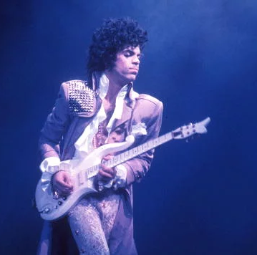
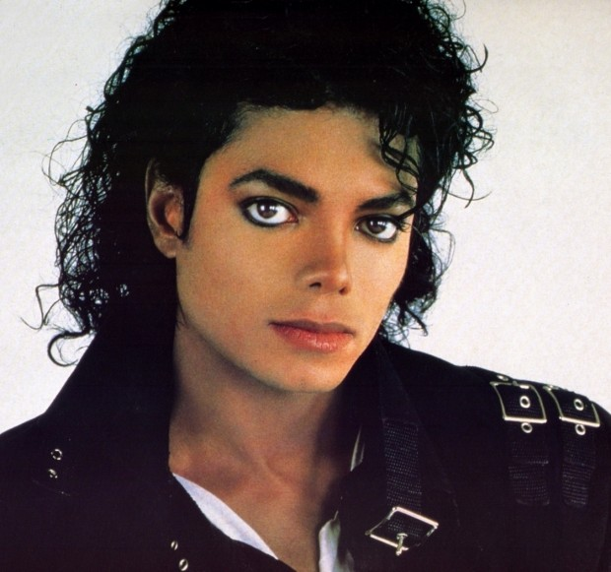
Popular Musicians of the 1980s
Madonna
Michael Jackson
Prince

Slide 21
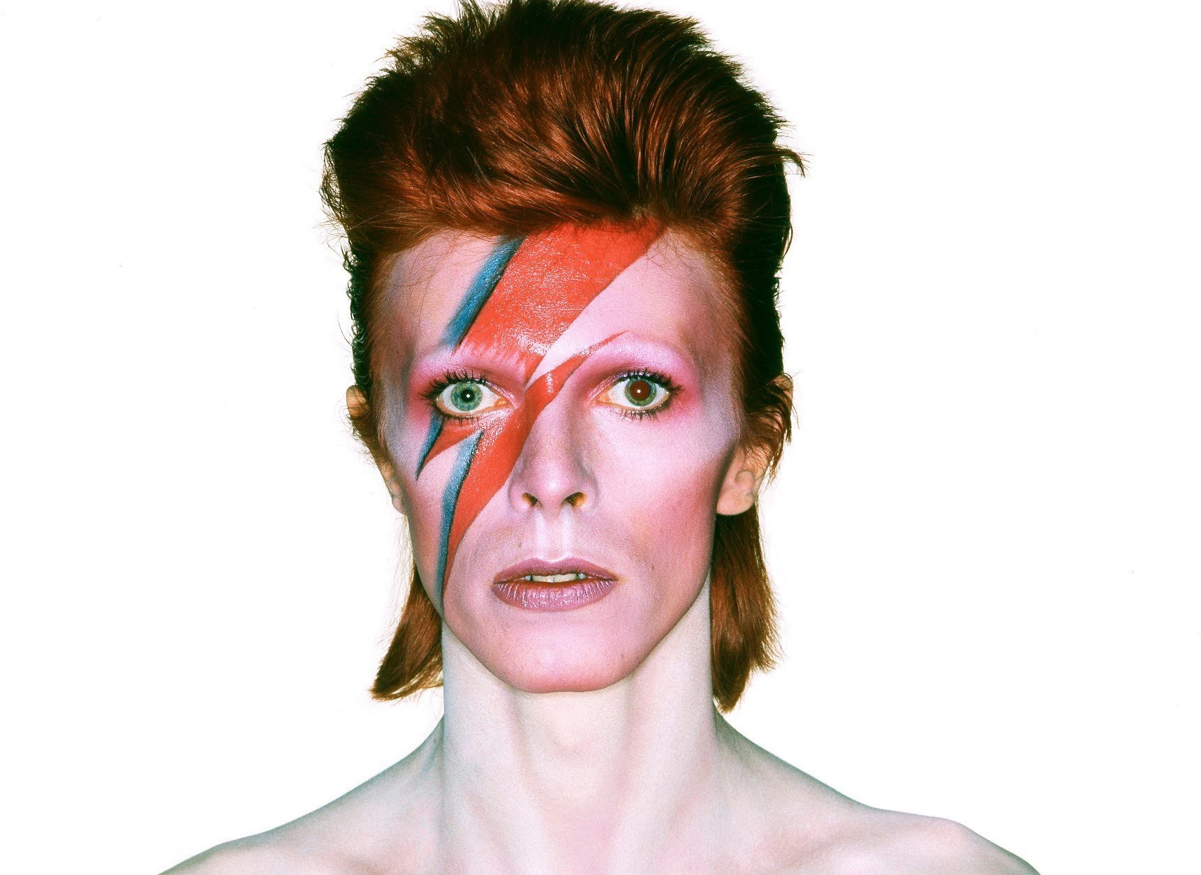
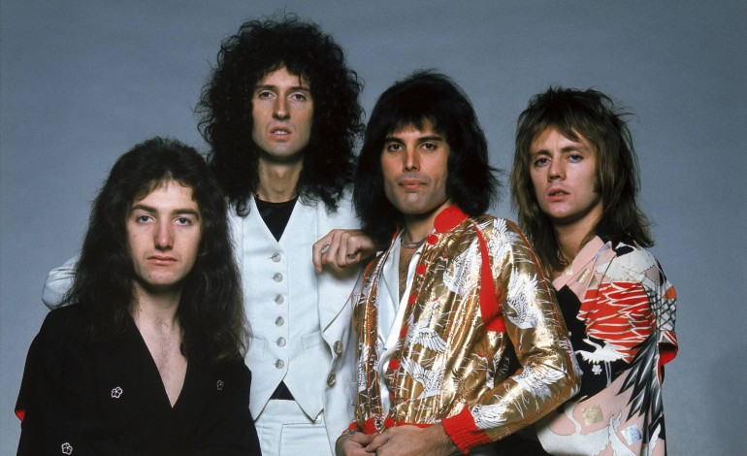
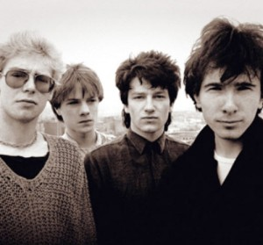
Popular Musicians of the 1980s
U2
David Bowie
Queen

Slide 22
Prince and Michael Jackson - A Comparison
Often regarded as the two greatest musicians of the 1980s, Prince and Michael Jackson and their music are frequently subject of comparison. However, the music each musician produced and the intentions behind each album are actually very different, especially regarding Michael Jackson’s Thriller and Prince’s Purple Rain.
Michael Jackson’s Thriller was created with the goal of making an album that sounded like it solely contained hit singles. Although the sounds in Thriller was indeed inventive, the album is not very thematic and lacks emotional significance.
Prince’s Purple Rain could be viewed as an antithesis of Thriller. It has raw emotional significance, contains a combination of studio and live recordings, and has a thematic emphasis on personal passion, loss, desire, and Prince’s disconnection from the events and cultural contexts occurring in the world around him.

Slide 23
Events that Shaped Music in the 1980s
The Assassination of John Lennon on December 8th, 1980
The assassination was the first incident of America’s dark and chilling obsession with the concept of a celebrity. Additionally, musicians became even more inspired to stand out so as to be remembered forever, whether it was dressing in an avant-garde and controversial way (very common among pop artists) or creating innovative sounds in music.
The launch of MTV in 1981
This was the first television channel that was solely dedicated towards music. This pivotal event caused the pop video to have importance equal to that of the pop single. Musicians increasingly created music videos that would circulate on this channel and hopefully generate media discussion.
The Live Aid concert on July 13th, 1985
The televised concert was watched by millions of people across the country and raised over $125 million towards fighting the famine crisis in Africa. Although it was one of the greatest philanthropic events to ever be organized, many regard it as the moment that pop music became pure “showbiz entertainment.”

Slide 24
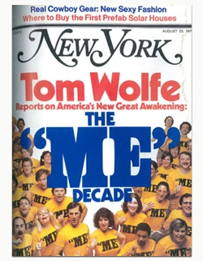
Political/Social Context of the 1980s
The Reagan Years
The recession in the United States ended during President Reagan’s first years. Taxes were reduced and inflation was controlled. Americans now felt confident again in spending and making money.
Americans in general became very concerned with themselves. Americans of the 1980s were regarded as “the ‘me’ generation” with their focuses on spending money and living lavishly.
This caused Americans to become increasingly enamored by lavish musicians. Musicians began to dress more controversially and expensivelly and live extremely expensive lifestyles. This helped musicians stay in the limelight, as “the ‘me’ generation” loved it.

Slide 25
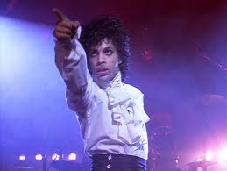
Politics and Prince
Prince was not very voracious when it came to overt political or social stances. As especially depicted in Purple Rain, Prince proposed himself as being disconnected from the political and social contexts of the contemporary world, instead focusing more on music sounds that seem to be from the future. Unlike U2 or The Police, Prince did not present himself as a politically aware artist composing socially relevant music.

Slide 26
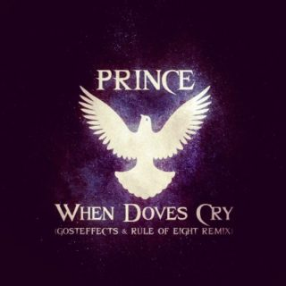
Musical Analysis
Dynamics:
-Pitch, intensity, and volume all vary throughout the song
-Adds some quick high pitched “ooh” and “hee” sounds, similar to Michael Jackson
Melody:
-Disjunct melody, notes and vocal pitch are very jumpy throughout the song
-Harmonized vocals create a chordal effect
Meter:
-4/4 meter
-basic subdivision
-backbeat
“When Doves Cry”
(Originally written for Purple Rain)

Slide 27
Musical Analysis
Instrumentation:
-Mainly keyboard and drums
-Synthesizer
-varies with sound effects on keyboard
-No bass line which was very uncommon for 80’s era music
Texture:
-Homophonic: main vocals and instrumental accompaniment
-Polyphonic Imitative in some brief vocal sections
Tempo:
-Consistently moderate throughout the song
Form:
-Chorus has an ABAB form
-Individual verses have the form ABCB
“When Doves Cry”
(Originally written for Purple Rain)

Slide 28
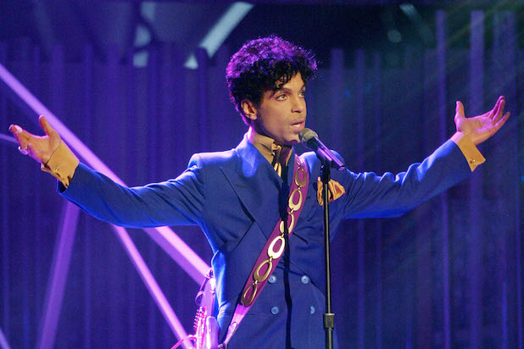
Conclusion
Prince was the epitome of music in the 1980s. His innovative sounds, avant garde performances, and unparalleled versatility led him to be regarded as one of the greatest pop, contemporary R&B, and rock musicians of all time. Not only did he impact countless musicians, he impacted the paths of genres altogether, and his legacy will continue to shape music for decades to come.

Slide 29
References
Biography.com Editors (2016). Prince Biography. Retrieved from http://www.biography.com/people/prince-9447278#career-highlights
Biography.com Editors (2016). Beyonce Knowles Biography. Retrieved from http://www.biography.com/people/beyonce-knowles-39230#synopsis
Biography.com Editors. (2016). James Brown Biography. Retrieved from http://www.biography.com/people/james-brown-9228350
Eightiesclub.com Editors (2016) The Music Scene. Retrieved from http://eightiesclub.tripod.com/id14.htm
Fleming, J. (2009). Prince’s Anxiety of Influence and ‘Purple Rain’ in the Context of ‘80s Pop Music. Retrieved from http://www.popmatters.com/feature/94059-maybe-im-just-like-my-father-princes-anxiety-of-influence-and-purple-/\
Kot, G. (2016). Pop music superstar Prince is dead at 57. Retrieved from: http://www.chicagotribune.com/entertainment/music/ct-prince-studio-death-investigation-20160421-story.html
Manythings.org Editors. (2016). 1970s and ‘80s Were a Period of Change in American Society. Retrieved from http://www.manythings.org/voa/history/224.html
Minsker, E. (2016). Questlove Writes Essay About Prince’s Music and Influence. Retrieved from http://pitchfork.com/news/65056-questlove-writes-essay-about-princes-music-and-influence/
O’Hagan, S (2004). Fifty Years of Pop. Retrieved from https://www.theguardian.com/music/2004/may/02/popandrock
Stuessy, J. & Lipscomb, L. (2013). Rock And Roll: Its History and Stylistic Development 7th Ed. Pearson Publishing.
Thorne, M. (2016). Prince: The Man and His Music. Evanston, IL: Agate Publishing
Williams, B. (2016). 11 Artists Who Perfectly Capture Prince’s Timeless Influence. Retrieved from http://www.huffingtonpost.com/entry/11-artists-capture-prince-influence_us_571934dce4b0d0042da8a574
Williams, T. (2016) Deconstructing Prince, Part 1: His Musical Influences. Retrieved from http://theboombox.com/deconstructing-prince-part-1-his-musical-influences/

Slide 30
Photo Sources
http://streetsonpoint.com/wp-content/uploads/2016/05/stevie-wonder-prince-2191539w948.jpg
https://pbs.twimg.com/media/Cglq7j3WwAAK8XI.jpg
http://assets.rollingstone.com/assets/2016/article/read-questloves-ranking-analysis-of-classic-prince-albums-20160608/243960/medium_rect/1465399728/720x405-questlove-ranks-prince-albums.jpg
http://www.fuse.tv/image/52c19f07cf9234ee7800000d/700/467/inside-photo-of-the-day-prince-janelle-monae-perform-mohegan-sun.jpg
http://www.abc.net.au/news/image/7348552-3x2-940x627.jpg
https://i.guim.co.uk/img/media/0a803a90e28842241d928688e75ec6b37dfb2c1d/0_0_594_356/master/594.jpg?w=620&q=55&auto=format&usm=12&fit=max&s=bdb9b734877e17f4fd4435c127bd0cb2
https://deenasdays.files.wordpress.com/2013/04/big007.jpg
http://images1.laweekly.com/imager/u/original/6470557/david-bowie-aladdin-sane.jpg
http://www.traofficial.ca/wp-content/uploads/2016/04/00_srtw_-_we_were_young_maya_jane_coles_remix_-spdeep166-web-2015-228-320x320.jpg
https://timedotcom.files.wordpress.com/2016/04/prince-death-artist-celebrities.jpeg?quality=75&strip=color&w=1100
http://assets.nydailynews.com/polopoly_fs/1.2610176.1461264534!/img/httpImage/image.jpg_gen/derivatives/article_750/jason22n-6-web.jpg

