Slide 1
Red Hot Chili Peppers
Group 3
Kaitlin Gaedtke
Lauren Lalumiere
Maisey Pierce

Slide 2
Why the Red Hot Chili Peppers?
The Red Hot Chili Peppers are an innovative rock group formed in the early 80s.
They have seemingly always been hugely influential in the style of rock and alternative rock.
Still successful in creating music and performing today.

Slide 3
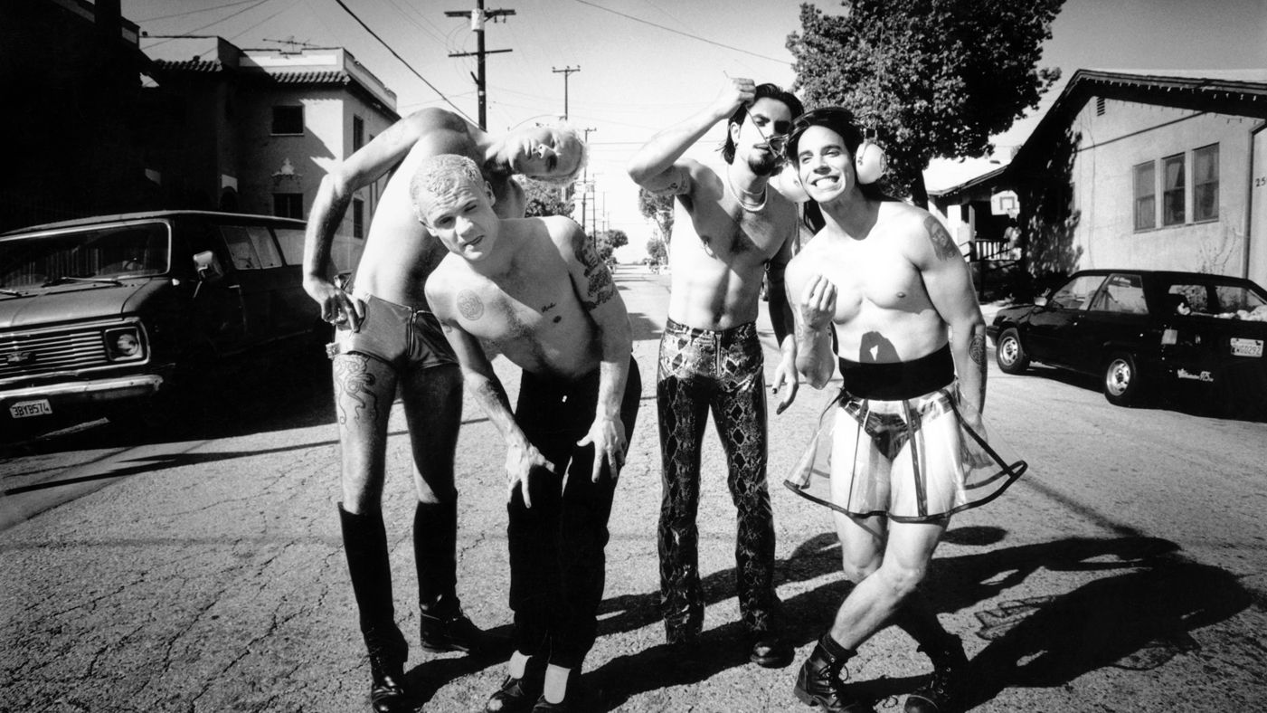
Group Biography
RHCP were formed from a California high school friendship and a mutual appreciation for punk rock and funk.
Started out as “Tony Flow & the Miraculously Majestic Masters of Mayhem,” this is also where their performing nude “trademark” started
They began a recording contract with EMI and gained popularity when their videos were featured on MTV

Slide 4
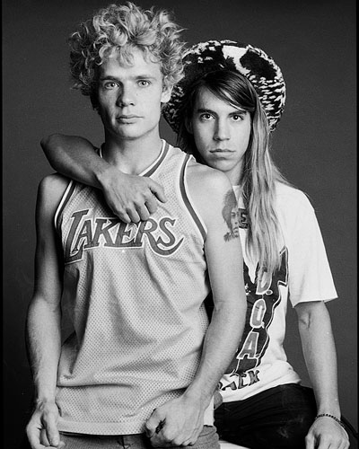
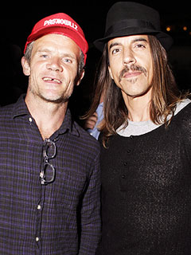
Group Biography (Cont.)
Several members fought drug addiction along the way; one (Slovak) even died from a heroin overdose.
They’ve had many different members but current members Kiedis and Flea are founders
Flea (left in both pictures) and Kiedis (right in both pictures) have been friends since they went to highschool together!

Slide 5
Current Members
Anthony Kiedis: lead vocals (1983-present)
Flea: bass, trumpet, piano, backing vocals (1983-present)
Chad Smith: drums, percussion (1988-present)
Josh Klinghoffer: guitar, keyboards, backing vocals (2009-present)

Slide 6
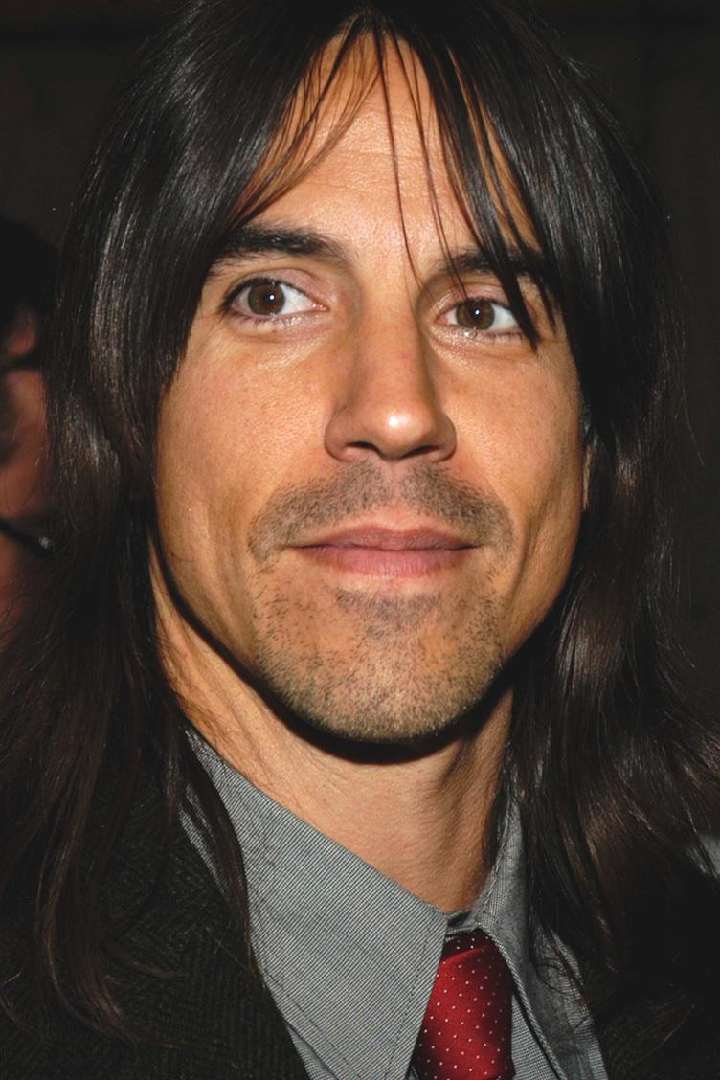
Anthony Kiedis:
went to highschool with Flea in California, where they acknowledged their mutual admiration of punk rock and funk groups by forming a band together.
talent for poetry and was convinced by Flea and Slovak to write music.
Even after his friend Slovak’s death due to an overdose, Kiedis still battled a drug addiction.
In the 2000’s, he attempted to turn his autobiography called “Scar Tissue” into a TV show, which failed.
He has acted as characters and also appeared as a cameo with the boys several times throughout the years.
Flea:
After being taught how to play bass by Slovak in high school, Michael “Flea” Balzary joined up with Slovak and Kiedis to form their first band.
Although he went to school in California, Flea was actually born in Australia.
Contrasting to a majority of kids his age, he had a soft spot for jazz music and therefore learned the trumpet.
In the 2000’s, he began studying musical theory at USC and engaged in a lot of different side projects.
Just like Kiedis, Flea has also done a little bit of acting.

Slide 7
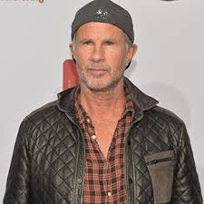
Chad Smith:
started playing drums at the age of 7 when he listened to bands like Led Zeppelin and The Rolling Stones.
He was in many bands as a drummer but said he only felt like a musician after another percussionist talk him how to play R&B and funk.
He wanted to join the RHCP when he heard that they had a record deal.
When he auditioned for RHCP, the band thought he wouldn’t fit in because of his “hair metal” look but, they were blown away by his persistence and they clicked musically, instantly.
Now known as one of the greatest drummers in rock.
Josh Klinghoffer:
Josh dropped out of school at 15 and joined a band two years later.
When the band recorded their first album, he met John Frusciante who was recording a guitar solo at the same time.
They started hanging out and eventually the band opened for RHCP at a show.
Josh ended up replacing John after their 2007 tour after being a touring member of the same tour.
At 32, he was the youngest inductee into the Hall of Fame in 2012.

Slide 8
Musical Style: RHCP compared to music of the periods
The Red Hot Chili Peppers have been around since the early 80s.
They’ve experienced transitions, successes, and everything in between.
RHCP Style: Funk Rock
Funk-Rock is a combination of the two genres funk and rock. This style typically
has a focus on rhythm and uses definitive beats and electric guitars.
Origins: R&B, jazz, and psychedelic, amongst other overlapping genres.
Elements of punk rock and psychedelic rock in the RHCP songs .
The next few slides will compare the RHCP to music of the 80s, 90s, 2000s & today.

Slide 9
RHCP in the 80s:
Early: First performance influenced by punk funk. The band improvised while Kiedis rapped the poem he had written for the event.
The band was asked to come back thanks to their lively performance.
Their first album The Red Hot Chili Peppers, debuted in 1984. Its style was punk rock & it sold 300,000 copies.
1985-1990 they tried combining punk with their funk.
Drug influence/experimentation.
Mother’s Milk, a funk rock/funk alternative album was an international success.
Music of the 80s:
Dance and New wave music became popular.
Rock music continued with its popularity.
Thrash metal and guitar characterized by heavy distortion, pinch harmonics, and whammy bar abuse became very popular.
Smooth jazz and glam metal also became popular.
Increased digital recordings and use of synthesizers gave songs an electric feel.

Slide 10
RHCP in the 90s:
With their new unexpected success came stress. Some members turned, once again, to drugs to cope.
Created rap rock and alternative rock songs.
Their songs had rapid guitar riffs along with some philosophical meaning.
The band went through transitions with band members, leaving them lacking in some parts with style.
Use of heavy metal guitar riffs
Hints of psychedelic rock
Music of the 90s:
Teen pop & dance pop from the 70s had begun to reemerge.
R&B and Urban music (aside from reggae) remained popular.
Urban music would blend styles together, resulting in fusion genres like hip hop-soul and g-funk.
Electronic music continued to increase in popularity.
Rock was very popular and alternative and industrial rock music emerged.

Slide 11
RHCP in the early 2000s
& today:
A reunited band found popularity once again.
Their album Californication sold over 16 million copies (1999). Contained fewer rap-driven songs.
Integrated more textured and melodic guitar riffs, vocals, and bass-lines.
Wanted to create a new creative & unique album.
It was subdued and focused primarily on melodic ballads.
Dani California reached the top of the Modern Rock charts.
Music of the early 2000s & today:
Creation of new styles had slowed.
Songs started getting auto-tuned (pitch corrected).
Bass guitars and bass synthesisers were replaced with loud drums and electronic instruments.
Teen pop continued to be popular in the 2000s.
Alternative rock also continued its popularity.
Today, alternative music, dance music, and hip hop music remain dominant. Rock music is seeing a revival.

Slide 12
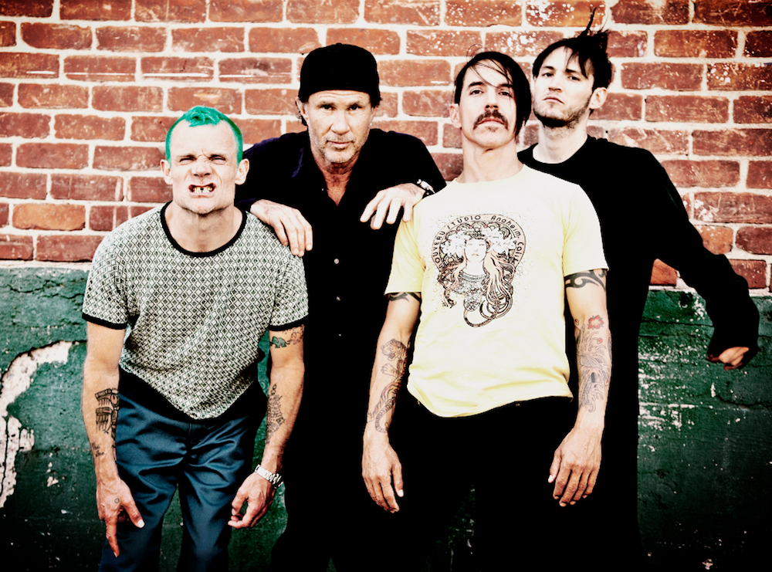
The Sound of RHCP: Typical or Innovative?
RHCP were innovative and created a new musical style for the time period by combining aspects of punk rock and funk.
This type of sound was soon parroted by other bands/groups, but none had as big of an influence on the genre as RHCP. The RHCP remained the kings and founders of this new sound!
By combining two musical styles that already existed and were somewhat typical of the time period, they created a brand new style that hadn’t been introduced yet.

Slide 13
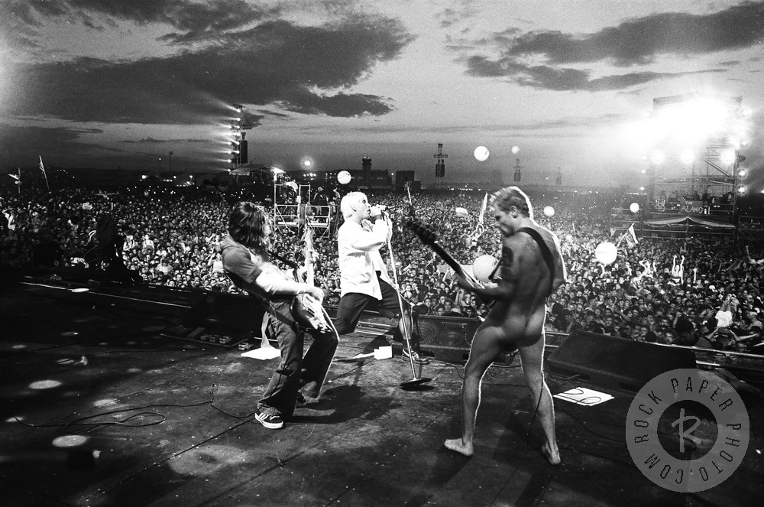
Events Impacting the RHCP’s Musical Development
Social events
RHCP played the Woodstock ‘99 festival which took a drastic turn from previous Woodstock festivals. This festival was a riot: flames, injuries, and violence. Following this festival, RHCP had security issues for a little while on tour overseas.
As stated in the biography, at this point band members began to work on their own side projects.
They also played the 2014 Super Bowl; however, the instrumental was pre-recorded for sound quality purposes (not RHCP’s choice). This caused controversy with some fans who thought they were “pretending” or completely faked the performance.

Slide 14
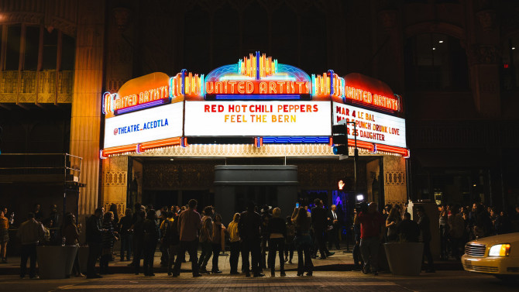
Events Impacting the RHCP’s Musical Development (Cont.)
Political
Josh Klinghoffer was inducted as the youngest Rock and Roll Hall of Famer ever!
This was controversial because he was only with the band for 1 album before he was inducted.
Bernie Sanders Campaign Show
Risky because RHCP could potentially lose fans, but lots of people showed up and Bernie’s messages were delivered and highly accepted by the crowd.
RHCP “Feel the Bern” Campaign Show

Slide 15
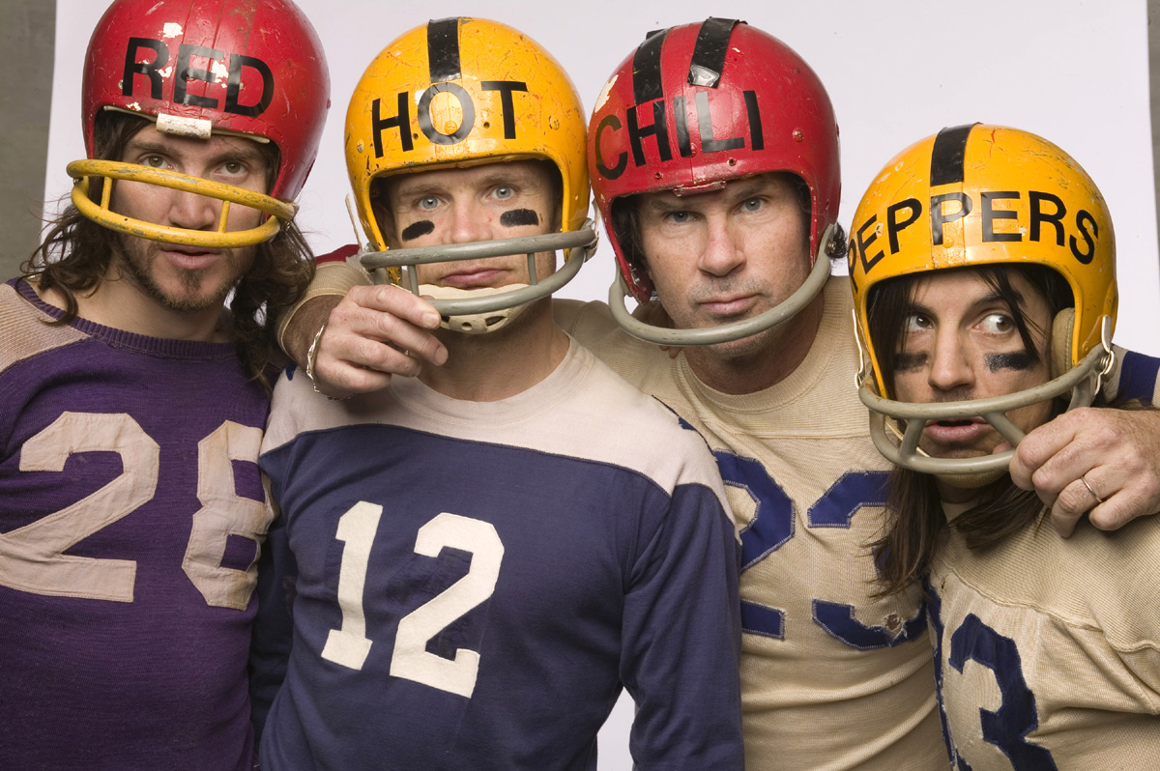
RHCP & the Evolution of Rock & Roll
As mentioned previously, the Red Hot Chili Peppers’ style is a combination of punk rock and funk.
By creating yet another new sub-genre of rock, they are able to appeal to an entirely new audience
They made punk softer
Used 80’s chord progressions along with a prominent bass-line
Still had the rock aspect by incorporating electric guitar solos too

Slide 16
Innovative & Unique Elements of RHCP
Musical Style:
Reflected the “Southern Californian milieu”
Witty, forceful style
Their album, One Hot Minute, was sadder, darker, and had a moodier vibe during a period with drug addictions and death.
Their comeback album, Californication, was all about the melodies, songs and was more philosophical.
Performance Style:
Energizing physicality
Were known for performing nude in encores (except for strategically placed socks)
Lots of improvisation during live shows

Slide 17
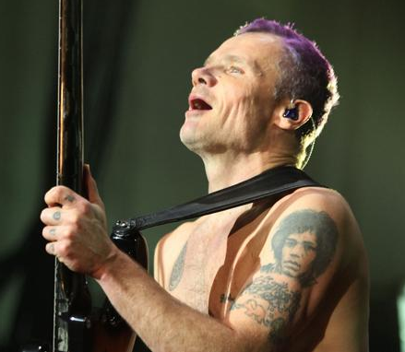
Musical Influences: Influential Predecessors
Jimi Hendrix: Considered to be one of the greatest guitarist in the history of rock music. He wrote and played music in a few genres including: R&B, hard rock, and psychedelic rock. A huge influence and inspiration to the RHCP guitar players. Flea even has Hendrix’s face tattooed on his arm.
Flea and his Jimi Hendrix tattoo

Slide 18
Influential Predecessors (Cont.)
Iggy Pop: The eccentric vocalist of the band The Stooges. He wrote and played songs of a variety of styles including punk rock, hard rock, jazz, blues. His wild and unpredictable stage performances, along with his style of music, infused the RHCP with an edgy, punk rock spirit.
Parliament: This band played songs mainly of the funk genre, but also psychedelic soul and funk rock. Parliament, along with its sister act “Funkadelic,” gave the RHCP the idea to combine rock riffs with elastic funk rhythms.

Slide 19
Musicians Influenced by RHCP
Sublime: A ska-punk band active from 1988-1996. Ska is an upbeat style of music made for dancing. It comes from Jamaica and is influenced by the caribbean folk style and american jazz. The RHCP is referenced as one of the Southern California punk scene music influences for Sublime’s style.
Korn: This genre’s that this band has been described of as include alternative metal, funk metal, and groove metal. Similar to the RHCP, their lyrics are often about pain and social isolation.

Slide 20
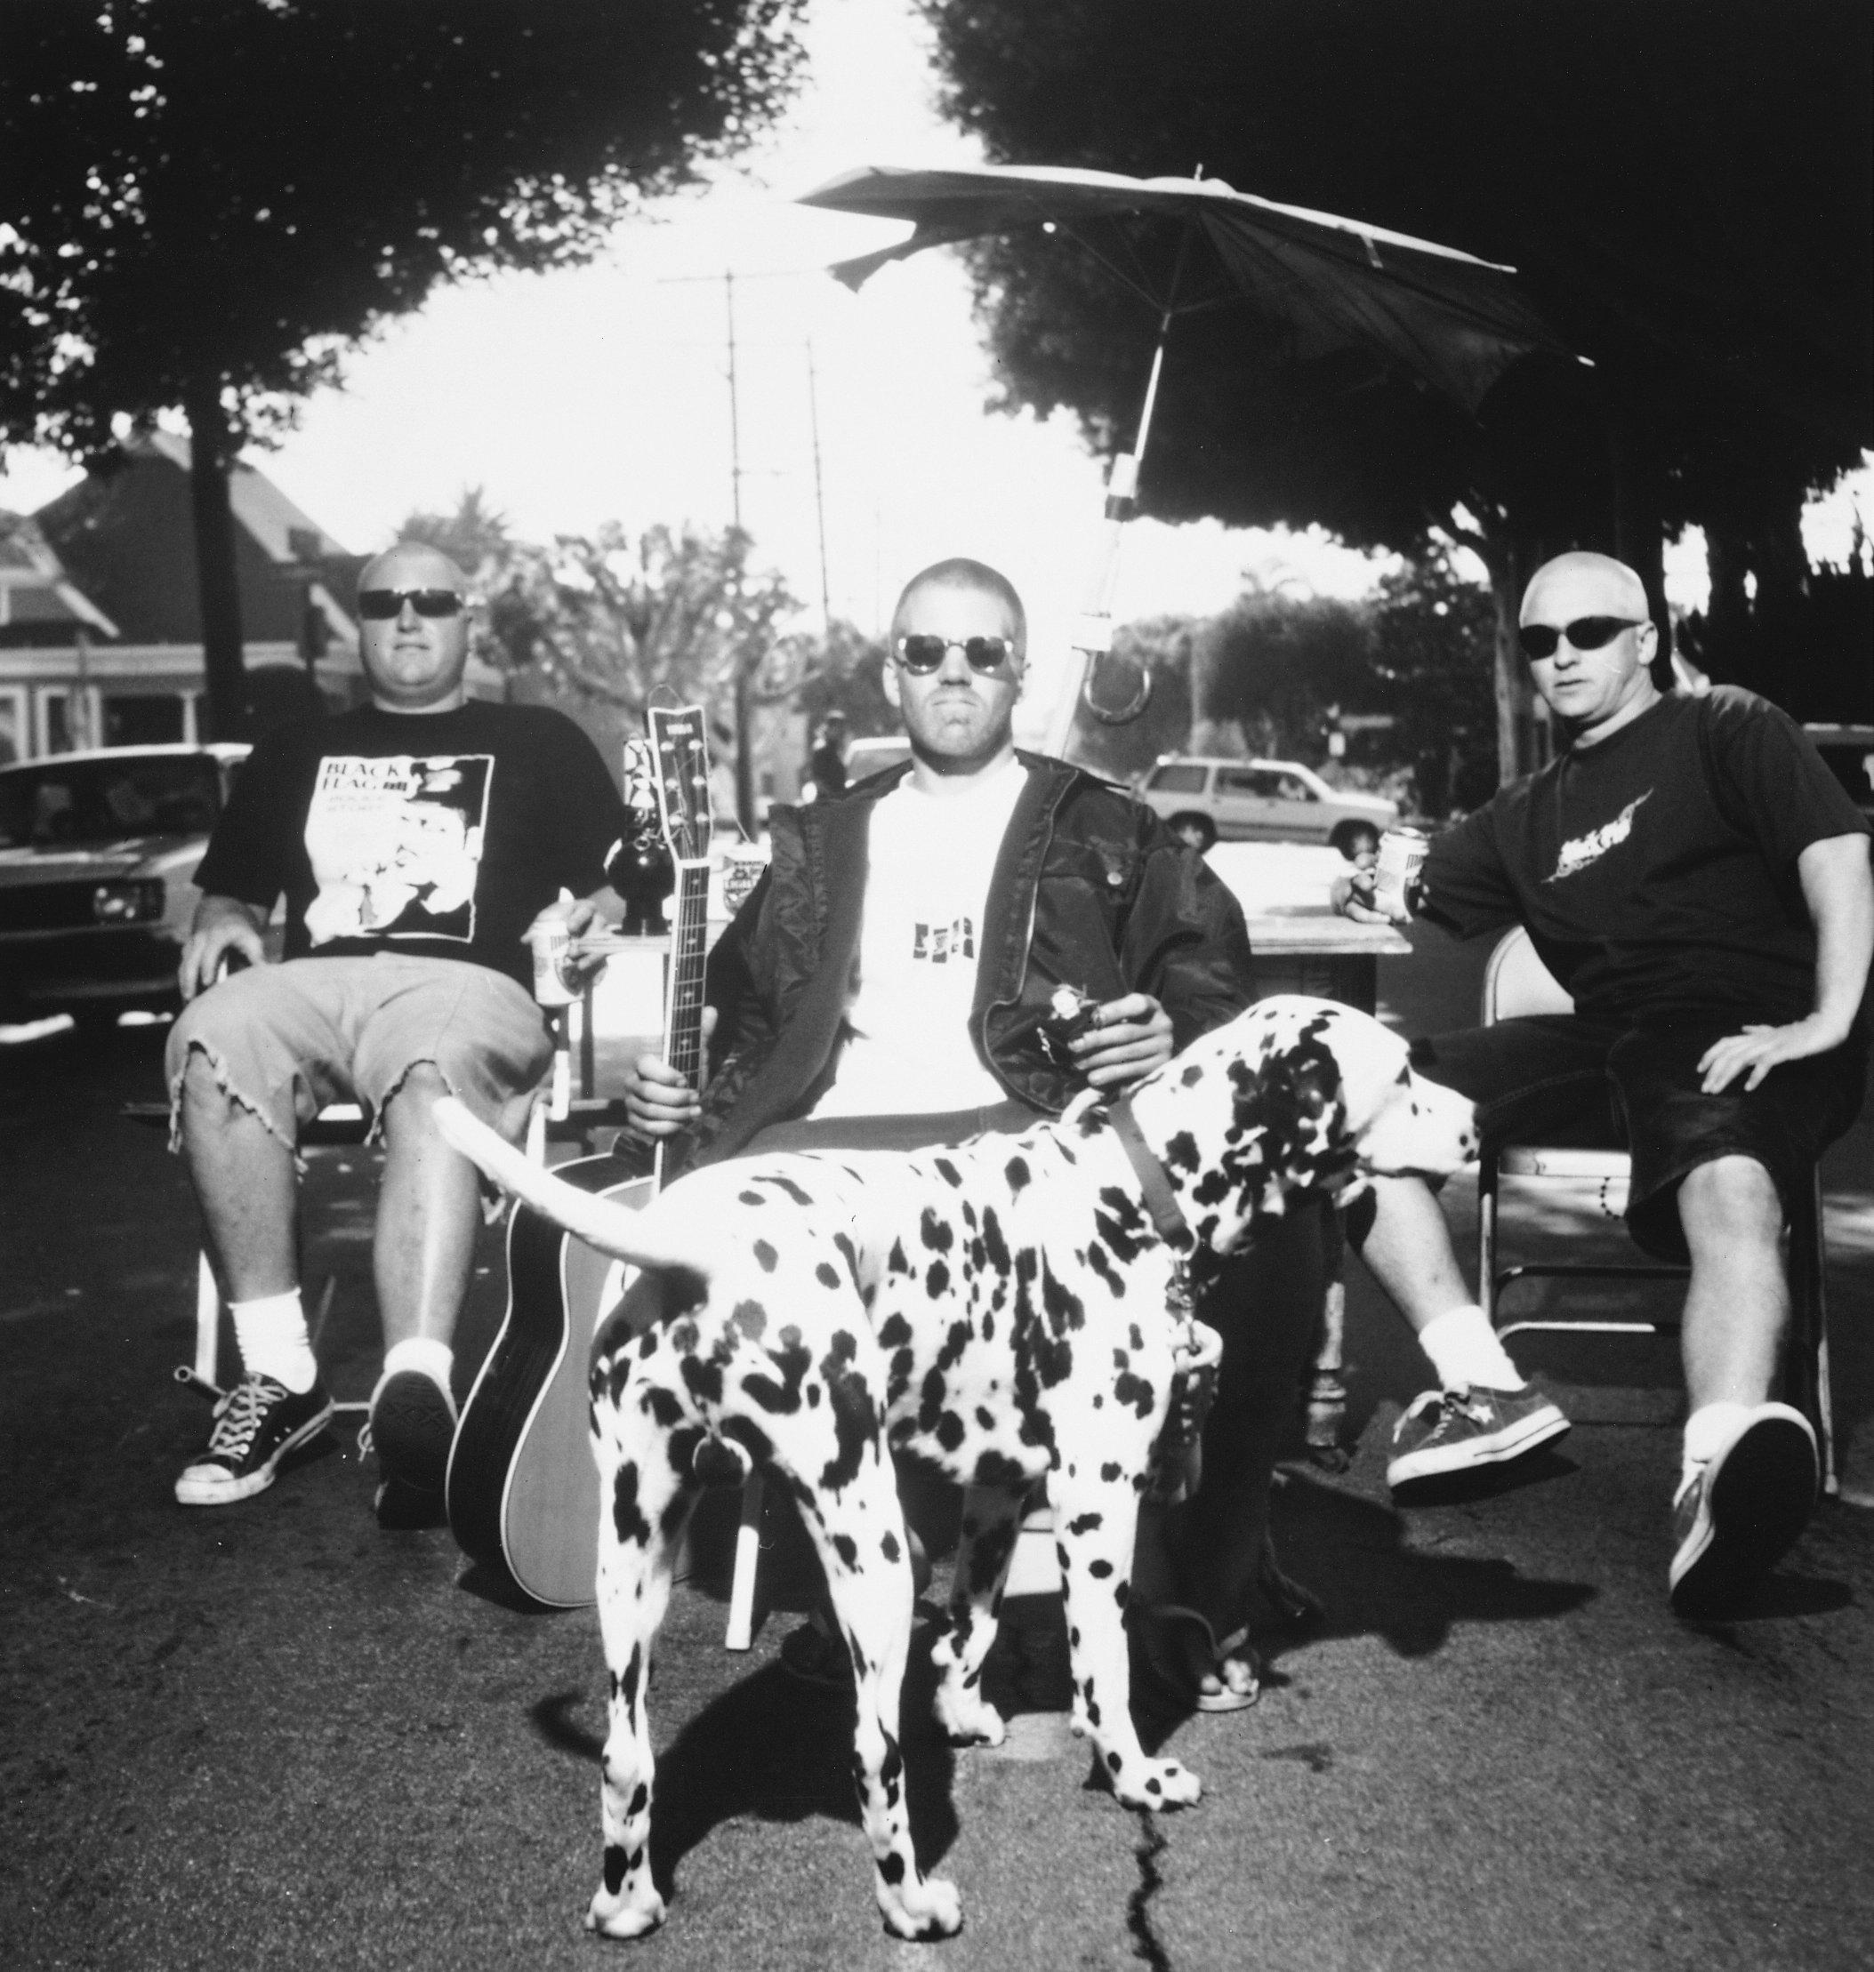
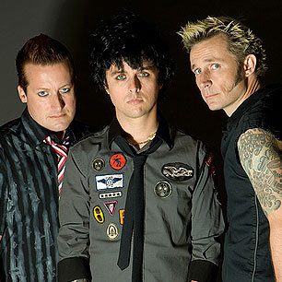
Musicians Influenced by RHCP (cont.)
Rage Against the Machine: An American rock band from Southern California. Like the RHCP, Rage Against the Machine is known for is revolutionary political views. They are also into activism, influenced partially by the RHCP.
Green Day: A punk-rock band formed in 1989. Described by Stephen Erlewine, an American Music Critic, as "punk revivalists who recharged the energy of speedy, catchy three-chord punk-pop songs.” The RHCP were an influence in alternative and punk styles of songwriting and performing.

Slide 21
Musical Analysis of the song Californication
Instrumentation: The song begins with the electric guitar setting the melody for the rest of the song. It also gets an instrumental solo before the last set of verses. The drums then join in to set the beat. A bass adds another melody line. There is one main vocal line with backup vocals mostly used in the bridges and chorus’ as “oos”. The main vocal timbre is clear and slides a lot.
Meter: This song is in duple meter or 4/4 time.
Beat subdivision: The subdivision is duple subdivision.
Texture:This song’s texture is mainly homophonic (melody and accompaniment). At one point, the guitar solo is the melody rather than the main vocalist. It isn’t until around 02:50 and again around 04:30 when supportive secondary vocal harmonies are added, creating polyphonic imitative texture.
Form: The musical form is a version of verse-and-chorus or more specifically “AABCAABCABC”. For each verse, every even line rhymes with “...ation” (“abcbdb”) while the chorus is “aabb”.

Slide 22
Awards
The success of the red hot chili peppers
Achievements
3 American Music Awards
2 California Music Awards
6 Grammy Awards
10 MTV Music Video Awards
Additionally, the RHCP have won numerous international music awards.
Inducted into the Rock & Roll Hall of Fame in 2012.
Star on the Hollywood Walk of Fame in 2008
Hold records for:
Most number singles (12)
Most cumulative weeks at #1 (85)
Most top ten songs (24)

Slide 23
RHCP and Their Advocacy for Change
Political Activism: The band works with the nonprofit Rock the Vote, an organization aimed at increasing voter turnout among 18-24 year olds. Flea also appeared in a Vote for Change ad showing his support for Obama. The band held a fundraiser for Bernie Sanders this year.
Social Activism: The RHCP have raised money for Hurricane Katrina victims, amongst other causes.
Environmental Activism: The band has performed at venues held to raise awareness for global warming and also raise awareness of ocean pollution.

Slide 24
Conclusion
RHCP were able to evolve with the times
They were a rock band with an emphasis on funk and each member incorporated their own twist
Kiedis added many rap verses
Flea combined punk and hard rock
Smith blended funk, rock, metal, and jazz
Klinghoffer used unconventional guitar effects with a jazzy feel
Went through the highest highs and the lowest lows and their albums reflected what was happening in their lives
One of the best selling bands of all time

Slide 25
References
Cross, A. (June 26, 2012). The Red Hot Chili Peppers: the secret history. Harper Collins.
Ford, D. (February 5, 2014). Red Hot Chili Peppers on Super Bowl Performance: Yep, we faked it. CNN: Entertainment. Retrieved June 25, 2016, from http://www.cnn.com/2014/02/04/showbiz/super-bowl-red-hot-chili-peppers/
Future Rock Legends: Blog. (February 11, 2012). Josh Klinghoffer is the Youngest Rock and Roll Hall of Famer Ever. Retrieved June 26, 2016, from http://www.futurerocklegends.com/blog_files/Josh_Klinghoffer_Youngest_Rock_Hall.html
Kiedis, A., Sloman, L. (2004). Scar Tissue. Hatchette Books.
Mullen, B., Kiedis, A., Frusciante, J., F., & Smith, C. (2010).The Red Hot Chili Peppers: An oral/visual history. New York: It Books
Parker, O. (n.d.). Red Hot Chili Peppers: A timeline. Retrieved June 5, 2016, from http://www.telegraph.co.uk/culture/music/8561725/Red-Hot-Chili-Peppers-a-timeline.html
Prato, G. (n.d.). Red Hot Chili Peppers: Biography and History. All Music. Retrieved June 24, 2016, from http://www.allmusic.com/artist/red-hot-chili-peppers-mn0000883318/biography

Slide 26
References (continued)
Prato, G. (n.d.). Flea: Biography and History. All Music. Retrieved June 24, 2016, from http://www.allmusic.com/artist/flea-mn0000182155/biography
Schwartz, G. (February 10, 2016). The Red Hot Chili Peppers Stoke the Fire for Bernie Sanders’ Political Revolution. PopMatters. Retrieved on June 26, 2016, from http://www.popmatters.com/review/the-red-hot-chili-peppers-stoke-the-fire-for-bernie-sanders-political-revol/#
The Rock and Roll Hall of Fame Museum. (n.d.). Retrieved June 23, 2016, from https://rockhall.com/inductees/red-hot-chili-peppers/bio/
Vaziri, A. (n.d.). Influences & Inspirations: Red Hot Chili Peppers. Retrieved June 25, 2016, from http://www.gibson.com/news-lifestyle/features/en-us/influencesinspirationsred.aspx

