Slide 1
Jimi Hendrix
By: Group 4
Angela Kenney, Yu Vang,
Austin Stack and Katie Duhr

Slide 2
Why Jimi Hendrix?
One of the best guitar players in the history of Rock and Roll
Without him guitar would not have been able to move into creating later genres such as metal, grunge, and punk
Was a part of historical time period in the history of Rock and Roll
The 1960’s leading into the 1970’s is a controversial and very important time period to America’s history
He died too soon; it would have been amazing to see him perform throughout the 1970’s
His opinion on later music in rock and roll would have been great to hear as well

Slide 3
Artist Biography
Born November 27, 1942
As Johnny Allen Hendrix
In Seattle, Washington
He taught himself to play guitar as a teenager
Had a difficult childhood: sometimes was living in the care of relatives and acquaintances.
He dropped out of high school
Grew up to be a Rock guitar legend
He was a guitarist, singer, and songwriter
He enlisted in the U.S. Army in 1961
He still made time for music creating a band named the King Casuals
He was discharged in 1962 due to an injury

Slide 4
Artist Biography (cont.)
He began his musical career playing backup guitar for various black artists
Such as: Little Richard, Ike and Tina Turner, Wilson Pickett and the Isley Brothers
He went to NY in 1964 and formed his own band in 1965
The band was named Jimmy James and the Blue Flames
He went to England in 1966
There he recruited British musicians to form a rock trio called the Jimi Hendrix Experience
The Jimi Hendrix experience was an immediate success
Several major hits were on the British charts
“Hey Joe,””Purple Haze,” and “The Wind Cries Mary”

Slide 5
Artist Biography (cont.)
In his early days, he played a lot of blues, some soul songs, and a few originals
Group members of the Jimi Hendrix Experience played the part
Frizzed their hair, wore psychedelically appropriate costumes and geared up to invade America
The band first appeared in America in 1967
At the Monterey Pop Festival of June 1967
Jimi played his guitar with his teeth and behind his back, he caressed his guitar and attacked it in a sexually aggressive way and lit his guitar on fire
He got America’s attention

Slide 6
Artist biography (cont.)
Their first album Are You Experienced?
Had risen to number 5 on the charts
Hard, raw, blues-based mainstream rock
Unlike almost anything else at the time
The guitar sounds were extremely unique
He was an accomplished songwriter and musical experimenter
He died on September 18, 1970 at age 27
From drug related complications
He left his mark on the world of rock music
He remains popular to this day

Slide 7
Musical style
Musical style is defined as:
unique and/or innovative elements of the artist’s musical/performance style; how the artist and their musical style fits into the evolution of rock music
One of the first musicians to use feedback as a desired noise/effect during recording
He used many types of electric guitar effect:
Most notably the wah-wah pedal, fuzz box, Uni-Vibe, toggle switch on a guitar, a tremolo bar

Slide 8
Musical Style (Cont.)
Many groups in acid rock were using some of these effects but Hendrix played and used these effects with much more control and intent
Jimi Hendrix played the guitar left handed but he used a right handed guitar that was flipped over and restrung
This gave the guitar a unique sound to it
Very revolutionary and unheard of at those times

Slide 9
Musical Style (cont.)
Hendrix was not known for his vocals:
He did not have much singing experience prior to his musical career but he felt that if Bob Dylan was allowed to sing, so was he
Performances were played with loud systems.
Hendrix and his bands were known to overload the sound systems
Hendrix was a very theatrical man on stage.
He played guitar with his teeth, behind his back, between his legs, the possibilities were endless

Slide 10
Musical style (cont.)
During Woodstock, Hendrix, at the end of his set took his guitar, covered it in lighter fluid and lit it on fire, burning it onstage for the whole crowd.
He revolutionized rock music with the fact that many of the guitar abilities he possessed are still trying to be mastered today
Hendrix was an innovator of his time, he was experimenting with sounds and ideas that are still coming into play today

Slide 11
Musical Style (cont.)
He was adorn in very costume like outfits.
When touring in Britain he bought military coats and was near told on numerous occasions it was illegal for him to wear them out of disrespect of the men who fought in them. Hendrix did not listen to this
He wore flat bill western-styled hats with purple ribbons/scarves and brooches on them
Bright and color clothing was very common for Hendrix, typically something with a lot of gypsy fashion, necklaces, scarves, hand and wrist jewelry
Without Hendrix, the electric guitar would not have made the advancements that it has gone through and the sounds and abilities of it would be decades behind

Slide 12
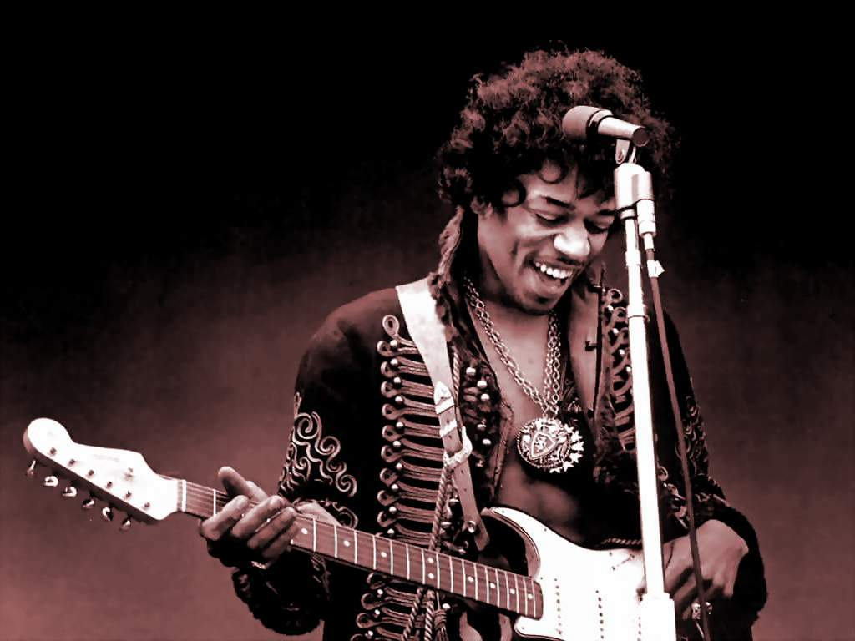
Musical Influences
1966- he became a former member of a rock group called “Animals”
Jazz, Rock “n” Roll, Folk, Surf, Soul, and R&B all became a part of his musical vocabulary
His influences was from Robert Johnson, B.B King, T-Bone Walker, Les Paul, Bo Diddley, John Lee Hocker, and Chuck Berry

Slide 13
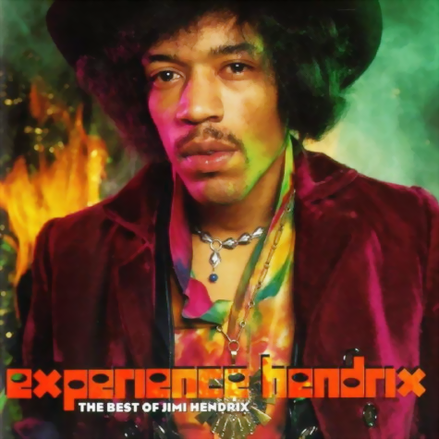
Who were influenceD
Beatles, Rolling Stones, the Who, and Eric Clapton were great admirers of Hendrix.

Slide 14
Other music of the period
Comes from an era where many artists became large influences on future music.
Other famous influences from Hendrix’s era include The Beatles and Bob Dylan;
all three of these musicians come from a different genre of rock and roll music of the time.
His lighting of his guitar on fire has added to his legend

Slide 15
Other music of the period
His family now has legal control over Hendrix’s music that was not released while he was still alive and continue to release the music “as the guitarist originally intended” (“Jimi Hendrix,” 2010)
Jimi Hendrix took influence from past guitarist who had originally experimented with guitar elements such as “distortion, feedback, volume…” (Saxton, 2004). These other guitarists included, but is not limited to:
Jimmy Page
Lou Reed
Jeff Beck
Mike Bloomfield

Slide 16
Other music of the period
Hendrix made sure that he was doing a lot of listening to other music in the “early part of his career” (Lawrence, 2005 29) in order to become a good musician in the future
He listened to a lot f blues in the clubs and on radio stations in the early 1960’s (Lawrence, 2005 29). This was also done in the south like “Kentucky and Nashville” (Lawrence, 2005 29) compared to what he had heard in his home town of Seattle

Slide 17
Other music of the period
To become a better musician overall, he played guitar for bigger musicians such as “Jackie Wilson, Sam Cooke, King George, and Wilson ‘Wicked’ Picket” (Lawrence, 2005 29)
Playing music with other established musicians helps to develop your own sound

Slide 18
Musical analysis of “All over the watchtower”

Slide 19
“All over the watchtower”
Opening drums and guitars: Instrumental introduction
The beat starts, intensifies, and then stops
The music parallels the dramatic structure of the song
Repeated, gradually progressing accents up the scale with blistering notes
The music ends with no resolution, but clearly pointing forward to some anticipated future act of liberation

Slide 20
“All over the Watchtower”
The vocals of this song are low, and even have a blues inspiration to them
The end of most of the lyric lines have a slight scream to them that was a trend of not only blues, but at that point in history rock and roll
The guitar also has a blues, twang feel; more than I was expecting
The guitar solo in the middle of the song, to keep with the blues theme, could have been a replacement for an instrument like a saxophone
The tempo seems to be a little slower than a moderate tempo

Slide 21
“All over the watchtower”
At the end of the guitar solo there is a use of distortion
The distortion has a “trippy” feel to it, a popular word for the time period that the song was released in
The song at the end fades out rather quickly rather than gradually like a lot of songs do when they fade out at the end

Slide 22
Musical analysis of “The wind cries mary”

Slide 23
“the wind cries mary”
Psychedelic blues rock
Slow, sad, and ballad like
Even though it is slow, the vocals keep an upbeat sound to the song especially during the chorus
Common misconception is that it is about Marijuana
“Mary Jane” is a common slang for marijuana
Actually about an argument he had with his girlfriend

Slide 24
“the wind cries mary”
Typical blues opening with the guitar and two snare hits
Hints at the mysteriousness of the song
Quickly changes into Hendrix’s style with his low singing and guitar accompaniment
Hendrix’s vocals have a lot of air in them, so to speak, and are even laid over one another at different points for added air
Ends with a short drum hit

Slide 25
“The wind cries mary”
The musical texture is homophonic, melody and accompaniment.
This can be heard with Hendrix's singing being the melody of the song while the guitar and bass are supporting the melody and following the rhythm that the drums are providing.
The lyrics are about an argument that occurred between Hendrix and his girlfriend at the time
She stormed out of the kitchen after Hendrix made a comment about her cooking.
Blues ballad tempo with the guitar riffs and licks of acid rock.

Slide 26
Conclusion
Without Hendrix, the electric guitar would not have made the advancements it has and the sounds and abilities of it would be decades behind
The innovator of the use of the electric guitar

Slide 27
References
Hendrix, n. o., & Hendrix, o. J. (n.d.). Jimi Hendrix Biography - Biography.com.Biography.com. Retrieved June 7, 2011, from http://www.biography.com/articles/Jimi-Hendrix-9334756
Jimi Hendrix Biography | The Official Jimi Hendrix Site. (n.d.). Jimi Hendrix | The Official Jimi Hendrix Site. Retrieved June 7, 2011, from http://www.jimihendrix.com/us/jimi
POWERS, A. (n.d.). CRITIC'S NOTEBOOK; A Haze As Ever Purple - New York Times. The New York Times - Breaking News, World News & Multimedia. Retrieved June 7, 2011, from http://www.nytimes.com/2000/10/13/movies/critic-s-notebook-a-haze-as-ever-purple.html
Stuessy, J., & Lipscomb, S. D. (2009). Rock and roll: its history and stylistic development (6th ed.). Upper Saddle River, NJ: Pearson Prentice Hall.
Lawrence, S. (2005). Jimi hendrix. New York, New York: HarperCollins.

Slide 28
References (cont.)
WATROUS, P. (n.d.). Pop/Jazz; Conjuring Up The Founder, Jimi Hendrix - New York Times. The New York Times - Breaking News, World News & Multimedia. Retrieved June 7, 2011, from http://www.nytimes.com/1989/12/01/arts/pop-jazz-conjuring-up-the-founder-jimi-hendrix.html
Jimi hendrix. (2010). Retrieved from http://rockhall.com/exhibits/featured-collections/jimi-hendrix/
Saxton, H. (2004, January 03). Jimi hendrix: the most influential guitarist of all time?. Retrieved from http://blogcritics.org/music/article/jimi-hendrix-the-most-influential-guitarist/page-2/
Jimi Hendrix. (2011). Biography.com. Retrieved 11:57, Jun 8 2011 from http://www.biography.com/articles/Jimi-Hendrix-9334756

